Slide 1





Medicare Overview & Hot Topics in Medicare
Erin M. Campbell
Staff Attorney
Pro Seniors, Inc.
September 20, 2024

Slide 2
Pro Seniors’ Mission
Our mission is to enhance the independence and quality of life for older adults by empowering them, by protecting their interests and by facilitating their access to resources

Slide 3

Pro Seniors’ Services
Ohio’s Senior Legal Helpline:
Staffed by experienced attorneys
Pre-set 30 minute appointments
By telephone
Free legal advice and counsel
Call 1.800.488.6070 or 513.345.4160.
Pension Questions?:
Pension attorneys to help with pension issues.
Call 1-866-783-5021

Slide 4

Pro Seniors’ Services
Ohio Senior Medicare Patrol (SMP)
Our volunteers stop Medicare fraud & scams by educating others to recognize the tell-tale signs. If your Medicare number has been compromised, or you suspect you have been scammed, we may be able to help!
Give us a call at 1-800-293-4767.
www.proseniors.org/Ohio-SMP/

Slide 5
Pro Seniors’ Veterans Services
Veterans age 60 and older are eligible for Pro Seniors services
Pro Seniors emphasizes services to veterans
We successfully advocated with the Ohio Department of Veterans Services to change a policy which discriminated against disabled veterans
We participate in a local Veteran Legal Clinic

Slide 6


Long-Term Care Ombudsman Program Butler, Clermont, Clinton, Hamilton and Warren counties in Southwest Ohio
Pro Seniors’ Services
Educate and empower residents and families about residents’ rights
Empower residents to speak up for excellence in their care
Advocate for residents, for quality of care, quality of life issues
Provide unbiased assistance to select a long-term care community
Locate Your Local LTC Ombudsman by Calling 1-800-282-1206
Notes:
Every State, per federal law, has an Ombudsman Program. In Ohio the Ombudsman program is part of the Ohio Department of Aging. The Ombudsman program for the 5 counties of Southwest Ohio is housed in the Pro Seniors agency. What does an Ombudsman do? Educate, empower, advocate. Hamilton, Butler, Warren, Clermont and Clinton Counties.

Slide 7

www.ProSeniors.org Resources Medicare-Medicaid Eligibility
Notes:
For financial eligibility factors, there are a lot of numbers involved, Pro Seniors’ website keeps track of those numbers.

Slide 8
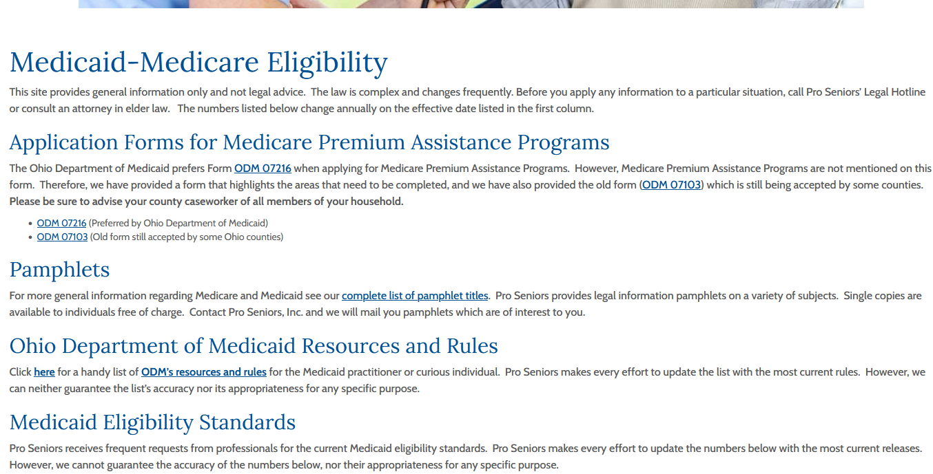
www.proseniors.org
Fact Sheets

Slide 9
Roadmap for Presentation
Basics and History of Medicare
Medicare Eligibility & Enrollment
Overview of Medicare Part A & Medicare Part B
Part C Medicare Advantage Plans
Prior Authorizations
Hospitals, Hospice, Skilled Nursing Facilities, & Home Health
Appeals
Observation Status in Hospitals
Medicare Part D & program update
Out-of-network Coverage: Medicare vs Group Health Plans (No Surprises)
** this presentation is information only, no legal advice intended**

Slide 10
Medicare
Medicare: Federal health insurance program administered by the U.S. Department of Health and Human Services’ (HHS) Center for Medicare and Medicaid Services (CMS).
Medicare eligibility is linked to eligibility for Social Security Title II benefits, but elderly individuals not eligible for Social Security benefits may enroll in Medicare by paying a substantial additional monthly premium.
Notes:
The Social Security Act of 1965 was signed into law on July 30, 1965, by President Lyndon B. Johnson as amendments to existing Social Security legislation. This legislation included the establishing of the Medicare program. At the bill-signing ceremony, Johnson enrolled former President Harry S. Truman as the first Medicare beneficiary and presented him with the first Medicare card, and Truman's wife Bess, the second. Truman had championed Medicare legislation during his tenure in honor of FDR, who had been forced to remove a health benefit plan from the Social Security Act of 1935. it had also been part of TR’s Bull Moose Platform.
President Johnson predicted that Medicare would be a vital protection for elderly Americans from the “hopeless despair” of not being able to afford health care.
SS title II is retirement benefits.
Medicare like Medicaid is public insurance. Vs private insurance.

Slide 11
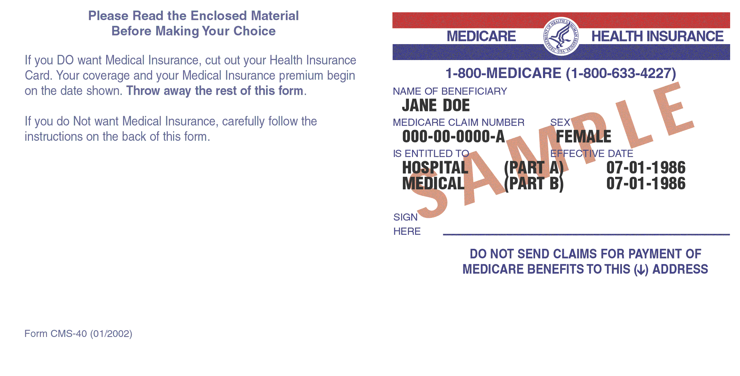
Medicare
Medicare health insurance is for:
People age 65 or older (July 30, 1965),
People younger than 65 and receiving Social Security Disability for 2 years (1972),
Any age for kidney failure requiring dialysis for more than 90 days or a kidney transplant (1972).

Slide 12
Medicare Programs
Part A Hospital Insurance - Hospitals, skilled nursing facility care, home health care, hospice (1966).
Part B Supplementary Medical Insurance - physician services, DME, outpatient hospital procedures and treatments, and medical supplies (1966).
Part C - Medicare Advantage – Replaces A & B; often includes a Part D plan (1997)
Part D - Prescription Drug Benefit (2003)
Notes:
Part A Home Health has a 100 visit limit. No co-pay. 3 day hospitalization required.
Original Medicare began service on July 1, 1966.
1972: President Richard M. Nixon extends Medicare eligibility to individuals under age 65 who have long-term disabilities or end-stage renal disease.
1997: Private insurance plans — originally called Medicare+Choice or Part C, later renamed Medicare Advantage — begin, giving beneficiaries the option of choosing an HMO-style Medicare plan instead of the traditional fee-for-service Medicare program.
2003: On Dec. 8, President George W. Bush greatly expands Medicare by signing the Medicare Modernization Act, which establishes a prescription drug benefit. This optional coverage, for which beneficiaries pay an additional premium, is called Medicare Part D.
2006: On Jan. 1, Medicare Part D goes into effect and enrolled beneficiaries begin receiving subsidized prescription drug coverage.
If you join a Medicare Advantage Plan, the plan will provide all of your Part A (Hospital Insurance) and Part B (Medical Insurance) coverage. Medicare Advantage Plans may offer extra coverage, such as vision, hearing, dental, and/or health and wellness programs. Most include Medicare prescription drug coverage (Part D).
Medicare pays a fixed amount for your care every month to the companies offering Medicare Advantage Plans. These companies must follow rules set by Medicare. However, each Medicare Advantage Plan can charge different out-of-pocket costs and have different rules for how you get services (like whether you need a referral to see a specialist or if you have to go to only doctors, facilities, or suppliers that belong to the plan for non‑emergency or non-urgent care). These rules can change each year.

Slide 13
Medicare Part A Eligibility
Aged Based Eligibility:
65 or older; and
they or their spouse worked at least 10 years in a Medicare-covered employment (paid FICA taxes)
Disability Based Eligibility:
meet Social Security’s definition of disability;
medical condition is expected to last 12 months; and
received disability benefits for 24 months (waived if you have ALS)
End Stage Renal Disease, if your or your spouse:
worked 10 years in a Medicare-covered employment (paid FICA taxes) or
receive benefits from Social Security or Railroad Retirement Board
Notes:
Note must have received SSD for 24 months. There is a 5-month period from onset of disability that SS pays nothing. So usually is 30 months from disability onset.
Those who buy into Part A pay a reduced premium if they work for 7.5 years (30 quarters). Full premium is $505 a month in 2024 and reduced premium is $278 in 2024.

Slide 14
Medicare Enrollment
If already receiving Social Security or Railroad benefits before 65 –
Automatically enrolled in Part A and Part B.
Will receive a “Welcome to Medicare” booklet with info on purchasing a Part D plan and a Supplement/Medigap Policy and electing to enroll in Medicare Advantage. Includes a letter, booklet and Medicare card.
If not, you have a 7-month window to contact the Social Security Administration at 1-800-772-1213 (TTY 1-877-486-2048) to enroll:
3 months before –
The 65th birthday month –
3 months after.
Notes:
Opt Out letter from SS re auto enrollment into Medicare.
Ohio has no guaranteed right to Med Supp pre age 65, but at age 65 then 6-month enrollment period to enroll in Med Supp w/o underwriting if you have Part B Cannot reject for any reason. May cost more but have to charge all in same class the same. https://www.medicare.gov/health-drug-plans/medigap/ready-to-buy

Slide 15
Medicare Enrollment
If apply before the month of your 65th birthday
You will be covered beginning the month you turn 65.
If you apply the month you turn 65 or during the next three months:
There will be a gap in your coverage of one to three months following the month of your enrollment.
Notes:
Should get Med Supp that month too. Check out Ohio Department of Insurance book re Med Supp plans. Start your research 90 days ahead of birthdate.
https://www.medicare.gov/basics/get-started-with-medicare/sign-up/when-does-medicare-coverage-start

Slide 16
Medicare Enrollment
Failure to enroll in first enrollment period results in a 10% lifetime penalty of Part B monthly premiums for each 12-month period enrollment is delayed.
After initial enrollment period, late enrollment in Part B is available only from January 1st – March 31st each year.
But actual coverage of Part B medical bills will not start until July 1st of that year.
Notes:
No notice from SS or Medicare at age 65. But Employer group health may require Medicare as primary at age 65.
Note SS FRA is now 66, folks keep on working.
Penalty is a not pro rated per 12 month period prior to enrollment.
Part A late enrollment – if you don’t buy it when first eligible for Medicare, monthly premium may go up 10%. You pay the penalty twice the number of years you did not sign up.
Some exceptions, such as if you missed your enrollment period due to incarceration, or after 1/1/2023, you lost Medicaid or could not sign up due to a declared natural disaster.

Slide 17
Medicare Enrollment
If, when you turn age 65.
You (or your spouse) continue working for an employer with 20 or more employees, and
You (or your spouse) are covered by that employer’s group health insurance plan, then
You can enroll in Part A only and
Delay enrolling in Part B without penalty, provided . . . .
Notes:
There is no Employer Group Health Creditable Coverage test for Part B.
Look at coverage. Medicare may be better than weak group health plan with high premiums.
Problems arise where retiree health ins is same as employee group plan and no one picks up that retiree should be on Medicare.

Slide 18
Medicare Enrollment
You enroll within 8 months following either
The termination of the employee group health coverage or
The termination of your (or your spouse’s) active employment
Whichever occurs first.
Note that COBRA coverage does not count as active employment health insurance coverage.
Notes:
https://www.medicare.gov/basics/get-started-with-medicare/medicare-basics/working-past-65
Before you sign up:
If your employer coverage is ending, check when your current coverage ends and sign up for Medicare about a month earlier. Signing up for Medicare before your current coverage ends can help you avoid a gap in coverage.
If your employer coverage is changing, check with your benefits administrator to see what you’ll need. Ask if you’ll need to sign up for both Medicare Part A and Part B.

Slide 19
Medicare Enrollment
Confusion
Every day, 10,000 Baby Boomers turn 65 but often the Medicare enrollment rules are unknown.
Social Security full retirement age is 66 and increasing to age 67. Delaying receipt of benefits to age 70 increases your benefit 8% per full year delayed beyond full retirement age.
People continue employment and continue employee health insurance.
Consequences include gaps in coverage, lifetime premium penalties, and disruptions in accessing needed care.
Notes:
Full Retirement Age
1943-1954 - 66
1955 - 66 and 2 months
1956 - 66 and 4 months
1957 - 66 and 6 months
1958 - 66 and 8 months
1959 - 66 and 10 months
1960 and later – 67
You can also enroll early in social security, reduction in benefit for every month you enroll early. If you retire at age 62. you receive about 30% less than if you waited until FRA to retire. Deduction is less for those born before 1960.

Slide 20
Medicare Enrollment
Best Practices
Start thinking about Medicare enrollment 6 to 9 months before you become eligible. Research Medicare Supplement policies, Advantage plans, and Part D drug coverage.
Consider financial assistance such as Medicare Premium Assistance, Part D Extra Help, and Medicaid
If you have employer-sponsored health coverage, carefully consider whether to enroll in or delay Medicare Part B depending on the size of your company and whether Medicare will be your primary coverage.

Slide 21
Medicare Enrollment
Make an appointment to speak to a representative at your local Social Security office about your circumstances after you have done some basic research.
Write down what you are told by the Social Security representative, confirm that you understand the information you are being given, and keep a record of all conversations.

Slide 22
Medicare Enrollment
If you are going to enroll in Part B, do so early in your initial enrollment period so that you do not experience any delay in coverage.
If you are in an unusual circumstance, don’t assume that you understand how the general rules apply to you. Explain your circumstance to a trained counselor and ask questions.

Slide 23
Medicare Supplement Insurance
Medicare Supplement Insurance (Medigap) is extra insurance you can buy from a private health insurance company to help pay your share of out-of-pocket costs in Original Medicare (Part A and B).
You can only by a policy if you have Part A and Part B
It is illegal to sell someone a Supplement Policy if they have Medicare Advantage.
The policies are standardized

Slide 24
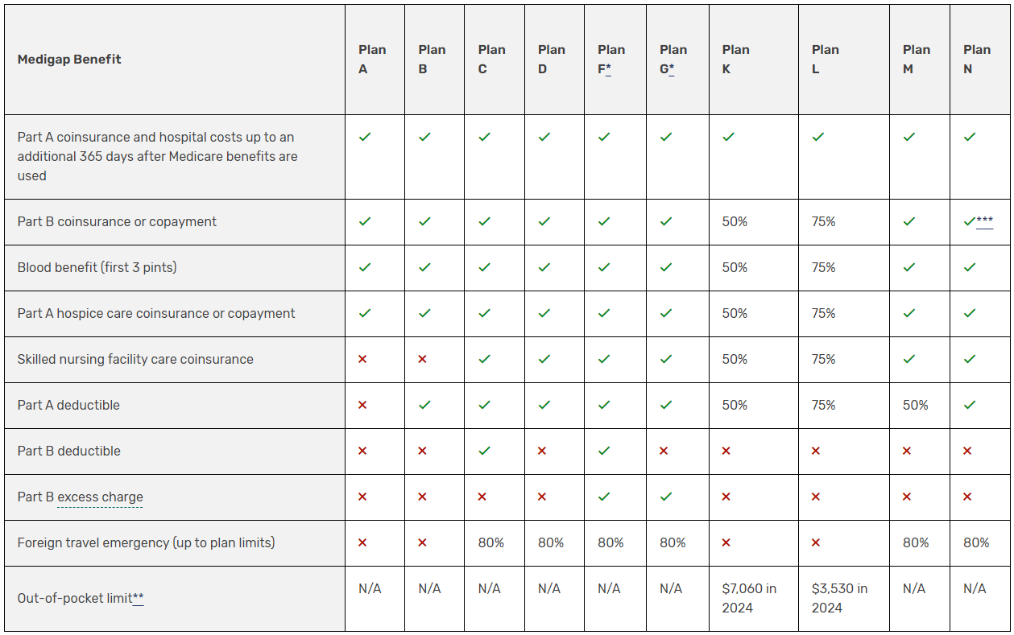
https://www.medicare.gov/health-drug-plans/medigap/basics/compare-plan-benefits
Notes:
Chart: https://www.medicare.gov/health-drug-plans/medigap/basics/compare-plan-benefits
The chart below shows basic information about the different benefits Medigap policies cover.
V ​= the plan covers 100% of this benefit
​X = the plan doesn't cover this benefit
% = the plan covers that percentage of this benefit and you’re responsible for the rest
N/A = not applicable
The Medigap policy will only pay your coinsurance after you’ve paid the deductible (unless the Medigap policy also covers your deductible).
If you turn 65 on or after 1/1/2020, plans C and F are not available.
*Plans F & G offer a high deductible plan in some states.
**Plans K & L show how much they'll pay for approved services before you meet your out-of-pocket yearly limit and Part B deductible. After you meet them, the plan will pay 100% of your costs for approved services.
***Plan N pays 100% of the costs of Part B services, except for copayments for some office visits and some emergency room visits. Part B excess charge: you have Original Medicare, and the amount a doctor or other health care provider is legally permitted to charge is higher than the Medicare-approved amount, the difference is called the excess charge.

Slide 25
Medicare Part A
Covered services
Inpatient Hospital Stays
Hospice Care
Home Health Care
Skilled Nursing Facility Care

Slide 26
Medicare Part A
A “Benefit period” is a period of time during which the Part A’s Hospital and Skilled Nursing Facility (SNF) benefit covers services.
A benefit period begins on a beneficiary’s first day of inpatient hospital care.
The benefit period is renewed when the beneficiary has not been an inpatient of a hospital or of a SNF for 60 consecutive days.
Notes:
A “Benefit period” is a period of consecutive days during which medical benefits for covered services, with certain specified maximum limitations, are available to the beneficiary.
Under Part A, 60 full days of hospitalization plus 30 coinsurance days represent the maximum benefit period. The benefit period is renewed when the beneficiary has not been an inpatient of a hospital or of a SNF (see §20.B) for 60 consecutive days.
Each patient also has a lifetime reserve of 60 additional days
Medicare Benefit Policy Manual Chapter 3; https://www.cms.gov/regulations-and-guidance/guidance/manuals/downloads/bp102c03pdf.pdf
https://www.medicare.gov/coverage/inpatient-hospital-care

Slide 27
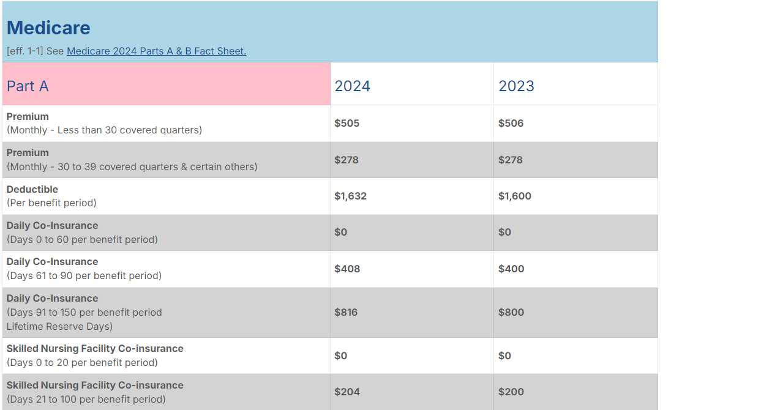

Slide 28
www.ProSeniors.org Resources Medicare-Medicaid Eligibility
Notes:
For financial eligibility factors, there are a lot of numbers involved, Pro Seniors’ website keeps track of those numbers.

Slide 29
Medicare Part B
Medically necessary covered services:
Physician services | Home health care
Outpatient hospital care | Dialysis for End Stage Renal Disease (unless in a Part A hospital stay)
Diagnostic tests | Screening services – mammography, pap smears and pelvic exams, glaucoma
Therapy | Certain vaccines
Ambulance transportation | Colorectal screening
Durable medical equipment | Prostate screening
Prosthetic devices other than dental

Slide 30
Not Covered by Medicare
Medicare does not cover services that are not medically reasonable or necessary.
No experimental procedures or treatments.
No Custodial Care / Long-term Care (like help with dressing, bathing or using the bathroom), except when you are also getting skilled nursing or therapy care in a skilled nursing facility or at home or receiving hospice care.
Notes:
https://www.cms.gov/outreach-and-education/medicare-learning-network-mln/mlnproducts/downloads/items-and-services-not-covered-under-medicare-booklet-icn906765.pdf
We don’t pay for medically unreasonable and unnecessary services and supplies to diagnose and treat a Medicare patient’s condition. These include: ● Hospital-provided services that, based on the patient’s condition, could have been provided in a lower-cost setting, like the patient’s home or nursing home ● Hospital services exceeding Medicare length of stay limits ● Evaluation and management services exceeding those considered medically reasonable and necessary ● Excessive therapy or diagnostic procedures ● Unrelated screening tests, exams, and therapies where the patient has no symptoms or diagnoses, except certain screening tests, exams, and therapies ● Unnecessary services, like transcendental meditation, based on the patient’s diagnosis ● Items and services administered to the patient to cause or assist in death (assisted suicide)

Slide 31
Not Covered by Medicare
No dental care or dentures unless related to a Medicare covered service. Example, dental reconstruction because of and after removal of a tumor.
No eyeglasses. (Exception: one pair of eyeglasses with standard frames or one set of contact lenses after cataract surgery that implants an intraocular lens.)
No hearing aids
Routine physical exams (but you do get a yearly wellness visit)

Slide 32
Not Covered by Medicare
Concierge care
Covered services from an opt-out doctor or provider except in case of emergency or urgent need.
No Medicare Part A or B deductibles, coinsurance, or copayments when you get certain health care services. Note that there are other programs that help low-income beneficiaries pay these items.
Notes:
https://www.medicare.gov/providers-services/original-medicare/not-covered

Slide 33
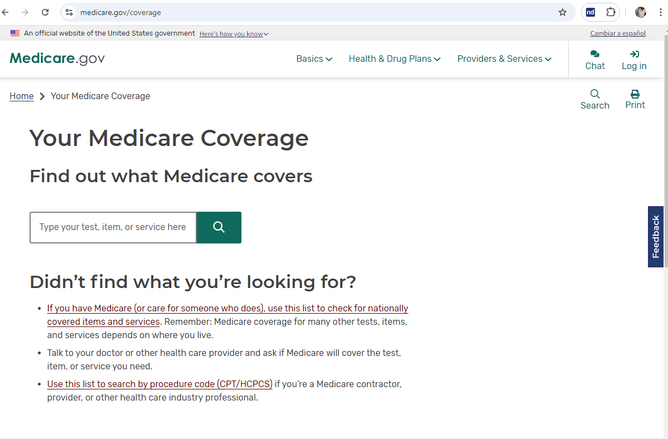
https://www.medicare.gov/coverage

Slide 34
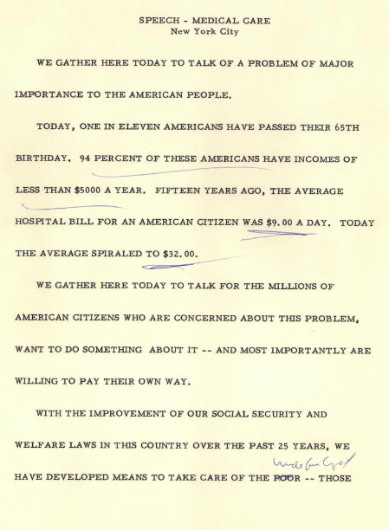
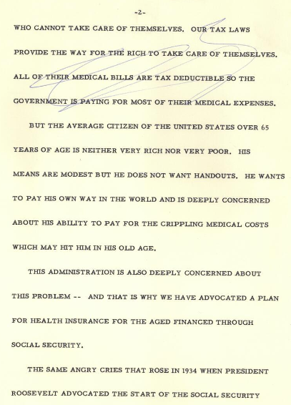
#1 Poll Slide
Address of John F. Kennedy at medical care for the aged rally, New York, 20 May 1962,
https://www.jfklibrary.org/asset-viewer/archives/jfkpof-038-023#?image_identifier=JFKPOF-038-023-p0007

Slide 35
Medicare Part B Costs
Co-payments
Medicare Part B pays 80% of the Medicare approved charge for a Part B service. Beneficiary pays remaining 20%.
The 20% co-payment may be substantial if the services are diagnostic tests, surgeon’s fees or outpatient hospital treatments (radiation, chemotherapy or dialysis treatments).
The Part B deductible of $240 and monthly premium of $174.70 (2024) are indexed to increase each year by the annual cost increase of Part B program.
Notes:
The monthly premium is paid by those with income up to $103,000. Those with higher income pay higher income relate premiums:
$244.60 in 2024 - $103,001 to $129,000
$349.40 in 2024 - $129,001 to $161,000
$559 in 2024 – more than $193,000 and less than $500,000

Slide 36
Part C Medicare Advantage Plans (MAPs)
Medicare Advantage Plans (MAPs) are managed care health plans that are approved by Medicare and run by private, for-profit companies.
Enrollment in a MAP is voluntary and in lieu of Original Medicare program Parts A and B, and sometimes Part D prescription drug coverage.
Notes:
9

Slide 37
Medicare Advantage Plans
All Medicare managed care options must provide beneficiaries with same medical coverage available under Original Medicare Part A and B.
Enrollees must get all their Medicare-covered services through the MAP which can include prescription drug coverage.
Notes:
42 CFR 422.101(a)

Slide 38
Medicare Advantage Plans
Some MAPs require enrollees to see network doctors, be admitted only to network hospitals, get prior approval from the plan before seeing a specialist, having surgery or being hospitalized unless an emergency.
However, out-of-network emergency care must be covered anywhere in the U.S.
Notes:
If you go outside a plan’s network of providers, or did not get specialty care approved in advance by the plan or by a required primary care physician, you may have to pay all of the cost of the specialist, surgery, or hospitalization

Slide 39
Medicare Advantage Plans
Health Maintenance Organization (HMO) – charge the least in premiums but must see only HMO’s providers unless emergency. You need a primary care physician and referrals to see specialists.
Preferred Provider Organization (PPO) – discounts for seeing network providers but permits out-of-network services at greater costs to patient.
Private Fee-for-Service (PFFS) – no network of providers, but medical provider must agree to accept plan’s terms and conditions. Beneficiary must show card before each service. Provider may accept or reject card on service by service basis.
Notes:
HMPs and PPOs – if you want part d prescription drug coverage, make sure you elect a plan that has it because you usually cannot buy a separate drug plan.

Slide 40
Medicare Advantage Plans
MAP enrollees continue to pay their Part B monthly premium. In addition, they may have to pay an extra monthly premium to the MAP.
However, the MAP premium is usually less than that of a Medicare Supplemental Insurance Plan.

Slide 41
Medicare Advantage Plans
MAP contracts are for twelve months. MAP benefits and cost sharing may change dramatically from year to year.
While MAP benefits are required to be actuarially better than traditional Medicare, they may be structured very differently and may result in more out-of-pocket costs than traditional Medicare.

Slide 42
Medicare Advantage Plans
MAPs charge differently:
Hypo MAP 1: co-pay of $310 for days 1 to 7 of an inpatient in-network hospital, $0.00 for days after that with a $4,600 cap on all in-network out-of-pocket beneficiary costs. No medical deductible.
Hypo MAP 2: co-pay of $440 for days 1-4 of an in-network hospital, $0 for days after that, with a $6,500 cap on in-network out-of-pocket costs. This plan has less expensive Part B co-pays. No medical deductible.
Hypo MAP 3: co-pay of $375 for days 1-5 of an in-network hospital admission, $0 for days after that with a $4,700 inpatient care only cap on a beneficiary’s annual in-network out-of-pocket costs. No medical deductible.
Notes:
Part A – first 60 days are free and then $402 a day days 61 to 90.

Slide 43
Medicare Advantage Plans
When selecting a MAP, beneficiaries must pay attention to co-pays, deductibles, and caps on out-of-pocket costs.
There can be hospital in-patient out-of-pocket caps as well as total beneficiary out-of-pocket caps.
In 2021, half of Medicare beneficiaries have Original Medicare, and most of those have some form of additional coverage, such as a supplement plan, or retiree benefits. The other half of Medicare beneficiaries are in a MAP and lack insurance to cover out-of-pocket costs.
Notes:
The test is cost of Med Supp and Part B verses cost of Part B and MAPs premium. Then what is total out-of-pocket cost?
https://www.kff.org/medicare/issue-brief/a-snapshot-of-sources-of-coverage-among-medicare-beneficiaries/

Slide 44
Medicare Advantage Plans
Maximum out-of-pocket costs on Medicare Advantage Plans for Part A & B services (MOOP Limits):
In-network: $8,850.00 (2024)
Catastrophic limit for combined in-network and out-of-network: $13,300.00 (2024) (note that this does not apply to HMOs because they do not cover out-of-network providers)
Plans can set lower limits

Slide 45
Medicare Advantage Plans - Hospitalizations
MAPs are required to cover medically necessary hospitalizations when they would be covered by Original Medicare.
If you are in a MAP that has a network, you may be required to go to an in-network hospital or you could pay more if you go to a hospital that is out-of-network.
You may need to obtain prior authorization for non- emergency hospitalization from your MAP.

Slide 46
Medicare Advantage Plans
MAP eligibility requirements:
Must live in MAP’s service area.
Entitled to Medicare Part A
Enrolled in Medicare Part B
Beneficiaries with End Stage Renal Disease join MAPs as of 2021.

Slide 47
Medicare Advantage Plans
Enrollment for MAPs:
Initial Medicare Enrollment Period.
Annual Open Enrollment Period: October 15th to December 7th
Medicare Advantage Open Enrollment (switch plans or return to Original Medicare:
January 1 to March 31
Within the first the 3 months after you qualify for Medicare
Notes:
https://www.medicare.gov/basics/get-started-with-medicare/get-more-coverage/joining-a-plan
Coverage starts:
- initial enrollment, say day your part B coverage starts
- open enrollment – Jan 1 of the next year
Medicare Advantage Open Enrollment – first of the month after the plan gets your request
Special enrollment – varies, usually first month after plan gets your request
42 cfr 422.62

Slide 48
Medicare Advantage Plans
Special Election Periods: may return to Original Medicare or elect a different MAP due to circumstances such as
Change in address outside of service area of plan
Enroll or disenroll is employer sponsored MA plan
Disenrolling in employer sponsored coverage (including COBRA) to elect an MA plan
Terminating a Supplement Plan during the trial period
Effected by a natural disaster
Notes:
42 cfr 422.62

Slide 49
Medicare Advantage Plans
Open Enrollment for institutionalized individuals.
At any time may elect an MAP or change their election from a MAP to Original Medicare.
Open enrollment ends the last day of the second month after the month the individual ceases to reside in a long-term care facility setting.
Notes:
42 cfr 422.62(a)(4)
Institutionalized means, for the purposes of defining a special needs individual and for the open enrollment period for institutionalized individuals at § 422.62(a)(4), an MA eligible individual who continuously resides or is expected to continuously reside for 90 days or longer in one of the following long-term care facility settings:(1) Skilled nursing facility (SNF) as defined in section 1819 of the Act (Medicare).(2) Nursing facility (NF) as defined in section 1919 of the Act (Medicaid).(3) Intermediate care facility for individuals with intellectual and developmental disabilities as defined in section 1905(d) of the Act.(4) Psychiatric hospital or unit as defined in section 1861(f) of the Act.(5) Rehabilitation hospital or unit as defined in section 1886(d)(1)(B) of the Act.(6) Long-term care hospital as defined in section 1886(d)(1)(B) of the Act.(7) Hospital which has an agreement under section 1883 of the Act (a swing-bed hospital).(8) Subject to CMS approval, a facility that is not listed in paragraphs (1) through (7) of this definition but meets both of the following:(i) Furnishes similar long-term, healthcare services that are covered under Medicare Part A, Medicare Part B, or Medicaid; and(ii) Whose residents have similar needs and healthcare status as residents of one or more facilities listed in paragraphs (1) through (7) of this definition.

Slide 50
Medicare Advantage Plans: Prior Authorizations
CMS received feedback that prior authorizations “can sometimes create a barrier to patients accessing medically necessary care.” Concerns were reported about:
the quality of MA plans' prior authorization decisions (e.g. denials made by plan clinicians without expertise in the field of medicine applicable to the requested service) and
process challenges (for example, repetitive prior approvals for needed services for enrollees that have a previously-approved plan of care).
OIG studied prior authorizations and found denials for services that met coverage guidelines
88 Fed. Reg. 22185, 22186 (Apr. 12, 2023)
Notes:
https://www.federalregister.gov/documents/2023/04/12/2023-07115/medicare-program-contract-year-2024-policy-and-technical-changes-to-the-medicare-advantage-program

Slide 51
Medicare Advantage Plans: Prior Authorizations
2023 Regulatory Changes:
Prior authorization policies for coordinated care plans may only be used to confirm diagnoses and ensure that an item or services is medically necessary based on CMS standards.
Prior authorizations must be valid for as long as medically necessary to avoid disruptions in care.
MAPs must follow Original Medicare coverage criteria where established.
88 Fed. Reg. 22122 (Apr. 12, 2023)
Notes:
https://www.federalregister.gov/documents/2023/04/12/2023-07115/medicare-program-contract-year-2024-policy-and-technical-changes-to-the-medicare-advantage-program
Coordinated care plans have networks of providers, like HMO, PPO : 42 cfr 422.4(a)(1)
422.112(b)(8)(i)(A) –
Approval of a prior authorization request for a course of treatment must be valid for as long as medically necessary to avoid disruptions in care, in accordance with applicable coverage criteria, the individual patient’s medical history, and the treating provider’s recommendation; and (B) A minimum 90-day transition period for any active course(s) of treatment when an enrollee has enrolled in an MA plan after starting a course of treatment, even if the service is furnished by an out-of-network provider. This includes enrollees new to a plan and enrollees new to Medicare. The MA organization must not disrupt or require reauthorization for an active course of treatment for new plan enrollees for a period of at least 90 days.
(ii) For purposes of this paragraph (b)(8), the following definitions apply: (A) Course of treatment means as a prescribed order or ordered course of treatment for a specific individual with a specific condition is outlined and decided upon ahead of time with the patient and provider. A course of treatment may but is not required to be part of a treatment plan. (B) Active course of treatment means a course of treatment in which a patient is actively seeing the provider and following the course of treatment.

Slide 52
Medicare Advantage Plans: Prior Authorizations
2023 Regulatory Changes:
When coverage criteria are not fully established Medicare in a statute, regulation, NCD, or LCD, MAPs can specify criteria, but must make the criteria publicly accessible. Unspecified criteria can only be used when the MAP demonstrates that the additional criteria provide clinical benefits that are highly likely to outweigh clinical harms, including from delayed access to services.
MAPs must establish Utilization Management Committee to review prior authorization policies annually and insurance their consistency with coverage requirements, including Original Medicare.
88 Fed. Reg. 22185 (Apr. 12, 2023)
Notes:
https://www.federalregister.gov/documents/2023/04/12/2023-07115/medicare-program-contract-year-2024-policy-and-technical-changes-to-the-medicare-advantage-program
42 cfr 422.137 – MA Utilization Management Committee

Slide 53
Medicare Advantage Plans
If patients have questions traditional Medicare, Medicare supplemental policies, prescription drug plans, or Medicare Advantage Plans, the Ohio Senior Health Insurance Information Program (OSHIIP) is a good place to start.
1-800-686-1578

Slide 54
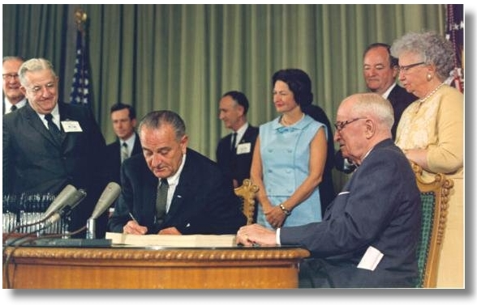
#2 Poll Slide
President Lyndon Johnson signing the Medicare program into law on July 30, 1965. Those shown include Lady Bird Johnson, the First Lady; former President Harry Truman; Vice-President Hubert Humphrey; and former First Lady Bess Truman. https://www.ssa.gov/history/lbjsm.html

Slide 55
Medicare Part A Coverage for Hospital Stays
Original Medicare Deductible
$1,632 per benefit period (2024)
Original Medicare Co-payments
Days 0 - 60: No co-pay
Days 61-90: $408 per day
Days 91-150 (60 Lifetime Reserve Days): $816 per day
Days 151 and beyond: No Medicare Coverage

Slide 56
Medicare Coverage of Hospice
1) Hospice Care Eligibility:
Entitled to Part A
Certified as terminally ill with 6 months or less to live if the illness runs its normal course:
Elect hospice coverage by waiving all rights to Medicare payments for Medicare services related to the treatment of the terminal condition other than services provided by the hospice and the attending physician.
Notes:
So services not covered are treatment intended to cure your illness or related conditions, prescription drugs to cure your illness rather than for symptom control or pain relief, care in a hospice unless arranged by your hospice team or unrelated to your terminal illness and related conditions.
https://www.medicare.gov/coverage/hospice-care
https://www.hhs.gov/guidance/sites/default/files/hhs-guidance-documents/bp102c09.pdf

Slide 57
Medicare Coverage of Hospice
2) Facility room and board is not covered. However, there is coverage of:
respite care for relief of the patient’s caregivers, and
general inpatient care for pain control and symptom management
Medicare will still pay covered benefits for health problems that are not part of your terminal illness and related conditions
If you are on MAP, your MAP will cover services that are not part of your terminal illness and Original Medicare will cover everything related to your terminal illness.
Notes:
5 to 7 days of respite care can be paid for room and board.

Slide 58
Medicare Coverage of SNFs
Benefit Eligibility Criteria include:
Admission to a SNF within 30 calendar days after the date of discharge from an inpatient hospitalization of at least 3 consecutive days, not counting the day of discharge.
MAPS can elect to cover in the absence of the prior hospital stay
Receipt of either skilled nursing services on a daily basis or skilled rehabilitation services 5 or more days a week.
Require care for a condition treated during the qualifying hospital stay or that occurred in the SNF while you were being treated for a condition that arose during the hospital stay
Notes:
2) above is really 30 days to onset of skilled services. It does happen where broken hip needs to heal prior to onset of skilled care and it takes longer than 30 days.
42 cfr 422.101(c)(2) – MAPs can elect to cover SNF in absence of qualifying hospital stay

Slide 59
Medicare Coverage of SNFs
Skilled Nursing Facility Coverage Includes:
Semi-private room
Meals
Skilled nursing care
Skilled rehabilitation services (Physical therapy, Occupational therapy, Speech-language pathology)
Medical social services
Drugs and biologicals
Medical supplies and equipment used in the facility
Ambulance transportation (when other transportation endangers health) to the nearest supplier of needed services that aren’t available at the SNF
Dietary counseling

Slide 60
Medicare Coverage of SNFs
Skilled Nursing Facility (SNF) Benefit:
Covers full cost of above skilled nursing facility services for days 1 – 20 per benefit period.
For Original Medicare, there is a daily, patient co-payment of $204 for days 21 – 100 of SNF care per benefit period.
MAPs may have higher co-payments than original Medicare. Beneficiaries may have to pay more or all their SNF care if they don’t tell the MAP before they are admitted. In-network SNFs may be less expensive.
Notes:
Note large co-pay means nice to have Med Supp plan.
Actuarial equivalent re SNF co-pay for MAPs is OK. Max allowed out-of-pocket for MAPs is coming down: $6,700 (2011)

Slide 61
Medicare Coverage of Home Health
Home Health Benefit Eligibility Criteria:
Physician must certify that beneficiary confined to the home.
Criteria One:
Patient cannot leave home because of illness or injury or needs the aid of supportive devices, use of specialized transportation, or the assistance of another person; or
because of their medical condition, leaving the home is medically contraindicated; and
Criteria two: The patient has a normal inability to leave the house and leaving the house requires considerable and taxing effort.
Notes:
Some examples of homebound patients that illustrate the factors used to determine whether a homebound condition exists are listed below. • A patient paralyzed from a stroke who is confined to a wheelchair or requires the aid of crutches in order to walk. • A patient who is blind or senile and requires the assistance of another person in leaving their place of residence. • A patient who has lost the use of their upper extremities and, therefore, is unable to open doors, use handrails on stairways, etc., and requires the assistance of another individual to leave their place of residence. • A patient in the late stages of ALS or neurodegenerative disabilities. In determining whether the patient has the general inability to leave the home and leaves the home only infrequently or for periods of short duration, it is necessary (as is the case in determining whether skilled nursing services are intermittent) to look at the patient's condition over a period of time rather than for short periods within the home health stay. For example, a patient may leave the home (meeting both criteria listed above) more frequently during a short period when the patient has multiple appointments with health care professionals and medical tests in 1 week. So long as the patient's overall condition and experience is such that he or she meets these qualifications, he or she should be considered confined to the home. • A patient who has just returned from a hospital stay involving surgery, who may be suffering from resultant weakness and pain because of the surgery and; therefore, their actions may be restricted by their physician or allowed practitioner to certain specified and limited activities (such as getting out of bed only for a specified period of time, walking stairs only once a day, etc.). • A patient with arteriosclerotic heart disease of such severity that they must avoid all stress and physical activity. • A patient with a psychiatric illness that is manifested in part by a refusal to leave home or is of such a nature that it would not be considered safe for the patient to leave home unattended, even if they have no physical limitations.
The aged person who does not often travel from home because of frailty and insecurity brought on by advanced age would not be considered confined to the home for purposes of receiving home health services unless they meet one of the above conditions.

Slide 62
Medicare Coverage for Home Health
Home Health Benefit:
Cost of part-time/intermittent skilled nursing and therapy services;
Part-time/intermittent home health aide;
Medical social services; and
Medical supplies for home use.
Notes:
If it is determined that the assisted living facility (also called personal care homes, group homes, etc.) in which the individuals reside are not primarily engaged in providing the above services, then Medicare will cover reasonable and necessary home health care furnished to these individuals.
Covered home health services include:
Medically necessary part-time or intermittent skilled nursing care, like:
Wound care for pressure sores or a surgical wound
Patient and caregiver education
Intravenous or nutrition therapy
Injections
Monitoring serious illness and unstable health status
Physical therapy
Occupational therapy
Speech-language pathology services
Medical social services
Part-time or intermittent home health aide care (only if you’re also getting skilled nursing care, physical therapy, speech-language pathology services, or occupational therapy at the same time), like:
Help with walking
Bathing or grooming
Changing bed linens
Feeding
Injectable osteoporosis drugs for women
Durable medical equipment
Medical supplies for use at home
Disposable negative pressure wound therapy devices

Slide 63
Medicare Coverage of Home Health
Part A – Covers 100 home health visits but must have Part A and B, have a three consecutive day stay in a hospital, and services are initiated and first home health visit is rendered within 14 days of hospital discharge or SNF discharge. After this or spell of illness concludes, Part B will cover additional visits.
Part B – unlimited visits are covered
Notes:
https://www.cms.gov/Regulations-and-Guidance/Guidance/Manuals/Downloads/bp102c07.pdf

Slide 64
Medicare Coverage of Home Health
Cost of Home Health Services
Original Medicare - $0 for covered home health care services under Part A and Part B, except:
- Part B home health has a 20% co-pay for medical equipment and osteoporosis drugs only.
Notes:
https://www.cms.gov/Regulations-and-Guidance/Guidance/Manuals/Downloads/bp102c07.pdf

Slide 65
Medicare Appeals
What happens when Medicare or a MAP makes a decision about coverage that the beneficiary doesn’t agree with? Medicare beneficiaries can appeal.
Notes:
You can appeal a decision by a MAP refusing to provide a service or you can appeal the amount that the MAP says you must pay for a service. You can appeal a MAP’s refusal to pay for out-of-the-area emergency services, urgently needed services, dialysis, or post-stabilization care. You can also appeal the reduction or discontinuation of previously authorized treatment. And you can appeal the failure of the MAP to timely cover health care services or to timely provide you with notice of an adverse determination when their delay adversely affects your health.

Slide 66
Medicare Appeals
All Medicare beneficiaries have a right to a written notice of a denial, reduction, or termination of care or if denied because “not covered” by Medicare.
Written notice will advise how and where to file an appeal.
If you do not know where you should send your appeal, ask the MAP or call the Ohio Senior Insurance Information Program at 1-800-686-1575 or at OSHIIPmail@insurance.ohio.gov.
Beneficiaries can appoint a representative. For questions on how to appoint a representative, call Medicare at 1-800-633-4227.
Notes:
https://www.hhs.gov/sites/default/files/omha/files/medicare-appeals-backlog.pdf
You can appeal a decision by a MAP refusing to provide a service or you can appeal the amount that the MAP says you must pay for a service. You can appeal a MAP’s refusal to pay for out-of-the-area emergency services, urgently needed services, dialysis, or post-stabilization care. You can also appeal the reduction or discontinuation of previously authorized treatment. And you can appeal the failure of the MAP to timely cover health care services or to timely provide you with notice of an adverse determination when their delay adversely affects your health.

Slide 67
Medicare Appeals
Expedited Appeal can be requested.
Home Health Agency, SNF, comprehensive outpatient rehabilitation facility or hospice:
Submit request by noon the day after receiving a notice of termination.
For home health agencies and comprehensive outpatient rehabilitation facility, a physician must certify that continued failure to provide services puts beneficiary’s health at significant risk.
Decision in 72 hours after receipt of request for expedited determination.
Hospital:
- Submit request by date of discharge. Decision in one day after receiving all pertinent information.
Notes:
72 hour max for an expedited appeal, or shorter as medical conditions dictate.
42 cfr 405.1200 and https://www.cms.gov/files/document/ed-qs-and-mar-06-updatepdf Q6

Slide 68
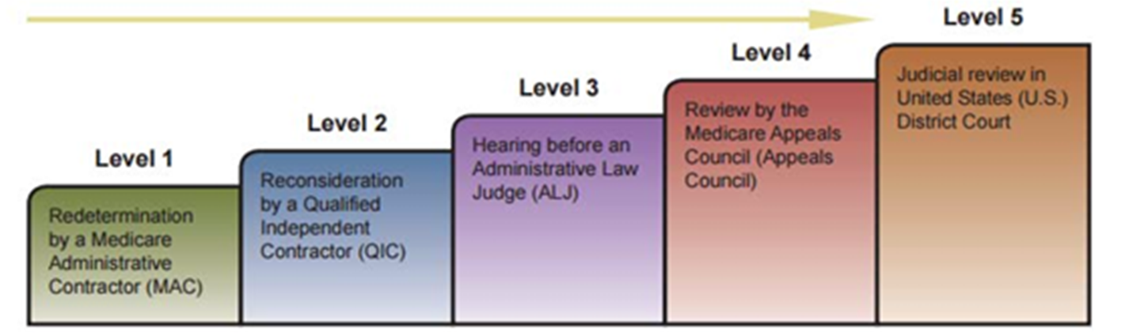
Medicare Appeals
Notes:
https://www.hhs.gov/sites/default/files/omha/files/medicare-appeals-backlog.pdf

Slide 69
Medicare Appeals
First Level of Appeal:
Original Medicare: Beneficiary must request a re-determination within 120 days of the initial determination.
MAPs: Enrollee must request Health Plan Reconsideration within as little as 30 days preservice or 60 days for payment.

Slide 70
Medicare Appeals
Second Level of Appeal:
Original Medicare: request a reconsideration by a Qualified Independent Contractor (QIC) within 180 days of the re-determination decision.
MAP: Request IRE reconsideration within as little as 30 days for preservice of 60 days for payment

Slide 71
Medicare Appeals
Third Level of Appeal:
Original Medicare and MAP: Request an Administrative Law Judge Hearing with 60 days of the adverse decision on the level two appeal. The amount in controversy must be at least $180 (2024).
Fourth Level of Appeal:
Original Medicare and MAP: If adverse administrative law judge hearing decision, appeal by requesting a review by the Medicare Appeals Council within 60 days.

Slide 72
Medicare Appeals
Fifth Level of Appeal:
Original Medicare and MAP: If $1,840 (2024) is in dispute, a beneficiary may file an appeal in federal court within 60 days of the Medicare Appeals Council’s adverse action.

Slide 73
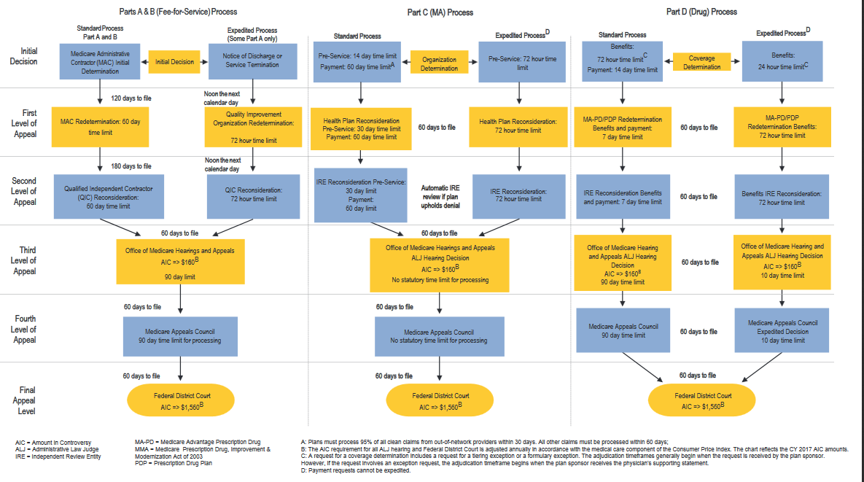
https://www.cms.gov/Outreach-and-Education/Training/CMSNationalTrainingProgram/
Downloads/2017-Comparison-of-the-Parts-A-B-C-and-D-Appeal-Processes.pdf

Slide 74
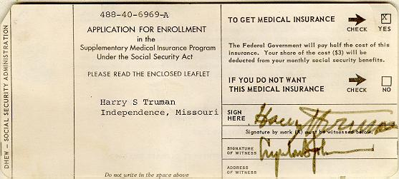
Poll Slide #3
President Truman's application for the optional Part B medical care coverage, which President Lyndon Johnson signed as a witness. SSA History Archives. https://www.ssa.gov/history/lbjsm.html

Slide 75
Hospital Observation Status Pitfall
Medicare coverage for SNF stay only if:
SNF admission was caused by an illness or injury that required a 3 – day inpatient hospital stay, not counting the day of discharge.
Inpatient hospital stay occurred within 30 days of admission to SNF.

Slide 76
Hospital Observation Status
Inpatient vs. Outpatient Status
You are an inpatient starting when you’re formally admitted to the hospital with a doctor’s order. The day before you are discharged is your last inpatient day.
You are an outpatient if you’re getting emergency department services, observation services, outpatient surgery, lab tests, or X-rays, or any other hospital services, and the doctor has not written an order to admit you to a hospital as an inpatient. You’re an outpatient even if you spend the night in the hospital.

Slide 77
Hospital Observation Status
Inpatient services are usually cheaper for patients due to the coverage they receive under Part A.
Outpatient services can be very expensive and preclude SNF Medicare coverage.

Slide 78
Hospital Observation Status
- CMS observed high rates of error for medically unnecessary inpatient care. Original Medicare now has a two-midnight rule, with Part A inpatient admission appropriate for those expected to stay over two midnights. MAPs can use their own criteria.
- As a result, more hospitals are placing patients on observation status, even if their doctors will go on to recommend care in an SNF afterwards.
- Patients that have outpatient status are required to received a Medicare Outpatient Observation Notice (MOON) if they are receiving outpatient services for at least 24 hours.
Notes:
https://www.cms.gov/newsroom/fact-sheets/fact-sheet-two-midnight-rule-0

Slide 79
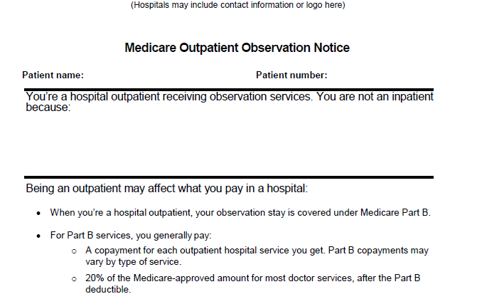
MOON Notice
Notes:
Newest MOON Notice as of 2023.
A space for reasoning to be provided to help deal with confusion.
Patients may not understand that their costs will be significantly higher if not familiar with Medicare costs.

Slide 80
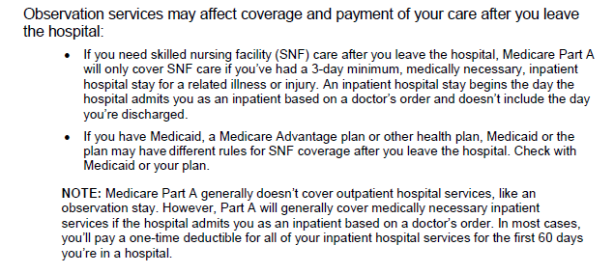
MOON Notice
Notes:
Confusion as to what a 3-day stay is, sometimes even by hospital.
Informs people of options under Medicaid and Part C.

Slide 81
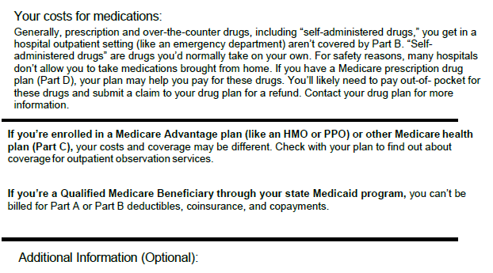
MOON Notice
Notes:
Good reason to have Part D.
Lets people know who are QMB eligible that they shouldn’t have to pay certain bills.

Slide 82
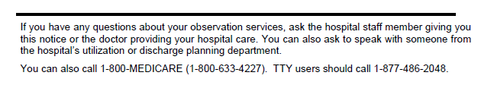

MOON Notice

Slide 83
Hospital Observation Status
Settlement of Alexander v. Azar, 613 F. Supp. 3d 559 (D. Conn. 2020), aff'd sub nom., Barrows v. Becerra, 24 F.4th 116 (2d Cir. 2022).
CMS recently promulgated draft rules to appeal observation status designation for the following:
1. Beneficiaries who are formally admitted on an inpatient basis and are subsequently reclassified by the hospital as an outpatient receiving “observation services”;
and
Notes:
https://www.cms.gov/newsroom/fact-sheets/fact-sheet-two-midnight-rule-0

Slide 84
Hospital Observation Status
2. Beneficiaries that receive a MOON indicating that observation services are not covered under Medicare Part A; and either
a. were not enrolled in Part B coverage at the time of their hospitalization; or
b. stayed at the hospital for 3 or more consecutive days but were designated as inpatients for fewer than 3 days, unless more than 30 days has passed after the hospital stay without the beneficiary's having been admitted to a skilled nursing facility.
Notes:
https://www.cms.gov/newsroom/fact-sheets/fact-sheet-two-midnight-rule-0

Slide 85
Hospital Observation Status
Proposed Legislation:
The Improving Access to Medicare Coverage Act
A proposed bill to:
Count a beneficiary’s time spent in the hospital on “observation status” towards the three-day hospital stay requirement for skilled nursing care; and
Establish a 90-day appeal period following passage for those that have a qualifying hospital stay and have been denied skilled nursing care after January 1, 2024.
https://www.brown.senate.gov/newsroom/press/release/sherrod-brown-introduce-bipartisan-legislation-protect-seniors-high-costs-necessary-medical-care
Notes:
https://www.cms.gov/newsroom/fact-sheets/fact-sheet-two-midnight-rule-0

Slide 86
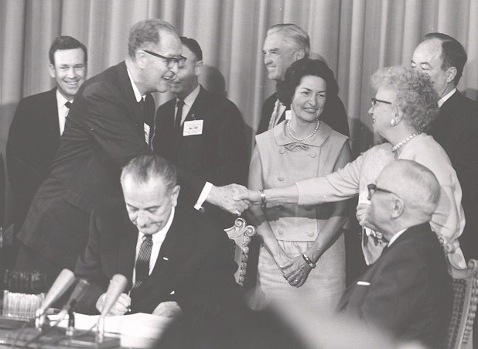
#4 Poll Slide
Senator Clinton Anderson (D-NM) shakes hands with Mrs. Truman. SSA History Archives. https://www.ssa.gov/history/medicarephotos.html

Slide 87
Part D Prescription Drug Coverage
Part D are standalone or can be purchased as part of a MAP.
If you delay getting coverage, and you don’t have other coverage or get Extra Help you can be penalized.
When picking Drug Coverage:
What is the premium and the deductible?
What coverage is available during the donut hole/coverage gap?
Are your medications on the plan’s formulary?

Slide 88
Part D Prescription Drug Coverage
Plan Formularies:
Must offer at least 2 drugs in the most common categories
Plans can change the formulary, but unless the change is due to new information on drug safety or efficacy, enrollees currently taking the drug are exempt for formulary changes for the rest of the contract year.
No coverage of drugs not on the plan formulary. You can request an exception to get a drug not on the formulary, but it may cost more because plans negotiate to get lower prices on their drug lists.
May offer tiers with lower costs for generic drugs.
Notes:
Your plan may change its drug list during the year because drug therapies change, new drugs are released, or new medical information becomes available.
https://www.law.cornell.edu/cfr/text/42/423.120; https://www.cms.gov/medicare/prescription-drug-coverage/prescriptiondrugcovcontra/downloads/part-d-benefits-manual-chapter-6.pdf
Formulary Maintenance Changes: After March 1, Part D sponsors may make maintenance changes to their formulary, such as replacing brand name with new generic drugs or modifying formularies as a result of new information on drug safety or effectiveness. o
Non-maintenance (Other) Formulary Changes: Part D sponsors may remove Part D drugs from their formulary, move covered Part D drugs to a less preferred tier status, or add utilization management requirements. For these additional types of formulary changes approved by CMS, Part D sponsors should make such formulary changes only if enrollees currently taking the affected drug are exempt from the formulary change for the remainder of the contract year.
If the formulary change is due to new information on drug safety or efficacy and is a negative change
they usually must:
give your written notice 60 before the date the change becomes effective and
when you request a refill, provide written notice of the change and at least 60 days supply under the same plan rules as before the change.
CMS considers negative formulary changes to include the following: 1) removal of a drug from a formulary; 2) increasing the cost-sharing status of a drug on the formulary subsequent to a change in tier; 3) adding, or making more restrictive: a) prior authorization requirements, b) quantity limits, c) step therapy requirements, and 4) imposing other restrictions on a drug that require CMS approval.

Slide 89
Part D Prescription Drug Coverage
The Donut Hole / Coverage Gap
Most Plans have a coverage gap that puts a temporary limit on what the Plan pays to cover drugs
In 2024, the coverage gap starts at $5,030. In the coverage gap you pay up to 25% of the cost of drugs.
Counts towards the coverage gap: yearly deductible, coinsurance, and copayments, discount you get on brand-name drugs in the coverage gap, what you pay in the coverage gap to buy brand name and generic drugs.
Does not count towards the coverage gap: premiums, pharmacy dispensing fee, what you pay for drugs that aren’t covered
Those on Extra Help do not have a coverage gap.
Notes:
https://www.medicare.gov/drug-coverage-part-d/costs-for-medicare-drug-coverage/costs-in-the-coverage-gap
Extra help – no premium and no deductible, very cheap costs for drugs
Who should apply for Extra Help?
In most cases, to qualify for Extra Help, you must have income and resources below a certain limit. These limits may go up each year.
Income and resource limits in 2024: Individual $22,590 $17,220
Married couple: $30,660 $34,360

Slide 90
Part D: Inflation Reduction Act of 2022
Insulin available at $35/month per covered prescription with no deductible
Access to recommended adult vaccines without cost-sharing
Expansion of the low-income subsidy program (LIS or “Extra Help”) under Medicare Part D to 150% of the federal poverty level starting in 2024
2024: no further payments for drugs once you hit the catastrophic coverage phase and your out-of-pocket spending is $8,000.
Notes:
https://www.medicare.gov/drug-coverage-part-d/costs-for-medicare-drug-coverage/costs-in-the-coverage-gap
Extra help – no premium and no deductible, very cheap costs for drugs
Who should apply for Extra Help?
In most cases, to qualify for Extra Help, you must have income and resources below a certain limit. These limits may go up each year.
Income and resource limits in 2024: Individual $22,590 $17,220
Married couple: $30,660 $34,360
https://www.medicare.gov/about-us/prescription-drug-law

Slide 91
Part D: Inflation Reduction Act of 2022
In 2025: A yearly catastrophic cap of $2,000 in 2025 on Part D out-of-pocket prescription drug costs
In 2025: All Part D plans and MAPs with drug coverage must offer enrollees the options to pay out of pocket prescription drug costs in the form of capped monthly payments instead of all at once at the pharmacy.
Notes:
https://www.medicare.gov/drug-coverage-part-d/costs-for-medicare-drug-coverage/costs-in-the-coverage-gap
Extra help – no premium and no deductible, very cheap costs for drugs
Who should apply for Extra Help?
In most cases, to qualify for Extra Help, you must have income and resources below a certain limit. These limits may go up each year.
Income and resource limits in 2024: Individual $22,590 $17,220
Married couple: $30,660 $34,360
https://www.medicare.gov/about-us/prescription-drug-law

Slide 92

Part D: Inflation Reduction Act of 2022
CMS given permission to negotiate lower prices on 10 drugs. In 2026, these drugs will have a discount over the 2023 Medicare price list price:
https://www.cms.gov/files/document/infographic-negotiated-prices-maximum-fair-prices.pdf
Notes:
Estimated out-of-pocket savings to beneficiaries of $1.5 billion. Drug manufacturers could chose to withdraw from Medicare instead. Drug manufacturers are suing to prevent this.

Slide 93
Out of Network Part Medicare A & B Services
Original Medicare: not a concern unless physician does not accept Medicare.
Emergencies: MA plans must pay out-of-network providers for emergency and urgent services and out of area dialysis.
Medicare Advantage PPOs: Annual Cap on combined in-network and out-of-network costs. Beneficiary pays 100% Original Medicare fee for service rate minus co-insurance
Medicare Advantage HMOs: No out-of-network cap. Out of network payments usually capped at amounts a beneficiary would pay in Original Medicare.

Slide 94
Group Health Plans / No Surprises Act
1) The No Surprises Act does not apply to Medicare, Medicare Advantage, Medicaid & Tricare.
If a patient in a group health plan goes to an emergency room, the No Surprises Act protects them from unexpected out-of-network charges for:
emergency services from the hospital
providers giving care at the hospital, and
air ambulance providers.
The beneficiary still must pay normal cost-sharing, including copayments, coinsurances, and deductibles.
Notes:
Medicare Advantage –
Generally speaking:
MA plans must pay out-of-network providers include emergency and urgently needed services, dialysis when outside of the network area, and placements when necessary and approved by the MA plan.
HMOs:
Out of network provider payment usually capped at amounts a beneficiary would pay in Original Medicare.
PPOs: Beneficiary pays 100% original FFS rate and is reimbursed by PPO minus co-insurance

Slide 95
Group Health Plans / No Surprises Act: Out of Network Providers at In-Network Hospitals
If a beneficiary is seen by an out-of-network provider at an in-network hospital, hospital outpatient department, or ambulatory surgical center, they are protected from additional out-of-network charges.
No similar protection at doctor’s offices, out-of-network facilities, ground ambulance services,
Protections do not apply for those with vision-only and dental-only insurance, short term limited duration and health care sharing ministry plans, fixed indemnity excepted benefits plans.

Slide 96
Group Health Plans / No Surprises Act Notice and Consent Forms
Notice and Consent Forms:
Beneficiaries can lose protections from out-of-network surprises if they sign a Notice and Consent form.
Signing the form means that you agreeing to get care out-of-network and giving up your protections from unexpected out-of-network bills. To save money, do not sign the form.
You cannot be asked to sign this form in an emergency or when there is no in-network provider available.
You can be asked to sign the form for post-stabilization services

Slide 97
No Surprises Act
No Surprises Help Desk
1-800-985-3059
The Help Desk can help consumers, their authorized representatives, and health care providers with:
Concerns about medical billing protections, such as balance or surprise medical bills.
Complaints that the requirements of the No Surprises Act are not being followed.
General questions about the protections and requirements of the No Surprises Act.

Slide 98
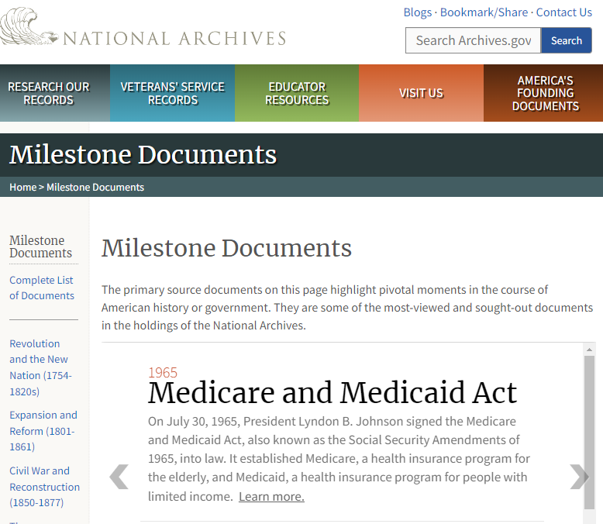
QUESTIONS?

Slide 99

QUESTIONS?
An act to provide a hospital insurance program for the aged under the Social Security Act with a supplementary medical benefits program and an expanded program of medical assistance, to increase benefits under the Old-Age, Survivors, and Disability Insurance System, to improve the Federal-State public assistance programs, and for other purposes, July 30, 1965;
https://www.archives.gov/milestone-documents/medicare-and-medicaid-act

Slide 100


Thank You!
This webinar series is presented by
Pro Seniors & the Ohio Department of Aging in collaboration with the
Ohio Training Advisory Committee of the Alliance of Ohio Legal Aids.

