Slide 1





Institutional Medicaid Financial Eligibility Part 2
March 22, 2024
Notes:
How is institutional Medicaid financial eligibility determined?
Have a better understanding of how financial eligibility works and what is relevant to the application process

Slide 2
Institutional Medicaid Resources and Transfers
Miriam H. Sheline
Managing Attorney
msheline@proseniors.org
Pro Seniors, Inc.
7162 Reading Road, Suite 1150
Cincinnati, Ohio 45237
513-345-4160
Notes:
In our work we assist clients often regarding various questions about financial eligibility for institutional Medicaid
Very important program for seniors with low income and resources
Please feel free to ask questions as we go along by raising your hand

Slide 3

www.ProSeniors.org Resources Medicare-Medicaid Eligibility
Notes:
- For financial eligibility factors, there are a lot of numbers involved, Pro Seniors’ website keeps track of those numbers.

Slide 4
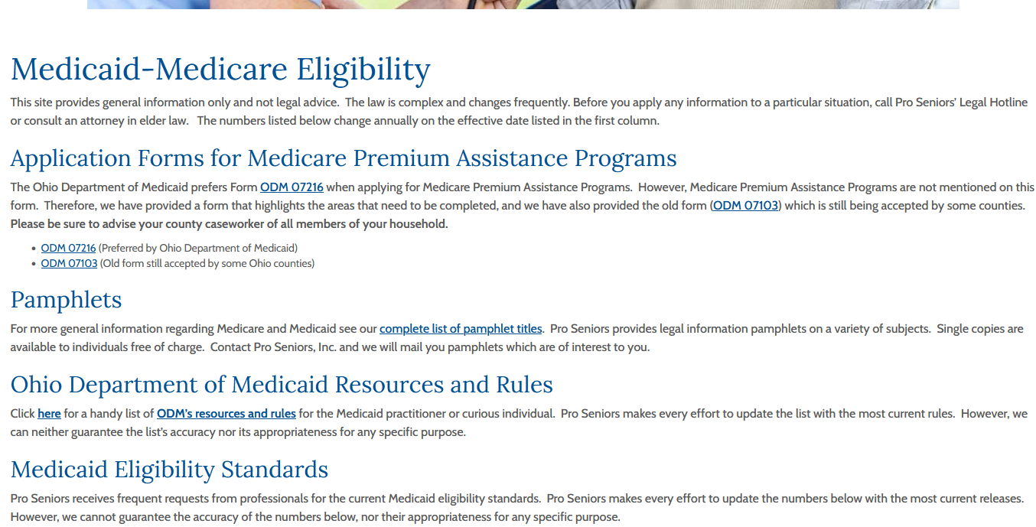
www.ProSeniors.org ODM’s Resources & Rules

Slide 5
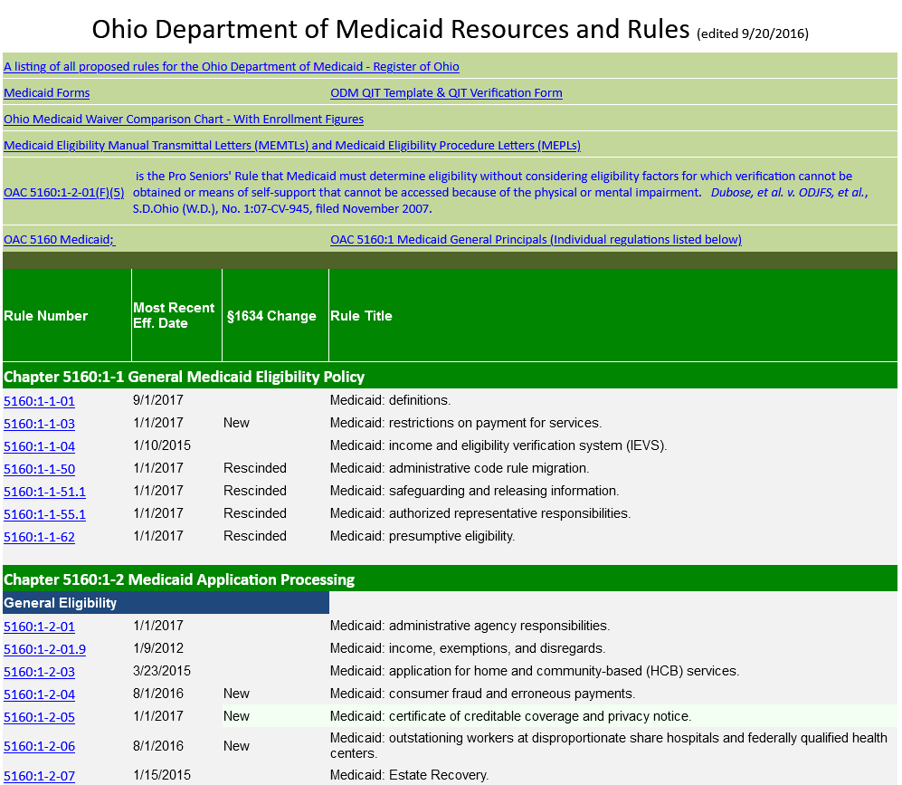

Slide 6
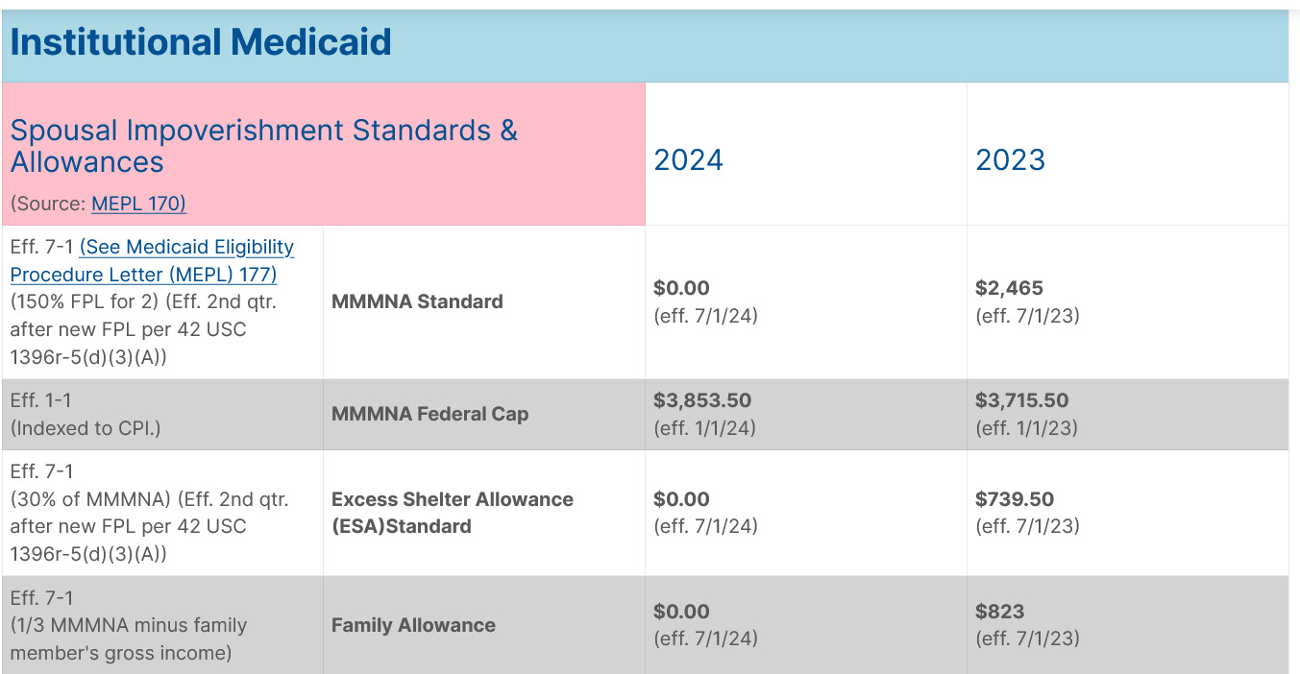
Notes:
- These numbers often change annually at different times of the year

Slide 7
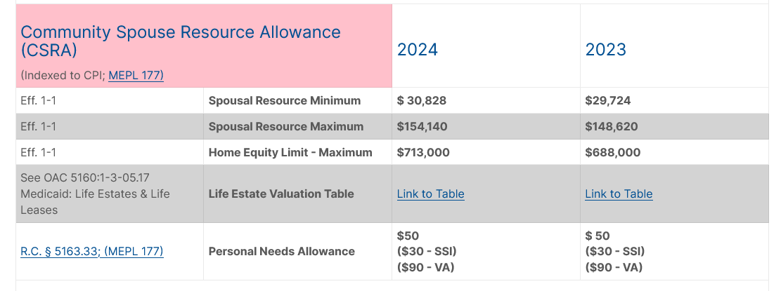

Slide 8
Financial Eligibility
The IS must meet financial thresholds to qualify for Institutional Medicaid.
Income Eligible
Resource Eligible
Notes:
Institutional Medicaid is something more and more people will need as the population ages
Many applicants may have never encountered applying for public benefits before, as even for those with large savings, institutional Medicaid is more likely to be needed
Income eligibility used to be less of a concern before the 1634 conversion in 2016, when applicants could use medical bills to spend down their income to qualify

Slide 9
Income Eligibility
The IS’s countable income must be at or below the special income level of 300% of SSI ($2,829 in 2024). Medical expenses can no longer be deducted to meet the special income level to become Medicaid income eligible.
The CS’s income is not included in this calculation.
Notes:
Since the 1634 conversion, Medicaid’s financial eligibility mirrors that of SSI
SSI, the Supplemental Security Income program, is another needs based program that pays cash to people whose income are below a certain threshold. The point of the program is to help them afford basic necessities.

Slide 10
Qualified Income Trust
Individuals receiving long-term care services with an income over 300% SSI ($2,829 in 2024) can only remain eligible for Medicaid by putting excess income into a Qualified Income Trust (QIT), a.k.a. a Miller Trust. Miller v. Ibarra, 746 F. Supp. 19 (D. Colo. 1990) and is specifically sanctioned by Congress in 42 U.S.C. § 1396p(d)(4)(B).

Slide 11
Post Eligibility Income Calculations
Applicant with QIT not eligible until QIT in place and funded. (No retroactive coverage).
Once applicant is income eligible, then consider income to determine patient liability.

Slide 12
How to calculate Patient Liability?
Gross Income
Minus excluded income
Minus PNA (Personal Needs Allowance) ($50, SIMNA $1839(PASSPORT) or ALMNA $943(Assisted Living Waiver))
Minus MIA for Community Spouse
Minus FA or FMNA for dependent family members
Minus Health Insurance Premiums, copayments, deductible and co-insurance for IS, CS, and IS’ minor or disabled child
Minus Past Unpaid Medical Expenses
Minus QIT bank fees of up to $15 per month
= Patient Liability
Notes:
Good idea to estimate patient liability during application for Medicaid so estimated patient liability can be paid to the facility until eligibility is established.
FA = family allowance FMNA = Family maintenance needs allowance
OAC 5160:1-6-07 Medicaid: post-eligibility treatment of income for individuals in medical institutions
OAC 5160:1-6-07.1 Medicaid: post-eligibility treatment of income for individuals receiving services through a home and community-based services (HCBS) waiver or the program of all-inclusive care for the elderly (PACE)
SIMNA = Special Individual Maintenance Needs Allowance
ALMNA = Assisted Living Maintenance Needs Allowance

Slide 13
Monthly Income Allowance (MIA)
MMMNA standard of $2,465 (7/1/23)
Add Excess Shelter Allowance (ESA)
Compare to MMMNA cap of $3,858.50 (eff. 1/1/24) and use the smaller. If actual is higher can request an administrative hearing for extraordinary circumstances.
Then subtract CS’s income
= MIA
Notes:
Amount that CS can keep to not be impoverished.
Excess Shelter Allowance has its own calculation. Taking into account cost of housing for CS.

Slide 14
Excess Shelter Allowance (ESA)
Total CS’ expenses for principal residence (mortgage, rent, property taxes, homeowner’s insurance, HOA fees, etc.)
Add standard Utility Allowance $724 (eff. 10/1/23) if spouse pays for gas, electric, coal, wood, oil, water, sewage, or telephone service for the residence
Subtract the ESA standard of $739.50 (eff. 7/1/23)
= ESA
Notes:
Needed to calculate MIA
Takes into account cost of the housing for the community spouse
OAC 5160:1-6-07

Slide 15
Financial Eligibility
The IS must meet financial thresholds to qualify.
Income Eligible
Resource Eligible
Notes:
Questions about income eligibility before we continue?

Slide 16
Resource Eligibility
Resource Assessment, then
Resource Allocation, if applicant is married
Resource Spend-Down, if resources allocated to the IS exceed $2,000
Resource Eligible once resources allocated to the IS are equal to or less than $2,000
Notes:
OAC 5160:1-3-05.1(B)(9) Medicaid: resource requirement

Slide 17
Resource Assessment, Allocation and Spend-Down
1. Determine Snapshot Date; Begin Resource Assessment
2. List All Resources
3. Determine Excluded Resources
4. Determine Non-Accessible Resources
5. Finalize Resource Assessment
6. Resource Allocation For Married Applicant
7. Spend-Down to $2,000
8. Medicaid Eligible

Slide 18
3. Determine Excluded Resources
Excluded Resources Summary
Automobile
Household Goods
Burial Spaces
Prepaid Burial Contracts
Life Insurance- face value less than $1500
The Home
Property listed for sale at fmv.
Long term Care insurance payments

Slide 19
Resource Assessment, Allocation and Spend-Down
1. Determine Snapshot Date; Begin Resource Assessment
2. List All Resources
3. Determine Excluded Resources
4. Determine Non-Accessible Resources
5. Finalize Resource Assessment
6. Resource Allocation for Married Applicant
7. Spend-Down to $2,000
8. Medicaid Eligible

Slide 20
6. Resource Allocation for Married Applicant
Resource Allocation is to protect a portion of the combined countable resources for the community spouse

Slide 21
6. Resource Allocation for Married Applicant
The Community Spouse Resource Allowance (CSRA)
Minimum is $30,828 (2024)
Maximum is $154,140 (2024)
CSRA amounts are indexed to the CPI and change annually 42 U.S.C.A. § 1396r-5(g)

Slide 22
Medicaid Resource Allocation - 2024
Institutionalized
Spouse
Community Spouse
$300,000
$454,520
Max Allocation
$154,520
66%
34%
$154,520
$309,040
Max Allocation
$154,520
50%
50%
$50,000
$100,000
50%
$50,000
50%
50%
$30,828
$67,828
50% or Minimum
$30,828
50%
50%
$6,172
$37,000
Minimum
$30,828
19%
81%
$ 2,000
$32,828
100% of 1st
$30,828
6%
94%

Slide 23
CSRA Case Facts
Julie Jones suffers from severe dementia and permanently entered a nursing facility on March 1, 2024. Julie owns her home worth $100,000 free and clear and has $6,000 in a checking account. She owns a 2006 Ford Focus.
Julie’s husband, Jim, continues to live in the home, although the deed is in Julie’s name.
Julie is able to direct and does not want to return home.
Julie and Jim also have IRAs totaling $30,000 and are not taking regular distributions.

Slide 24
Poll Question #1

Slide 25
6. Resource Allocation for Married Applicant
The Community Spouse Resource Allowance (CSRA)
Minimum is $30,828 (2024)
Maximum is $154,140 (2024)
CSRA amounts are indexed to the CPI and change annually 42 U.S.C.A. § 1396r-5(g)

Slide 26
CSRA Case Facts
Julie Jones suffers from severe dementia and permanently entered a nursing facility on March 1, 2024. Julie owns her home worth $100,000 free and clear and has $6,000 in a checking account. She owns a 2006 Ford Focus.
Julie’s husband, Jim, continues to live in the home, although the deed is in Julie’s name.
Julie is able to direct and does not want to return home
Julie and Jim also have IRAs totaling $30,000 and are taking regular distributions.
Instead of a Ford Focus, Julie owns a 2023 Mercedes.
Julie also owns $100,000 in P&G stock.

Slide 27
3. Determine Excluded Resources
Excluded Resources Summary
Automobile
Household Goods
Burial Spaces
Prepaid Burial Contracts
Life Insurance- face value less than $1500
The Home
Property listed for sale at fmv.
Long term Care insurance payments

Slide 28
Medicaid Resource Allocation - 2024
Institutionalized
Spouse
Community Spouse
$300,000
$454,520
Max Allocation
$154,520
66%
34%
$154,520
$309,040
Max Allocation
$154,520
50%
50%
$50,000
$100,000
50%
$50,000
50%
50%
$30,828
$67,828
50% or Minimum
$30,828
50%
50%
$6,172
$37,000
Minimum
$30,828
19%
81%
$ 2,000
$32,828
100% of 1st
$30,828
6%
94%

Slide 29
Julie and Jim’s countable resources are 106,000. Jim’s CSRA would be 50%. They would have to spend 53,000 down to 2000, or 51,000 before Julie will qualify for Medicaid.

Slide 30
CSRA Case Facts
Julie Jones suffers from severe dementia and permanently entered a nursing facility on March 1, 2024. Julie owns her home worth $100,000 free and clear and has $6,000 in a checking account. She owns a 2023 Mercedes.
Julie’s husband, Jim, continues to live in the home, although the deed is in Julie’s name.
Julie is able to direct and does not want to return home
Julie has IRAs totaling $20,000 and is not taking regular distributions.
Jim is still working and has 100,000 in P&G stock in his 401k which he cannot access until he quits.

Slide 31
6. Resource Allocation for Married Applicant
Transfer of Resources from Institutionalized Spouses to the Community Spouse– OAC § 5160:1-6-04(E)(9)
The institutionalized spouse has 12 months to complete any necessary resource transfers from IS to CS once eligibility is established.
After 12 months, IS eligibility is determined counting all of the resources in the IS’s name.

Slide 32
6. Resource Allocation for Married Applicant
Reluctant Spouse Rule – OAC § 5160:1-6-04(E)(7)
The CS will not cooperate to make resources available to the IS after a resource assessment
The CS must be given notice of the duty to cooperate in making resources available to the IS.
IS must assign support rights to the State

Slide 33
6. Resource Allocation for Married Applicant
Reluctant Spouse Rule – OAC § 5160:1-6-04(E)(7)
If the CS refuses to cooperate, or ignores notice, Medicaid must be approved, provided that all other eligibility factors and conditions have been met
The case referred to the state attorney general's office, to attempt to recover funds from the CS for any Medicaid payments up to the IS’s allocated share of the couple's assets

Slide 34
6. Resource Allocation for Married Applicant
A Court Order – OAC § 5160:1-6-04(E)(5)(b)(iv)
The allocation of resources specified in a current court order which is more than the CSRA supersedes the CDJFS resource allocation
The CS’s CSRA is the amount of resources allocated to her in the court order

Slide 35
Resource Assessment, Allocation and Spend-Down
1. Determine Snapshot Date; Begin Resource Assessment
2. List All Resources
3. Determine Excluded Resources
4. Determine Non-Accessible Resources
5. Finalize Resource Assessment
6. Resource Allocation for Married Applicant
7. Spend-Down to $2,000
8. Medicaid Eligible

Slide 36
7. Spend-Down to $2,000
Being resource eligible on the last day of the month means resource eligible for the entire month as coverage begins in the month the individual applies and meets all eligibility criteria. OAC § 5160:1-2-01(M)

Slide 37
7. Spend-Down to $2,000
Spend down Options:
Buy things for either spouse
Pay legal obligations of either spouse
Put the money into an excluded resource
See a Medicaid planning attorney

Slide 38
Example - Resources
House $185,000
Car $ 20,000
Household Goods $ 5,000
IRA $ 50,000
Savings $ 10,000
Inheritance $ 90,000
Life Insurance CSV $ 10,000
Countable Resources $160,000

Slide 39
3. Determine Excluded Resources
Excluded Resources Summary
Automobile
Household Goods
Burial Spaces
Prepaid Burial Contracts
Life Insurance- face value less than $1500
The Home
Property listed for sale at fmv.
Long term Care insurance payments

Slide 40
Example - Spend-Down
Total Countable Assets $160,000
Less: CSRA $ 80,000
Resources Allocated to IS $ 80,000
Less: Burial Spaces & Prepaid Burial $ 18,000
Cost to Cash-In IRA $ 2,000
Credit Card Pay Off $ 10,000
Home Repairs $ 5,000
Automobile Loan Pay Off $ 20,000
Furniture / Clothes for IS $ 1,000
Mortgage Loan Pay Off $ 14,000
Mediterranean Cruise for CS $ 8,000
IS resource limit $ 2,000

Slide 41
Resource Assessment, Allocation and Spend-Down
1. Determine Snapshot Date; Begin Resource Assessment
2. List All Resources
3. Determine Excluded Resources
4. Determine Non-Accessible Resources
5. Finalize Resource Assessment
6. Resource Allocation for Married Applicant
7. Spend-Down to $2,000
8. Medicaid Eligible

Slide 42
Retroactive Medicaid coverage
Administrative Agency Responsibilities – OAC § 5160:1-2-01(M)(1)(b)
Retroactive eligibility for medical assistance is effective no earlier than the first day of the 3rd month before the month of application, if the individual:
Was alive and received Medicaid covered services during that period;
Requests retroactive eligibility; and
Meets all eligibility criteria for medical assistance at the time the services were provided.
For those needing a QIT, no retroactive coverage because ineligible until month QIT is set up and funded.

Slide 43
Asset Transfers

Slide 44
Asset Transfers - Introduction
Asset transfers are asked about at the initial application for Medicaid
Have there been any asset transfers in the last five years immediately prior to applying for Medicaid?
You sign your response under penalty of perjury
Medicaid Fraud: RC § 2913.40(B)
No person shall knowingly make or cause to be made a false or misleading statement or representation for use in obtaining reimbursement from the Medicaid program.

Slide 45
Asset Transfers Defined
Asset transfers are either proper or improper. See OAC § 5160:1-6-06.
Improper transfers trigger a Medicaid penalty.
An improper transfer occurs when the institutionalized individual (or his or her spouse) disposes of assets for less than fair market value on or after the look-back date. Any such transfer will be presumed an improper transfer unless an exception applies.

Slide 46
Asset Transfers – Look-Back Period
Baseline Date
First date when the individual is both institutionalized and has applied for Medicaid.
Look-Back Date
60 months prior to the baseline date. The earliest date that an asset transfer can be deemed improper.
Look-Back Period
Begins with the baseline date and ends with the look-back date.
Notes:
OAC 5160:1-6-01.1(A)(1), (18)

Slide 47
Improper Transfer Penalty
If an improper transfer occurred within the look-back period, then the applicant is penalized.
The penalty is a restricted period of Medicaid coverage.
During this restricted period, there will be no NF service coverage nor HCBS coverage, e.g., PASSPORT (long-term care services will not be paid for).
There will be Medicaid coverage for other services such as medications, hospital.
Notes:
- OAC 5160:1-6-06.5 Medicaid: restricted medicaid coverage period

Slide 48
Improper Transfer Penalty
The length of the penalty period depends on the value of the improper transfer.
The months of restricted coverage is calculated by adding the values of all improper transfers and dividing that result by $7,453 (effective 9/1/22 - MEPL 168), the average cost of monthly NF care in Ohio.
There is no cap on the length of the penalty period.
Notes:
- OAC 5160:1-6-06.5 Medicaid: restricted medicaid coverage period

Slide 49
Improper Transfer Penalty
An improper transfer of $74,530 results in a 10 month period of restricted Medicaid coverage
The beginning date of a restricted Medicaid coverage period is
The date on which the individual is eligible for Medicaid and would otherwise be receiving long term care services but for the application of the penalty.
Notes:
- OAC 5160:1-6-06.5 Medicaid: restricted medicaid coverage period

Slide 50
Curing An Improper Transfer
When all assets transferred are returned to the individual, no penalty for transferring assets can be assessed.
When only part of the asset or its equivalent value is returned, a restricted Medicaid coverage period cannot be modified
Notes:
- OAC 5160:1-6-06.5 Medicaid: restricted medicaid coverage period

Slide 51
Paying The Restricted Medicaid Coverage Debt
Any unpaid NF costs incurred while the individual was in a period of restricted coverage as the result of an improper transfer of assets, cannot be used as a UPME
"Unpaid Past Medical Expense" (UPME) means a medically necessary medical expense.
Notes:
- OAC 5160:1-6-07(G)(6) Medicaid: post-eligibility treatment of income for individuals in medical institutions

Slide 52
Transfer of Assets Timeline
DEC
JAN
FEB
JAN
FEB
JAN
FEB
JAN
FEB
JAN
FEB
JAN
FEB
2018
2019
2020
2021
2022
2023
2024
Mr. R Enters NF Jan. 1, 2024
House $74,530 Gift 12/2018
House $74,530 Gift 2/2020
1st Cont. Period of Institutionalization
House $74,530 Gift 2/2019
Look-Back Date
Baseline Date
Look-Back Period
Institutionalized & Applied 4 M/d 1/2024

Slide 53
Asset Transfer case facts
Julie Jones permanently entered a nursing facility on March 1, 2024. Julie owns her home worth $74,530 free and clear and has $2,000 in a checking account. She owns a 2006 Ford Focus.
The nursing home immediately applied for Medicaid for Julie.
Julie transferred her home to her daughter, Jill on April 1, 2019

Slide 54
Poll Question #2

Slide 55
Proper transfers: Home
Under OAC § 5160:1-6-06(D) The IS may transfer the home, that is still considered the principal place of residence, to:
The CS
The IS’s child under the age of twenty-one;
The IS’s child age twenty-one or over who is blind or permanently and totally disabled.

Slide 56
Proper Transfers
The sibling equity exclusion: The IS’s sibling who has an equity interest (must be a documented, legal interest) in the home and was residing in the home for at least one year immediately before the individual became institutionalized.

Slide 57
Proper Transfers
The adult child caretaker who
Continuously resided in the home for at least 2 years immediately before the date the IS becomes institutionalized, and
who provided care to the IS which permitted the IS to reside at home, rather than in an institution or facility or under an HCBS waiver

Slide 58
Proper Transfers
PLUS The adult child caretaker has documentation requirements: OAC § 5160:1-6-06 (D)(2)(c)
Written statement of date that child moved in.
Written statement regarding Level of Care (ODM 03697)
Written statement from attending physician regarding kind and duration of care required to delay institutionalization
Written statement of type of care and number of hours a day child provided care
Written statement of any full or part-time jobs or school child attended, while providing care
Written documentation from any service agency that provided care to the individual, dates care was provided, and extent and type of care provided.

Slide 59
Proper transfers
Under OAC § 5160:1-6-06(D) the IS may also transfer assets:
Between spouses or to another for the sole benefit of the institutionalized individual’s spouse.
To the IS’s blind or disabled child or to a trust for the sole benefit of a blind or disabled child
To a trust for a disabled individual under age 65
“Transfer for sole benefit” means the asset cannot benefit anyone else and the trustee must be required to use the resource for the beneficiary during that individual’s life expectancy.

Slide 60
Annuities
1) If purchased after Feb 8, 2006
Purchase of the annuity is improper unless
State of Ohio is beneficiary
In first position, or
In second behind spouse or minor or disabled child
For the amount of medical expenses paid by Ohio
Must be purchased with qualified retirement funds – i.e. proceeds of IRA, Roth, 401K, etc.
Must be irrevocable and non-assignable
Must be actuarially sound – no lump sum payments or balloons
Notes:
OAC 5160:1-6-06.1

Slide 61
Annuities as Improper Transfers
If purchased before the lookback period, not an improper transfer.
A purchase of an annuity by the CS is no longer an improper transfer so long as the annuity meets the same criteria as one purchased by the applicant.
OAC 5160:1-6-06.1

Slide 62
Rebutting the Presumption of an Improper Transfer
The institutionalized individual or spouse intended to:
Transfer the asset for fair market value or for other valuable consideration; or
Transfer the asset exclusively for a purpose other than to qualify for medical assistance.
Notes:
OAC 5160:1-6-06(F)

Slide 63
Defending an Improper Transfer
Must document the reasons the transfer was less than FMV.
Must provide a written explanation with supporting documentation which explains the following:
The reason for transferring the asset for less than fair market value; and
The attempts that were made to transfer the asset for fair market value; and
The reasons for accepting less than fair market value for the asset; and
The institutionalized individual's relationship to the person to whom the asset was transferred
Notes:
OAC 5160:1-6-06(F)

Slide 64
Defending An Improper Transfer
Could argue:
Not a transfer
Transfers by FPOA
Not authorized by FPOA; a theft
Was transferred for fair market value (FMV)
Money paid for services rendered are FMV
Court ordered transfer (child sues parent for services rendered)
Court defined transfer (parent sues child for money loaned – not gifted)

Slide 65
Defending An Improper Transfer
Yes, it was a gift, but not given for the purpose of qualifying for Medicaid
Grandma’s special occasion gifts
Tithing (gifting pattern)
Traumatic onset of disability
Diagnosis of a previously undetected disabling condition

Slide 66
Improper Transfer Undue Hardship
The individual, otherwise eligible for medical assistance, will not be subject to restricted Medicaid coverage resulting from an improper transfer if restricted Medicaid coverage will result in an undue hardship. See OAC 5160:1-6-06.6.

Slide 67
Improper Transfer Undue Hardship
An undue hardship exists when imposition of the restricted Medicaid coverage would:
deprive the individual of medical care such that the individual's health or life would be endangered; or
deprive the individual of food, clothing, shelter, or other necessities of life.
Notes:
OAC § 5160:1-6-06.6

Slide 68
Improper Transfer Undue Hardship
Undue hardship must be requested in writing.
See ODM Form 07140 - Availability of Hardship Exemption.
Has to be requested by the IS, the IS’ spouse, someone authorized by the IS, or someone with the legal authority to act on behalf of the IS.
Must show an undue hardship exists and no alternative income or resource available to provide medical care, food, clothing, shelter or other necessities of life.
Notes:
OAC § 5160:1-6-06.6

Slide 69
Improper Transfer Undue Hardship
The applicant must document that a good faith attempt was made to recover the transferred asset or document recovery would cost more than the asset
The individual cooperated in any attempt to recover the asset
An undue hardship exemption shall not be granted the improper transfer was made after a previous request for a hardship exemption
Notes:
OAC § 5160:1-6-06.6

Slide 70
Improper Transfer Undue Hardship
Previously: If in a long-term care facility, the individual must:
Document a planned NF discharge resulting from the imposition of a restricted Medicaid coverage period.
The individual must exhaust all administrative remedies to challenge the planned discharge.
This requirement was eliminated January 1, 2024.
Notes:
OAC § 5160:1-6-06.6

Slide 71
Asset Transfer case facts
Julie Jones suffers from severe dementia and permanently entered a nursing facility on March 1, 2024. Julie is married to Jim. Julie owns her home worth $74,530 free and clear and has $2,000 in a checking account. She owns a 2006 Ford Focus.
Julie transfers her home to Jim on April 1, 2019
Julie and Jim have a daughter, Jill, age 30 who lives with them.
Jim transfers the home to Jill on April 1, 2020.
Jill receives Social Security Disability.

Slide 72
Poll Question #3

Slide 73
Asset Transfers Summary
Improper transfers
For less than FMV
Within 60 months of both Medicaid application institutionalization
Medicaid penalty calculated and assessed
2) Defenses to presumption of improper transfer
Not a transfer (FPOA theft)
FMV transfer
Transfer purpose not for Medicaid eligibility

Slide 74
Asset Transfers Summary
Proper Transfers
Non-home: CS, disabled child, pooled trust
Home: CS, minor or disabled child, sibling equity exclusion, adult child caretaker exclusion
The transfer is improper
Cure transfer by transferring back
Begin penalty period with PASSPORT
Prove undue hardship

Slide 75
Questions

Slide 76

Pro Seniors’ Services
Ohio’s Senior Legal Helpline:
Staffed by experienced attorneys
Pre-set 30 minute appointments
By telephone
Free legal advice and counsel
Call 1.800.488.6070 or 513.345.4160.
Mid America Pension Rights Project:
Pension attorneys to help with pension issues.
Call 1-866-400-9164

Slide 77

Pro Seniors’ Services
Ohio Senior Medicare Patrol (SMP)
Our volunteers stop Medicare fraud & scams by educating others to recognize the tell-tale signs. If your Medicare number has been compromised, or you suspect you have been scammed, we may be able to help!
Give us a call at 1-800-293-4767.
www.proseniors.org/Ohio-SMP/

Slide 78
Pro Seniors Referral Service
State wide
Pre-screened clients (referral made only after helpline attorney has done the initial consultation)
Opportunities for attorneys to help Seniors.
https://www.proseniors.org/legal-services/hrap/

