Slide 1





Institutional Medicaid Financial Eligibility Part 1
March 8, 2024
Notes:
How is institutional Medicaid financial eligibility determined?
Have a better understanding of how financial eligibility works and what is relevant to the application process

Slide 2
Institutional Medicaid Income and Resource Eligibility
Miriam H. Sheline
Managing Attorney
msheline@proseniors.org
Pro Seniors, Inc.
7162 Reading Road, Suite 1150
Cincinnati, Ohio 45237
513-345-4160
Notes:
In our work we assist clients often regarding various questions about financial eligibility for institutional Medicaid
Very important program for seniors with low income and resources
Please feel free to ask questions as we go along by raising your hand

Slide 3
What is Medicaid?
Medicaid is a joint Federal / State Program.
Enacted in 1965 as Title XIX of the Social Security Act
The goal of Medicaid is to pay for health care for those individuals who could not otherwise pay it
CMS (The Center for Medicare and Medicaid Services) administers the federal Medicaid program
CMS is a subordinate organization within DHHS (Department of Health and Human Services)
Ohio is part of CMS Region 5 – Chicago
Notes:
Needs based program
The reason why there are so many rules around financial eligibility
Ohio has an agreement with CMS, the Medicaid State Plan, which states how Ohio is going to run its own Medicaid program in compliance with federal law
There is some flexibility in how states can run their Medicaid programs, but must still comply with federal law

Slide 4
Ohio Medicaid
ODM (Ohio Department of Medicaid) administers the Ohio Medicaid Program, as of July, 2013
Each county has its own Dept. of Job and Family Services that administers the Medicaid program at the local level
Ohio Medicaid Law:
Statutes: Ohio Revised Code (R.C.) Chapters 5160-5167
Rules: Ohio Administrative Code (O.A.C.) 5160:1-3-01, et seq. and 1-6-01 et seq. (long term care)
Notes:
There are federal laws as well
Can be differences in how some aspects of Medicaid are administered from county to county

Slide 5
Categorical Eligibility
Institutional Medicaid eligibility is per individual.
The individual (See OAC 5160:1-3-02):
Must meet Medicaid’s “Limiting Physical Factor” definition to be categorically eligible, i.e. member of a group defined as Medicaid eligible:
Aged (65 years of age or older); or
Blind (as defined by Social Security); or
Disabled (disability is presumed when individual meets a nursing facility (NF) level of care (LOC))
[Note there are other Medicaid eligibility criteria, e.g. citizenship, that we are not discussing here.]

Slide 6
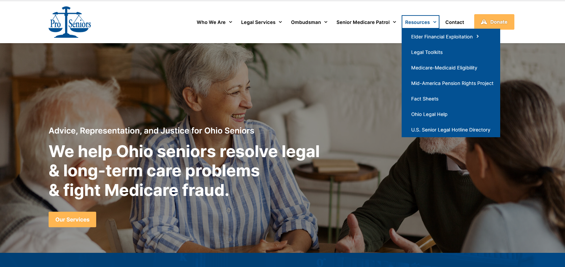
www.ProSeniors.org Resources Medicare-Medicaid Eligibility
Notes:
- For financial eligibility factors, there are a lot of numbers involved, Pro Seniors’ website keeps track of those numbers.

Slide 7
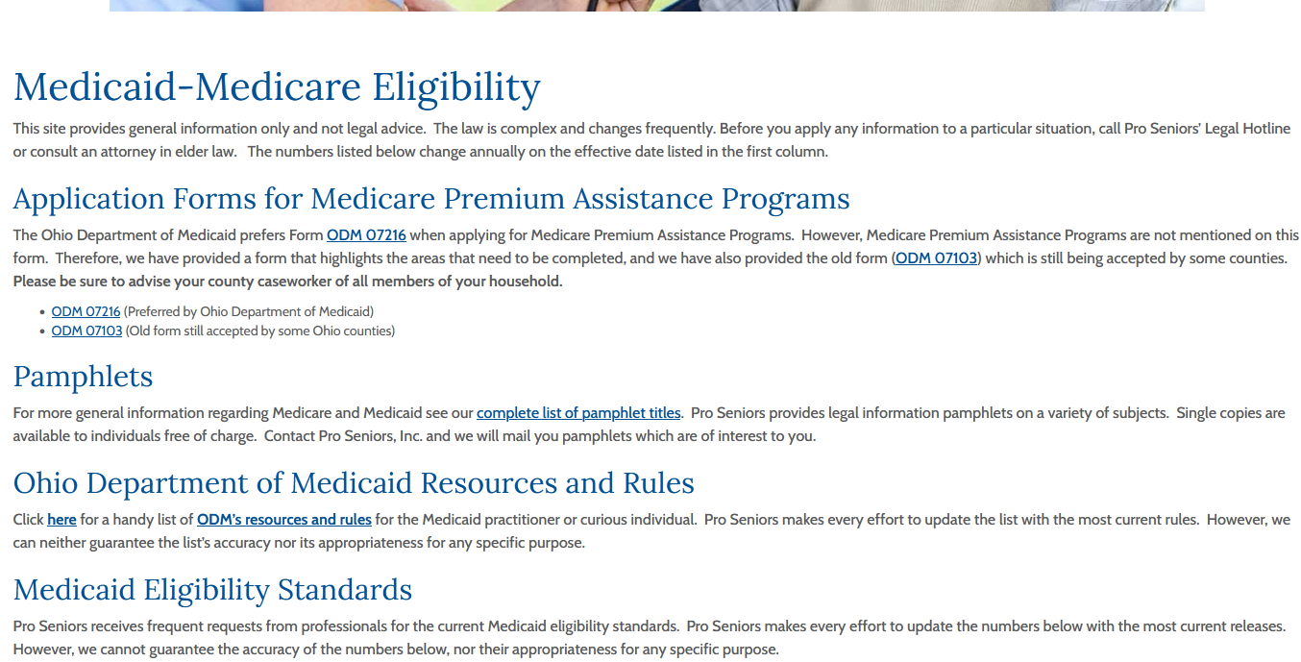
www.ProSeniors.org ODM’s Resources & Rules

Slide 8
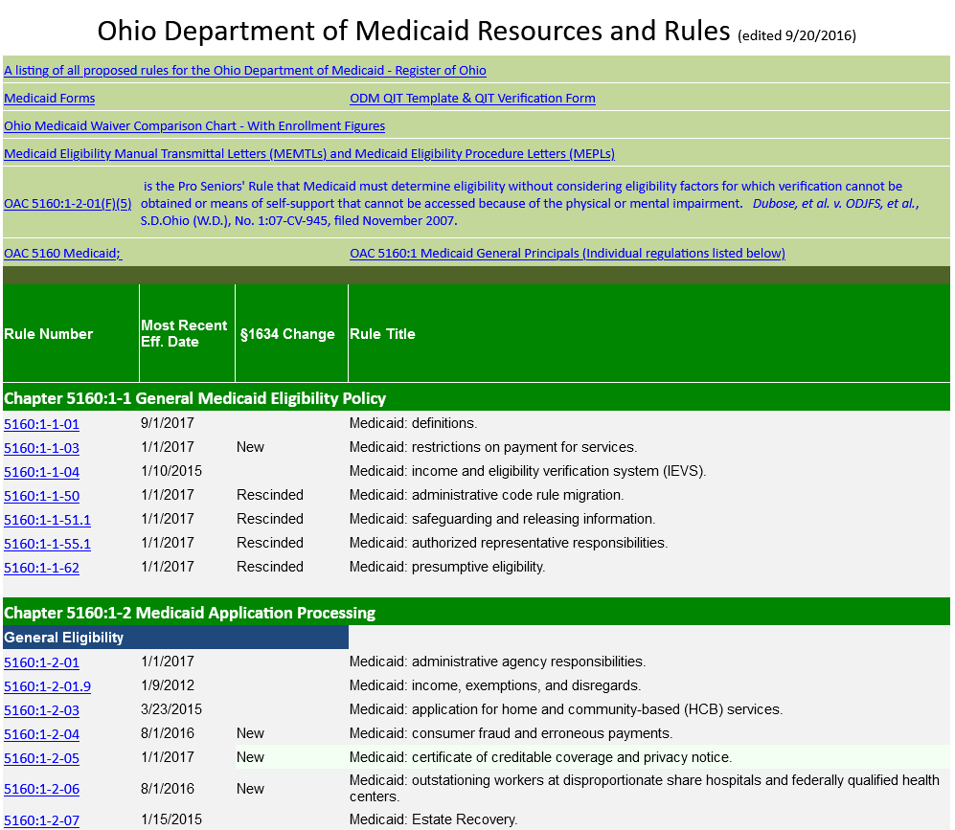

Slide 9
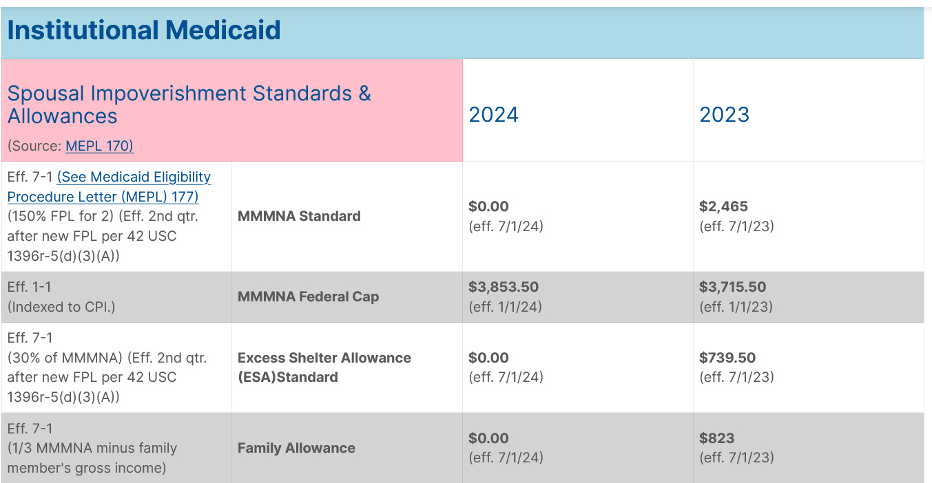
Notes:
- These numbers often change annually at different times of the year

Slide 10
Medicaid Terminology
Medicaid Applicant – is the person applying for Medicaid.
IS – is the Institutionalized Spouse of a married couple.
CS – is the Community Spouse of a married couple.

Slide 11
Financial Eligibility
The IS must meet financial thresholds to qualify for Institutional Medicaid.
Income Eligible
Resource Eligible
Notes:
Institutional Medicaid is something more and more people will need as the population ages
Many applicants may have never encountered applying for public benefits before, as even for those with large savings, institutional Medicaid is more likely to be needed
Income eligibility used to be less of a concern before the 1634 conversion in 2016, when applicants could use medical bills to spend down their income to qualify

Slide 12
What is Income?
1) Income is cash, in-kind income, or something of value which is received, available, and attributable to an individual.
2) Income includes earned income and unearned income.
3) Earned income consists of wages and net earnings from employment or self-employment.
Notes:
OAC 5160:1-1-01 Medicaid Definitions

Slide 13
Unearned Income
1) Unearned income is all income that is not wages or net earnings from self-employment. All income which does not meet the definition of earned income is unearned income.
2) The IS must actually receive the payment in order to have it counted as income.
3) However, if receipt is deferred, it will be counted in the month it could have been received.
Notes:
OAC 5160:1-1-01 Medicaid Definitions
OAC 5160:1-3-03.1 Medicaid: income

Slide 14
Potential Income
1) The IS must pursue collection of all potential income.
2) The reason for the IS’s failure to pursue income is presumed to be that s/he wants to make herself/himself eligible for medical assistance.
Notes:
Medicaid is a large portion of the state budget, rules are aimed at reducing costs by making sure each beneficiary is paying as much as they can for their own care
OAC 5160:1-3-03.1(D) Medicaid: income
If don’t pursue potential income, constitutes income ineligibility unless good cause is shown

Slide 15
Retirement Funds As Income
It is unearned income if the individual can receive regular guaranteed lifetime payments (see MEPL 164 for details on IRAs)
Must apply for all such benefits when available
Must maximize benefits – must request CS to waive joint and survivor benefit (ERISA problems)
CS Just Say NO
Must document CS’s refusal
Notes:
Required Minimum Distributions
Employment Retirement Income Security Act
OAC 5160:1-3-03.10 Medicaid: retirement funds
For IRAs, regular, periodic payments are key if don’t have a required minimum distribution under MEPL 164

Slide 16
Income Eligibility
The IS’s countable income must be at or below the special income level of 300% of SSI ($2,829 in 2024). Medical expenses can no longer be deducted to meet the special income level to become Medicaid income eligible.
The CS’s income is not included in this calculation.
Notes:
Since the 1634 conversion, Medicaid’s financial eligibility mirrors that of SSI
SSI, the Supplemental Security Income program, is another needs based program that pays cash to people whose income are below a certain threshold. The point of the program is to help them afford basic necessities.

Slide 17
Income Exclusions - Eligibility
A list of Income Exclusions for income eligibility are at OAC 5160:1-3-03.2(D), (like HUD housing subsidies, German Reparations, Japanese reparations, Student grants, Earners income tax credit, in-kind gifts not converted to cash, the first two thousand dollars of any cash gifts within a calendar year);
The most common exclusion is a general disregard of $20 and $65 earned income.

Slide 18
Income exclusions from the SIL
In addition, when looking at the special income level there are further income exclusions at OAC 5160:1-6-03.1(H).
The main additional income exclusion is VA aid and attendance benefits.
Notes:
- VA aid and attendance benefits are additional benefits on top of pension or compensation benefits a veteran may be receiving.

Slide 19
Income eligibility example
Susie Smith enters a nursing facility on February 1, 2024. Susie is married to Sam who continues to live at home. Susie receives $2560 Social Security and $1000 in a GE pension.
Sam receives $1250 in Social Security. They have a $25,000 mortgage on the home which has a mortgage payment of $550 per month. Their real estate taxes are $1200/6 months. Home owner’s insurance is $720/year ($60/mo). Susie has a Medicare supplemental policy which costs $250/month.
Notes:
First paragraph:
Is the Social Security income countable? Yes
Is the GE pension income countable? Yes
Is Susie Smith income eligible? No, over the rate of 2,742
What if only receives 1,000 GE Pension? Yes
Second paragraph:
Is Sam’s income considered as part of Susie’s Medicaid eligibility? No
Are any of these expenses relevant in Susie’s income eligibility for institutional Medicaid? No, no more spend down for medical expenses and more relevant to patient liability

Slide 20
Qualified Income Trust
Individuals receiving long-term care services with an income over 300% SSI ($2,829 in 2024) can only become eligible for Medicaid by depositing excess income into a Qualified Income Trust (QIT), a.k.a. a Miller Trust. Miller v. Ibarra, 746 F. Supp. 19 (D. Colo. 1990) and is specifically sanctioned by Congress in 42 U.S.C. § 1396p(d)(4)(B).

Slide 21

What is a Qualified Income Trust
A special legal arrangement to disregard a portion of an individual’s income.
The individual, the guardian of their estate or their Financial POA, if authorized, may open a Qualified Income Trust.
Cannot contain spousal / family resources
Must be Irrevocable
Must be signed and name the State as residuary beneficiary
Can contain only the individual’s income
Must be used for income only & cannot shield other assets
Key characteristics that make a Qualified Income Trust unique.
Allows resources to be recovered by the State
Notes:
By depositing the excess income into the QIT, the income no longer is counted as income for Medicaid purposes, and the beneficiary becomes income eligible
Would Susie be able to be eligible for Medicaid for October if she still doesn’t have QIT set up?
Requirement for QITs has lead to difficulty for many applicants in qualify for Medicaid
Need to find bank to do QIT
May not have anyone who can be trustee
Need to set up process by which income can be deposited and taken out each month
Need to stay on top of as numbers change from year to year
Delays in qualifying for Medicaid as wait for banks to process QIT

Slide 22
Qualified Income Trust
Income irrevocably transferred to a Miller or Qualified Income Trust (QIT) is not countable for Medicaid income eligibility purposes only.
A QIT can only be used for Institutional Medicaid eligibility, which includes HCBS waiver programs.
Form is located at:
https://medicaid.ohio.gov/families-and-individuals/citizen-programs-and-initiatives/qit-template
Notes:
Common issues with establishing or maintaining QIT:
Applicant has no POA and is disabled
Finding bank that will establish QIT
Setting up auto-deposit system
Applicant not having any trustees for their QIT
Applicant initially funding QIT, then losing ability to handle finances with no one to take over
Applicant is unable to sign for QIT and has no POA

Slide 23
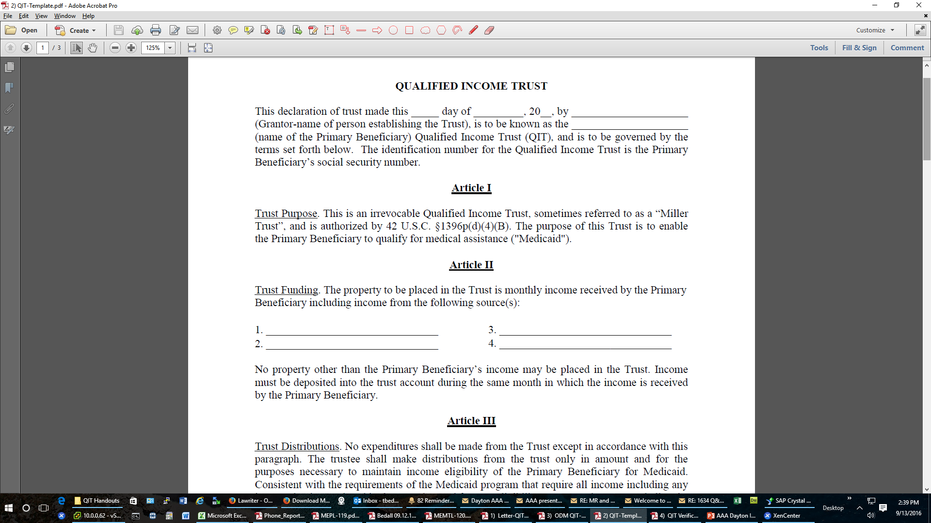
Qualified Income Trust

Slide 24
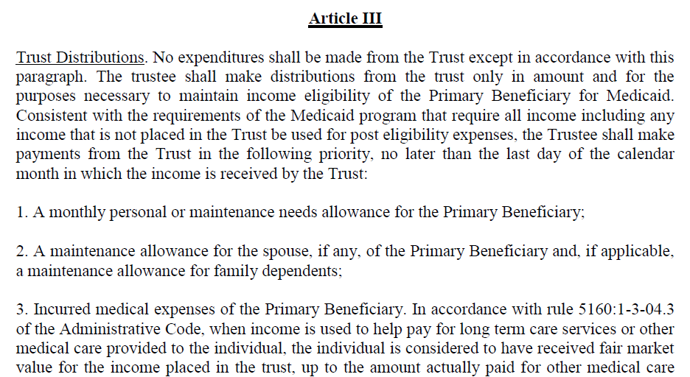
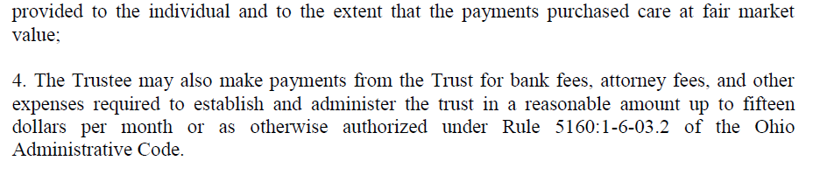
Qualified Income Trust

Slide 25
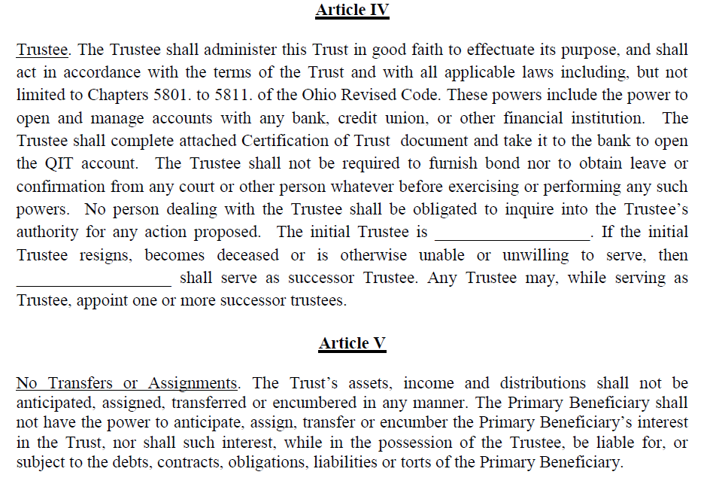
Qualified Income Trust

Slide 26
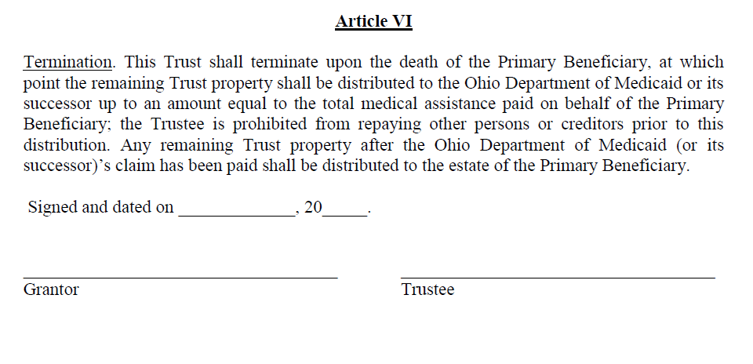
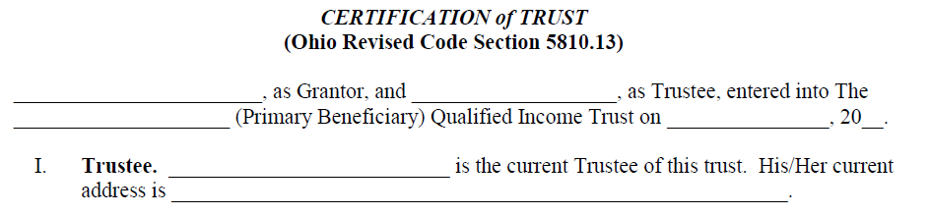
Qualified Income Trust

Slide 27
QIT verification
You must fill out a verification form once the QIT account is established. ODM form 10193
https://medicaid.ohio.gov/static/Resources/Publications/Forms/ODM10193fillx.pdf

Slide 28
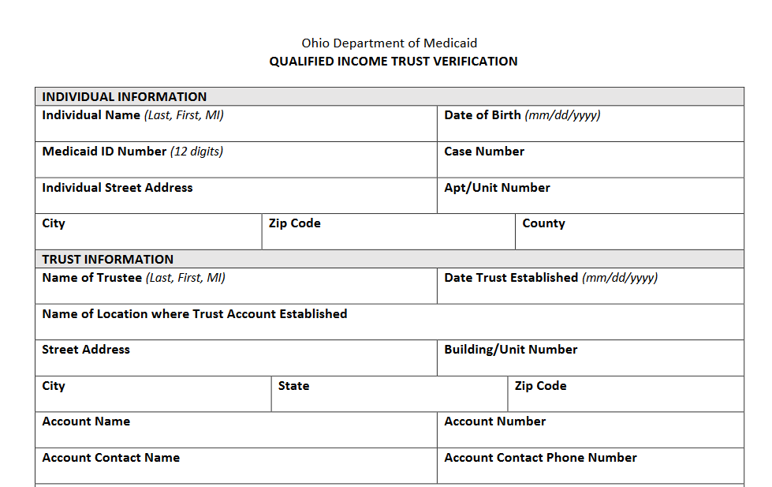
QIT verification

Slide 29
QIT Process
Individual creates a QIT by filling out the QIT trust form.
Individual opens a QIT bank account for deposits into the trust account
Trust bank account information is provided to county JFS office for eligibility processing
Individuals make monthly auto-deposits into and out of their QIT bank account
$15 deduction from income allowed for monthly trust account cost
State monitors Trust transactions at annual renewal
Notes:
Auto-deposits may not always be available (for example if client has two separate banks, one for regular checking and one for QIT)
Nursing facilities oftentimes are able to set up Qualified Income Trust accounts themselves if can’t find bank

Slide 30
QIT and Patient Liability
A QIT affects institutional Medicaid eligibility only.
Patient Liability calculations are determined post-eligibility and have not changed.
The income deposited into the QIT bank account is still income for all post-eligibility budgeting including Patient Liability.

Slide 31
Example of QIT
Susie Smith enters a nursing facility on February 1, 2024. Susie is married to Sam who continues to live at home. Susie receives $2560 Social Security and $1000 in a GE pension.
Sam receives $1250 in Social Security. They have a $25,000 mortgage on the home which has a mortgage payment of $550 per month. Their real estate taxes are $1200/6 months. Home owner’s insurance is $720/year ($60/mo). Susie has a Medicare supplemental policy which costs $250/month.

Slide 32
POLL QUESTION # 1

Slide 33
For income eligibility, only looking at Susie’s income which is $3560 per month.
To be income eligible is Susie’s income above $ 2829 per month? Yes, how much over the income limit? $731.
Does Susie have to deposit all of her income into the QIT trust?
No only enough to reduce her income below $2829.
Remember the income number is gross before deductions for Medicare premiums.
Good practice- deposit some extra to account for COLAs

Slide 34
POST ELIGIBILITY INCOME CALCULATIONS

Slide 35
Post Eligibility Income Calculations
Applicant with QIT not eligible until QIT in place and funded. (No retroactive coverage).
Once applicant is income eligible, then consider income to determine patient liability.

Slide 36
Income Exclusions- patient liability
German reparation payments, Austrian social insurance payments, and Netherlands reparation payments
Japanese and Aleutian restitution payments
Agent Orange settlement payments
Radiation exposure compensation payments
VA pensions up to ninety dollars per month, paid to veterans in a nursing facility or on HCBS Waiver. This reduced pension applies to the following:
A veteran without a spouse or child; and
A veteran's surviving spouse without a child.
SSI benefits, for institutionalized individuals, during the first three full months of institutionalization.
RSS benefits to institutionalized individuals
Victims of Crime payments
OAC 5160:1-6-07(G)(2)
Notes:
- RSS, Residential State Supplement, financial assistance to person’s with disabilities

Slide 37
Veteran’s Income
VA pension is based on financial need and is a benefit for Veterans or their spouses.
If Veteran or spouse enters a nursing facility, VA pension should be reduced to $90 per month.
Regardless of whether, or when, the VA pension is reduced, the first $90 of the VA pension is not income.
Notes:
- This exclusion for VA pension for patient liability is different from the exclusion for VA aid and attendance benefits for initial income eligibility.

Slide 38
Deductions to Income
Generally, gross income is counted
Examples of deductions not allowed:
Court ordered child or spousal support
Other court ordered deductions
Taxes withheld
Garnishment orders
Notes:
Beneficiary may need to go to court to ask for modification of order in such cases.
OAC 5160:1-3-03.1(C) Medicaid: income

Slide 39
How to calculate Patient Liability?
Gross Income
Minus excluded income
Minus PNA (Personal Needs Allowance) ($50, SIMNA(PASSPORT) or ALMNA(Assisted Living Waiver))
Minus MIA for Community Spouse
Minus FA or FMNA for dependent family members
Minus Health Insurance Premiums, copayments, deductible and co-insurance for IS, CS, and IS’ minor or disabled child
Minus Past Unpaid Medical Expenses
Minus QIT bank fees of up to $15 per month
= Patient Liability
Notes:
Good idea to estimate patient liability during application for Medicaid so estimated patient liability can be paid to the facility until eligibility is established.
FA = family allowance FMNA = Family maintenance needs allowance
OAC 5160:1-6-07 Medicaid: post-eligibility treatment of income for individuals in medical institutions
OAC 5160:1-6-07.1 Medicaid: post-eligibility treatment of income for individuals receiving services through a home and community-based services (HCBS) waiver or the program of all-inclusive care for the elderly (PACE)
SIMNA = Special Individual Maintenance Needs Allowance
ALMNA = Assisted Living Maintenance Needs Allowance

Slide 40
Unpaid Past Medical Expenses (UPME) a.k.a. (Act 52)
UPME will be applied to the patient liability first before calculating payment to the nursing facility
Client chooses which months to apply the UPME to the patient liability
Notes:
For example, beneficiary with 12,000 medical bill and 1,000 patient liability can have patient liability reduced to 0 for one year while using the money to pay off the bill.
Cannot pay back missed patient liability payments

Slide 41
Monthly Income Allowance (MIA)
MMMNA standard of $2,465 (7/1/23)
Add Excess Shelter Allowance (ESA)
Compare to MMMNA cap of $3,858.50 (eff. 1/1/24) and use the smaller. If actual is higher can request an administrative hearing for extraordinary circumstances.
Then subtract CS’s income
= MIA
Notes:
Amount that CS can keep to not be impoverished.
Excess Shelter Allowance has its own calculation. Taking into account cost of housing for CS.

Slide 42
Excess Shelter Allowance (ESA)
Total CS’ expenses for principal residence (mortgage, rent, property taxes, homeowner’s insurance, HOA fees, etc.)
Add standard Utility Allowance $724 (eff. 10/1/23) if spouse pays for gas, electric, coal, wood, oil, water, sewage, or telephone service for the residence
Subtract the ESA standard of $739.50 (eff. 7/1/23)
= ESA
Notes:
Needed to calculate MIA
Takes into account cost of the housing for the community spouse
OAC 5160:1-6-07

Slide 43
Post eligibility income example
Susie Smith enters a nursing facility on February 1, 2024. Susie is married to Sam who continues to live at home. Susie receives $2560 Social Security and $1000 in a GE pension.
Sam receives $1250 in Social Security. They have a $25,000 mortgage on the home which has a mortgage payment of $550 per month. Their real estate taxes are $1200/6 months. Homeowner’s insurance cost $720/year ($60/mo). Susie has a Medicare supplemental policy which costs $250/month.
Notes:
Using same scenario as before for example of how to calculate patient liability.

Slide 44
How to calculate Patient Liability?
Gross Income
Minus excluded income
Minus PNA (Personal Needs Allowance) ($50, SIMNA(PASSPORT) or ALMNA(Assisted Living Waiver))
Minus MIA for Community Spouse
Minus FA or FMNA for dependent family members
Minus Health Insurance Premiums, copayments, deductible and co-insurance for IS, CS, and IS’ minor or disabled child
Minus Past Unpaid Medical Expenses
Minus QIT bank fees of up to $15 per month
= Patient Liability
Notes:
Good idea to estimate patient liability during application for Medicaid so estimated patient liability can be paid to the facility until eligibility is established.
FA = family allowance FMNA = Family maintenance needs allowance
OAC 5160:1-6-07 Medicaid: post-eligibility treatment of income for individuals in medical institutions
OAC 5160:1-6-07.1 Medicaid: post-eligibility treatment of income for individuals receiving services through a home and community-based services (HCBS) waiver or the program of all-inclusive care for the elderly (PACE)
SIMNA = Special Individual Maintenance Needs Allowance
ALMNA = Assisted Living Maintenance Needs Allowance

Slide 45
Monthly Income Allowance (MIA)
MMMNA standard of $2,465 (7/1/23)
Add Excess Shelter Allowance (ESA)
Compare to MMMNA cap of $3,858.50 (eff. 1/1/24) and use the smaller. If actual is higher can request an administrative hearing for extraordinary circumstances.
Then subtract CS’s income
= MIA
Notes:
Amount that CS can keep to not be impoverished.
Excess Shelter Allowance has its own calculation. Taking into account cost of housing for CS.

Slide 46
Excess Shelter Allowance (ESA)
Total CS’ expenses for principal residence (mortgage, rent, property taxes, homeowner’s insurance, HOA fees, etc.)
Add standard Utility Allowance $724 (eff. 10/1/23) if spouse pays for gas, electric, coal, wood, oil, water, sewage, or telephone service for the residence
Subtract the ESA standard of $739.50 (eff. 7/1/23)
= ESA
Notes:
Needed to calculate MIA
Takes into account cost of the housing for the community spouse
OAC 5160:1-6-07

Slide 47
Excess Shelter Allowance Example
Mortgage $ 550
Real estate taxes $ 200
Insurance $ 60
Total Shelter cost $ 810
(Plus) Utility Allowance $ 724
$ 1,534
(Less) Excess Shelter Allowance Std. $(739.50)
Excess Shelter Allowance $ 794.50

Slide 48
Monthly Income Allowance Example
(Plus) Excess Shelter Allowance $794.50
Minimum Monthly Maintenance Needs Allowance (MMMNA) Standard $2,465.00
MMMNA(Capped at $3,853.50(eff. 1/1/24))$3,259.50
(Minus) CS’ Income $(1,250.00)
Monthly Income Allowance (MIA) $2,009.50

Slide 49
Patient Liability Example
IS’ Gross Countable Income $ 3,560.00
(Minus) Bank Fee for QIT account $ (15.00) (Minus) Personal Needs Allowance (PNA) $ (50.00) IS’ Available Net Income $ 3,495.00
(Minus) MedSupp Insurance Premium $ (250.00)
(Minus) MIA $ (2,009.50) Patient Liability $ 1,235.50

Slide 50
PASSPORT
What if Susie is applying for PASSPORT Medicaid, how does this change the analysis?
Does she need a QIT for income eligibility?
How is the patient liability calculated?

Slide 51
PASSPORT income eligibility
Income eligibility for PASSPORT is the same as for nursing home Medicaid.
Therefore, to be income eligible the applicant’s income must be below 300% of SSI. If not, a QIT must be used to qualify for PASSPORT services.

Slide 52
PASSPORT patient liability
Calculating the applicant’s cost sharing obligations for PASSPORT is the same as patient liability calculations for nursing home Medicaid, with the only difference being the PNA for a PASSPORT recipient is $1839/month (eff. 1/1/2024)

Slide 53
Susie Smith applies for PASSPORT on February 1, 2024. Susie is married to Sam who continues to live at home. Susie receives $2560 Social Security and $1000 in a GE pension.
Sam receives $1250 in Social Security. They have a $25,000 mortgage on the home which has a mortgage payment of $550 per month. Their real estate taxes are $1200/6 months. Homeowner’s insurance cost $720/year ($60/mo). Susie has a Medicare supplemental policy which costs $250/month.

Slide 54
How to calculate Patient Liability?
Gross Income
Minus excluded income
Minus PNA (Personal Needs Allowance) ($50, SIMNA(PASSPORT) or ALMNA(Assisted Living Waiver))
Minus MIA for Community Spouse
Minus FA or FMNA for dependent family members
Minus Health Insurance Premiums, copayments, deductible and co-insurance for IS, CS, and IS’ minor or disabled child
Minus Past Unpaid Medical Expenses
Minus QIT bank fees of up to $15 per month
= Patient Liability
Notes:
Good idea to estimate patient liability during application for Medicaid so estimated patient liability can be paid to the facility until eligibility is established.
FA = family allowance FMNA = Family maintenance needs allowance
OAC 5160:1-6-07 Medicaid: post-eligibility treatment of income for individuals in medical institutions
OAC 5160:1-6-07.1 Medicaid: post-eligibility treatment of income for individuals receiving services through a home and community-based services (HCBS) waiver or the program of all-inclusive care for the elderly (PACE)
SIMNA = Special Individual Maintenance Needs Allowance
ALMNA = Assisted Living Maintenance Needs Allowance

Slide 55
Monthly Income Allowance (MIA)
MMMNA standard of $2,465 (7/1/23)
Add Excess Shelter Allowance (ESA)
Compare to MMMNA cap of $3,858.50 (eff. 1/1/24) and use the smaller. If actual is higher can request an administrative hearing for extraordinary circumstances.
Then subtract CS’s income
= MIA
Notes:
Amount that CS can keep to not be impoverished.
Excess Shelter Allowance has its own calculation. Taking into account cost of housing for CS.

Slide 56
Excess Shelter Allowance (ESA)
Total CS’ expenses for principal residence (mortgage, rent, property taxes, homeowner’s insurance, HOA fees, etc.)
Add standard Utility Allowance $724 (eff. 10/1/23) if spouse pays for gas, electric, coal, wood, oil, water, sewage, or telephone service for the residence
Subtract the ESA standard of $739.50 (eff. 7/1/23)
= ESA
Notes:
Needed to calculate MIA
Takes into account cost of the housing for the community spouse
OAC 5160:1-6-07

Slide 57
Excess Shelter Allowance Example
Mortgage $ 550
Real estate taxes $ 200
Insurance $ 60
Total Shelter cost $ 810
(Plus) Utility Allowance $ 724
$ 1,534
(Less) Excess Shelter Allowance Std. $(739.50)
Excess Shelter Allowance $ 794.50

Slide 58
Monthly Income Allowance Example
(Plus) Excess Shelter Allowance $794.50
Minimum Monthly Maintenance Needs Allowance (MMMNA) Standard $2,465.00
MMMNA(Capped at $3,853.50(eff. 1/1/24))$3,259.50
(Minus) CS’ Income $(1,250.00)
Monthly Income Allowance (MIA) $2,009.50

Slide 59
PASSPORT Cost sharing Example
IS’ Gross Countable Income $ 3,560.00
(Minus) Bank Fee for QIT account $ (15.00) (Minus) Personal Needs Allowance (SIMNA) $ (1839.00) IS’ Available Net Income $ 1,706.00
(Minus) MedSupp Insurance Premium $ (250.00)
(Minus) MIA $ (2,009.50) Recipient’s share of cost $ 0.00

Slide 60
PASSPORT LIMITS
Note however that PASSPORT has a cost cap on services to be provided of $14,700. If the cost of care is higher than the cap, the individual will be denied enrollment. OAC 5160-31-03(A)(2).

Slide 61
Assisted Living Waiver
Similar to PASSPORT, ALW is an HCBS waiver program. Therefore, its income eligibility will be the same as nursing home Medicaid.
Similarly, the patient liability will also be calculated the same, except for the PNA + Room and Board.
Because Medicaid does not pay for room and board, there is an allowance from the recipient’s income for these costs, which is allowed at the SSI rate -$50.00
OAC 5160:1-6-07.1

Slide 62
Susie Smith enters an assisted living facility and applies for the ALW waiver on February 1, 2024. Susie is married to Sam who continues to live at home. Susie receives $2560 Social Security and $1000 in a GE pension.
Sam receives $1250 in Social Security. They have a $25,000 mortgage on the home which has a mortgage payment of $550 per month. Their real estate taxes are $1200/6 months. Homeowner’s insurance cost $720/year ($60/mo). Susie has a Medicare supplemental policy which costs $250/month.

Slide 63
How to calculate Patient Liability?
Gross Income
Minus excluded income
Minus PNA (Personal Needs Allowance) ($50, SIMNA(PASSPORT) or ALMNA(Assisted Living Waiver))
Minus MIA for Community Spouse
Minus FA or FMNA for dependent family members
Minus Health Insurance Premiums, copayments, deductible and co-insurance for IS, CS, and IS’ minor or disabled child
Minus Past Unpaid Medical Expenses
Minus QIT bank fees of up to $15 per month
= Patient Liability
Notes:
Good idea to estimate patient liability during application for Medicaid so estimated patient liability can be paid to the facility until eligibility is established.
FA = family allowance FMNA = Family maintenance needs allowance
OAC 5160:1-6-07 Medicaid: post-eligibility treatment of income for individuals in medical institutions
OAC 5160:1-6-07.1 Medicaid: post-eligibility treatment of income for individuals receiving services through a home and community-based services (HCBS) waiver or the program of all-inclusive care for the elderly (PACE)
SIMNA = Special Individual Maintenance Needs Allowance
ALMNA = Assisted Living Maintenance Needs Allowance

Slide 64
Monthly Income Allowance (MIA)
MMMNA standard of $2,465 (7/1/23)
Add Excess Shelter Allowance (ESA)
Compare to MMMNA cap of $3,858.50 (eff. 1/1/24) and use the smaller. If actual is higher can request an administrative hearing for extraordinary circumstances.
Then subtract CS’s income
= MIA
Notes:
Amount that CS can keep to not be impoverished.
Excess Shelter Allowance has its own calculation. Taking into account cost of housing for CS.

Slide 65
Excess Shelter Allowance (ESA)
Total CS’ expenses for principal residence (mortgage, rent, property taxes, homeowner’s insurance, HOA fees, etc.)
Add standard Utility Allowance $724 (eff. 10/1/23) if spouse pays for gas, electric, coal, wood, oil, water, sewage, or telephone service for the residence
Subtract the ESA standard of $739.50 (eff. 7/1/23)
= ESA
Notes:
Needed to calculate MIA
Takes into account cost of the housing for the community spouse
OAC 5160:1-6-07

Slide 66
Excess Shelter Allowance Example
Mortgage $ 550
Real estate taxes $ 200
Insurance $ 60
Total Shelter cost $ 810
(Plus) Utility Allowance $ 724
$ 1,534
(Less) Excess Shelter Allowance Std. $(739.50)
Excess Shelter Allowance $ 794.50

Slide 67
Monthly Income Allowance Example
(Plus) Excess Shelter Allowance $794.50
Minimum Monthly Maintenance Needs Allowance (MMMNA) Standard $2,465.00
MMMNA(Capped at $3,853.50(eff. 1/1/24))$3,259.50
(Minus) CS’ Income $(1,250.00)
Monthly Income Allowance (MIA) $2,009.50

Slide 68
Assisted Living patient liability
IS’ Gross Countable Income $ 3,560.00
(Minus) Bank Fee for QIT account $ (15.00) (Minus) Personal Needs Allowance (ALMNA) $ (943.00) IS’ Available Net Income $ 2,602.00 (Minus) MedSupp Insurance Premium $ (250.00)
(Minus) MIA $ (2,009.50) Patient liability $ 343.00
Plus room and board $ 893.00
Amount owed to the facility $1,236.00

Slide 69
Medicare Premium Assistance
MPAP programs provide for payment of Medicare premiums (SLMB and Q-I for up to 135% of FPL) and, for incomes up to 100% of FPL, payment of Medicare co-pays and deductibles. (QMB)
Compare the income of the individual and spouse to the FPL for the family size, which includes spouse and dependent minor children.
Notes:
- Reminder for people who don’t qualify for Medicaid to look into this or for CS to look into.

Slide 70
Financial Eligibility
The IS must meet financial thresholds to qualify.
Income Eligible
Resource Eligible
Notes:
Questions about income eligibility before we continue?

Slide 71
Resource Eligibility
Resource Assessment, then
Resource Allocation, if applicant is married
Resource Spend-Down, if resources allocated to the IS exceed $2,000
Resource Eligible once resources allocated to the IS are equal to or less than $2,000
Notes:
OAC 5160:1-3-05.1(B)(9) Medicaid: resource requirement

Slide 72
Resource Assessment, Resource Allocation & Resource Spend-Down
1. Determine Snapshot Date; Begin Resource Assessment
2. List All Resources
3. Determine Excluded Resources
4. Determine Non-Accessible Resources
5. Finalize Resource Assessment
6. Resource Allocation For Married Applicant
7. Spend-Down to $2,000
8. Medicaid Eligible

Slide 73
1. Determine Snapshot Date; Begin Resource Assessment
Resource Assessment – OAC 5160:1-6-04
"Resource assessment" means the process where the resources of both the IS and the CS are assessed to determine the couple's total countable resources existing at the beginning of the first continuous period of institutionalization.
Only one resource assessment is completed per individual regardless of how often an individual has been institutionalized or has applied for Medicaid.

Slide 74
1. Determine Snapshot Date; Begin Resource Assessment
Resource Assessment – OAC 5160:1-6-04
However ODM only accepts the date of first period of continuous institutionalization from another state and not the resource assessment. A new Ohio resource assessment must be completed when the IS moves to Ohio.
Prenuptial and similar agreements shall be disregarded when conducting a resource assessment.

Slide 75
1. Determine Snapshot Date; Begin Resource Assessment
Resource Assessment – OAC 5160:1-6-04(E)(5)(a)
“Snapshot Date”: (i) The first day of the month in which the IS was in a medical institution for a continuous period of institutionalization; (ii) The first day of the month in which IS is expected to be in a medical institution for a continuous period of institutionalization; or (iii) The day that the IS applied for or requested HCBS services, so long as the IS meets the non-financial requirements to receive such services.

Slide 76
1. Determine Snapshot Date; Begin Resource Assessment
Resource Assessment – OAC 5160:1-6-04
Example: Joe is admitted to a NF February 1, 2022. Joe is married and the CS private pays for two years. As their savings dwindle, CS becomes concerned and applies for Medicaid on February 1, 2024. What is the Snapshot date?

Slide 77
POLL QUESTION #2

Slide 78
Resource Assessment, Allocation and Spend-Down
1. Determine Snapshot Date; Begin Resource Assessment
2. List All Resources
3. Determine Excluded Resources
4. Determine Non-Accessible Resources
5. Finalize Resource Assessment
6. Resource Allocation For Married Applicant
7. Spend-Down to $2,000
8. Medicaid Eligible

Slide 79
2. List All Resources
List All Resources
Resources are funds held within a financial institution, investments, personal property, and real property an individual and/or the individual's spouse has an ownership interest in, has the legal ability to access in order to convert to cash, and is not legally prohibited from using for support and maintenance.
Countable resources is everything that remains after all exclusions have been applied.
Notes:
OAC 5160:1-1-01(B)(82)

Slide 80
2. List All Resources
Retirement Funds as Resources – OAC 5160:1-3-03.10(D)(2)
If the Retirement fund is determined not to be income, then it is considered a resource. It is a countable resource if the IS or CS has an ownership interest in the fund and the legal ability to access in order to convert it to cash.

Slide 81
2. List All Resources
Retirement funds include:
public and private pension, disability, or retirement plans;
defined benefit employer pension plans,
profit sharing pension plans, 403(b) pension plans, money purchase pension plans, employee stock ownership plans,
individual retirement accounts (IRA); KEOGH pension plans, Roth IRAs, simplified employee pension plans (SEP-IRA), and 401k pension plans;
or any other retirement plans.
Notes:
- OAC 5160:1-3-03.10(B) Medicaid: retirement funds

Slide 82
Resource Assessment, Allocation and Spend-Down
1. Determine Snapshot Date; Begin Resource Assessment
2. List All Resources
3. Determine Excluded Resources
4. Determine Non-Accessible Resources
5. Finalize Resource Assessment
6. Resource Allocation For Married Applicant
7. Spend-Down to $2,000
8. Medicaid Resource
Eligible

Slide 83
3. Determine Excluded Resources
Excluded Resources – OAC 5160:1-3-05.14(B): Resource exclusions for the resource assessment are:
One automobile
Regardless of value so long as used by the IS or a member of the household for transportation
If there is a CS, regardless of value or use.
See OAC 5160:1-3-05.11
Household goods and personal effects
Notes:
OAC § 5160:1-3-05.14(B)(2)(a) – household goods

Slide 84
3. Determine Excluded Resources
Burial Space Exclusion– OAC 5160:1-3-05.7:
The value of any burial space for the individual, spouse, or any other member of the immediate family is excluded.
"Burial space", means a burial plot, gravesite, crypt, mausoleum, casket, urn, niche. The term also includes a contract for care and maintenance of the gravesite and reasonable improvements, including but not limited to vaults, headstones, markers, or plaques, burial containers (e.g., for caskets) and arrangements for the opening and closing of the gravesite.

Slide 85
3. Determine Excluded Resources
Burial Space Exclusion – OAC 5160:1-3-05.7:
An individual's immediate family includes his parents, including adoptive parents, minor or adult children, including adoptive and stepchildren, siblings, including adoptive and stepsiblings and the spouses of the immediate family members.
"Agreement", for the purpose of this rule, means a contract with a burial provider for a burial space held for the eligible individual or a member of his/her immediate family. See RC 1721.211 – Preneed cemetery merchandise and services contract.

Slide 86
3. Determine Excluded Resources
Prepaid Burial Contracts– OAC 5160:1-3-05.6:
Irrevocable prepaid burial contracts for IS & CS are excluded.
The ownership of a life insurance policy must be irrevocably transferred to a provider of funeral services for the specific use as an irrevocable prepaid burial contract for the individual and/or spouse to be excluded.

Slide 87
3. Determine Excluded Resources
Burial Funds – OAC 5160:1-3-05.6(C):
Up to $1,500 each for the IS & CS can be excluded in burial funds:
Irrevocable prepaid burial contracts are independent exclusions.
Revocable prepaid burial & burial space contracts are treated as burial funds.
Burial funds must be clearly designated for the IS or CS’s burial and must be kept separate from non-burial-related assets in order to be excluded.
Burial funds expenses are generally those related to preparing a body for burial and any services prior to burial to include transportation of the body, embalming, cremation, flowers, clothing, services of the funeral director and staff, etc. These overlap with prepaid burial contracts.

Slide 88
3. Determine Excluded Resources
Life Insurance – OAC 5160:1-3-05.12:
The total Cash Surrender Value (CSV) of all life insurance policies for an individual is excluded if the total face value of the policies is equal to or less than $1,500. (C)(1)
If the total face value of all life insurance policies for any one individual is more than $1,500, then the total CSV of all the policies for that individual is counted toward the applicable resource limit.

Slide 89
3. Determine Excluded Resources
Life Insurance – OAC 5160:1-3-05.12:
Life insurance dividend accumulations are now countable as a resource.

Slide 90
3. Determine Excluded Resources
The Home – OAC 5160:1-3-05.13:
“Home” includes any appertaining property an individual has an ownership interest in and is the individual's principal place of residence.
“Principal place of residence” means the dwelling the individual considers her principal home to which, if absent, she intends to return and can be real or personal property, fixed or mobile, and located on land or water.

Slide 91
3. Determine Excluded Resources
The Home – OAC 5160:1-3-05.13:
Only one place can be the principal place of residence.
A temporary absence from the home is not a problem so long as the individual has not established permanent residence elsewhere.
The CDJFS must obtain a signed statement, declaring the principal place of residence, if the individual resides in more than one place.

Slide 92
3. Determine Excluded Resources
The Home – OAC 5160:1-3-05.13:
The value of the home is excluded if:
It is the principal place of residence of the IS or CS, or another specified family member; and
The deed to the home is in the name of the IS or CS or a revocable (living) trust for either

Slide 93
3. Determine Excluded Resources
The Home – OAC 5160:1-3-05.13:
The home is no longer considered to be the IS’s principal place of residence if the IS does not intend to return to the home.
The IS must provide a (non-self-contradictory) signed statement of his or her intention to return to the home and cannot have established permanent residence elsewhere. See, Anna W. v. Bane, 863 F.Supp. 125 (W.D. NY. 1993).

Slide 94
3. Determine Excluded Resources
The Home – OAC 5160:1-3-05.13:
Is moving into Assisted Living establishing permanent residence elsewhere?
If the IS does not intend to return home, the home is still not a countable resource if a spouse or dependent relative of the IS continues to live there.
Dependency may be of any kind (e.g. financial, medical, etc.).

Slide 95
3. Determine Excluded Resources
The Home – OAC 5160:1-3-05.13:
“Relative” means
Child, stepchild, or grandchild; parent, stepparent, or grandparent; aunt, uncle, niece, or nephew; brother, sister, step-brother or step-sister, half-brother or half-sister; cousin; or in-law.

Slide 96
3. Determine Excluded Resources
The Home – OAC 5160:1-3-05.13:
If the IS does not intend to return home, the home is still not a countable resource if its sale would cause undue hardship, due to loss of housing, for a co-owner of the property.

Slide 97
3. Determine Excluded Resources
The Home – OAC 5160:1-3-05.13:
The co-owner must provide a signed statement that she:
Uses the property as her principal place of residence;
Would have to move if the property were sold; and
Has no other living quarters readily available.

Slide 98
3. Determine Excluded Resources
The Home – OAC 5160:1-3-05.13:
If the IS does not intend to return home, the home is still not a countable resource if
The IS leaves her home due to domestic abuse and has not established a new principal place of residence; or
The property satisfies the provisions governing the treatment of property essential for self-support described in rule 5160:1-3-05.19.

Slide 99
3. Determine Excluded Resources
The Home – OAC 5160:1-3-05.13:
Even though the home is considered the IS’s principal place of residence, the value of the home is not excluded if the IS’s equity interest in the home exceeds the home equity limit of $713,000 (2024). OAC 5160:1-6-02.1
The IS can use a reverse mortgage or home equity loan to reduce her total equity interest in the home below the home equity limit.

Slide 100
3. Determine Excluded Resources
The Home – OAC 5160:1-3-05.13:
The home equity limit does not apply to an IS if any of the following persons are lawfully residing in the home: OAC 5160:1-6-02.1 (D)
The CS
The IS’s child who is
Under age 21 or
Blind or disabled

Slide 101
3. Determine Excluded Resources
The Home – OAC 5160:1-6-02.1:
The IS will not be subject to a denial of benefits resulting from home equity in excess of the home equity limit if the denial will result in an undue hardship that would deprive the IS of:
Medical care such that the individual's health or life would be endangered, or
Food, clothing, shelter, or other necessities of life.

Slide 102
3. Determine Excluded Resources
The Home – Summary of Exemptions:
The home is exempt if
The IS intends to return home and has not established a permanent residence elsewhere; or
IS does not intend to return home but
Spouse or dependent relative lives there, or
Co-owner lives there and undue hardship applies, or
IS left because of domestic abuse, or
The property is essential for self-support

Slide 103
3. Determine Excluded Resources
6) The Home – OAC 5160:1-6-02.1:
Property No Longer the Principal Place of Residence and No Exception Applies or other Real Property–
Real Property is excluded so long as the individual lists the property for sale at an amount equal to the fair market value determined by the county auditor, where available, or any other knowledgeable source. OAC 5160:1-3-05.1(C)(6).

Slide 104
3. Determine Excluded Resources
7) Real Property pending sale – OAC 5160:1-3-05.1:
To show that the individual has listed the property for sale for fair market value, the individual must provide documentation that establishes one of the following:
Documentation from two different knowledgeable sources that that the property has not sold due to an attribute of the property or market or both.
Notes:
- OAC § 5160:1-3-05.1(C)(6)(c)(i)

Slide 105
3. Determine Excluded Resources
7) Real Property pending sale – OAC 5160:1-3-05.1(C)(6):
Knowledgeable sources for real property includes: county auditors, real estate brokers, real estate agents, real estate appraisers, United States department of agriculture (USDA) rural development service center offices, USDA farm service agency service center offices, banks, savings and loan associations, mortgage companies and similar lending institutions, and the county extension service offices.
Notes:
- OAC § 5160:1-3-05.1(C)(6)(c)(i)

Slide 106
3. Determine Excluded Resources
7) Real Property pending sale – OAC 5160:1-3-05.1(C)(6):
Documentation showing an actual but unsuccessful sale attempt has been made.
Documentation must show that the property has been, and is currently, listed for sale in a newspaper or with a for sale by owner website, real estate agent, real estate broker, or real estate firm in the geographic area.

Slide 107
3. Determine Excluded Resources
7) Real Property pending sale – OAC 5160:1-3-05.1(C)(6):
The property must be listed for sale at an amount equal to the fair market value determined by the county auditor, where available, or any other knowledgeable source.
The real estate agent, broker, or firm must verify that no reasonable offer to purchase the property has been declined. An offer is reasonable when it is not less than ninety per cent of the fair market value established by the county auditor, where available, or any other knowledgeable source.

Slide 108
3. Determine Excluded Resources
7) Real Property pending sale – OAC 5160:1-3-05.1(C)(6):
When the individual receives an offer for the property that is less than ninety per cent of the fair market value established by the county auditor, where available, or any other knowledgeable source, the low offer may be an indication that the value is incorrect.

Slide 109
3. Determine Excluded Resources
7) Real Property pending sale – OAC 5160:1-3-05.1(C)(6):
When it appears that the stated market value is incorrect, either the individual or the administrative agency may obtain an appraisal from a second source to set a more accurate value. A second appraisal is not necessary when the purchase offer is so low that it is obviously unreasonable.
The individual has the right to rebut the value of the property by obtaining an appraisal of the property.

Slide 110
3. Determine Excluded Resources
7) Real Property pending sale – OAC 5160:1-3-05.1(C)(6):
The individual may produce documentation showing good cause for not listing the property.
A good cause exception may be requested by the individual or the individual's authorized representative.
Good cause exists when the individual was prevented by circumstances beyond his or her control from listing the property for sale.

Slide 111
3. Determine Excluded Resources
7) Personal property pending sale - OAC 5160:1-3-05.1(C)(6)
Exclusion also applies to personal property which may have value but is difficult to sell. It must be listed for sale at the fair market value determined by knowledgeable sources. These would include: any professional, business owner or operator, or expert who has experience in the sale, trade, restoration, or valuation of the type of personal property in question.

Slide 112
Resource example
Julie Jones suffers from severe dementia and permanently entered a nursing facility on February 1, 2024. Julie owns her home worth $100,000 free and clear and has $2,000 in a checking account. She owns a 2006 Ford Focus.
Julie’s impoverished cousin James continues to live in the home, although the deed is in Julie’s name.
Julie is able to direct and does not want to return home.
Julie also owns real property in Kentucky which is listed for sale.

Slide 113
POLL QUESTION #3

Slide 114
3. Determine Excluded Resources
8) Ohio’s Partnership for Long-Term Care Ins. OAC 5160:1-6-02.2
Purpose is to offer private long-term care insurance to moderate income consumers most likely to deplete assets and rely on Medicaid for long-term care.
Qualified Partnership Policies offer Medicaid Asset Protection benefits. For information on LTC Qualified Partnership Policies see https://insurance.ohio.gov/consumers/long-term-care/partnership-ltc-ltc4me

Slide 115
3. Determine Excluded Resources
8) Ohio’s Partnership for Long-Term Care Ins.
The total assets a person may keep is the combined total of the Medicaid asset limit, $2,000, and the total amount paid by a partnership policy.
For example, a single individual whose partnership policy has paid $100,000 toward nursing home or community-based long-term care would qualify for Medicaid coverage and still retain $102,000 worth of assets

Slide 116
3. Determine Excluded Resources
Excluded Resources Summary
Automobile
Household Goods
Burial Spaces
Prepaid Burial Contracts
Life Insurance- face value less than $1500
The Home
Property listed for sale at fmv.
Long term Care insurance payments

Slide 117
Resource Assessment, Allocation and Spend-Down
1. Determine Snapshot Date; Begin Resource Assessment
2. List All Resources
3. Determine Excluded Resources
4. Determine Non-Accessible Resources
5. Finalize Resource Assessment
6. Resource Allocation For Married Applicant
7. Spend-Down to $2,000
8. Medicaid Eligible

Slide 118
4. Determine Non-Accessible Resources
Non-Accessible Resources – OAC 5160:1-1-01(B)(82)
A resource is anything the applicant or the applicant’s spouse owns and has the legal ability to access in order to convert to cash.

Slide 119
4. Determine Non-Accessible Resources
Non-accessible resources are 2 different issues: a. Requires legal action to access, or b. Individual cannot access due to physical or mental impairment
Always identify problem and list efforts taken in writing and ask CDJFS for help accessing resources or documentation.

Slide 120
4. Determine
Non-Accessible Resources
Shared Ownership– OAC 5160:1-3-05.1(C)(4)
If co-owner is spouse or child of IS, then IS assumed able to sell unless documented.
If owner cannot be located, the cost of a legal action is prohibitive or the individual was unsuccessful in a legal action, then the resource is not counted

Slide 121
4. Determine Non-Accessible Resources
Non-Accessible Resources – Physical or Mental Impairment OAC 5160:1-2-01(F)(5)
When the physical or mental impairment substantially limits the individual's ability to access verifications.
Determine if another person is available to assist with obtaining verifications, e.g., FPOA or guardian.

Slide 122
4. Determine Non-Accessible Resources
Non-Accessible Resources/disability
If no person is available to assist
Refer the case to CDJFS's legal counsel and request evaluation whether the matter should be referred to the probate court, adult protective services, etc.
Note in the case record that verifications, resources or income are not available and must not be considered a disqualifying factor until a means of access to those items is obtained or established.

Slide 123
4. Determine Non-Accessible Resources
Non-Accessible Resources/disability
Determine eligibility without considering eligibility factors for which verification cannot be obtained or means of self-support that cannot be accessed because of the physical or mental impairment. Use the best evidence available without delaying the determination of eligibility.
Re-determine eligibility once a means of access to verifications or means of self-support is obtained or established.

Slide 124

Pro Seniors’ Services
Ohio’s Senior Legal Helpline:
Staffed by experienced attorneys
Pre-set 30 minute appointments
By telephone
Free legal advice and counsel
Call 1.800.488.6070 or 513.345.4160.
Mid America Pension Rights Project:
Pension attorneys to help with pension issues.
Call 1-866-400-9164

Slide 125
Pro Seniors’ Services
Ohio Senior Medicare Patrol (SMP)
Our volunteers stop Medicare fraud & scams by educating others to recognize the tell-tale signs. If your Medicare number has been compromised, or you suspect you have been scammed, we may be able to help!
Give us a call at 1-800-293-4767.

Slide 126
Pro Seniors Referral Service
State wide
Pre-screened clients (referral made only after helpline attorney has done the initial consultation)
Opportunities for attorneys to help Seniors.
https://www.proseniors.org/legal-services/hrap/

