Slide 1





Unraveling the Mysteries of Medicaid Estate Recovery
Miriam Sheline, Esq.
Managing Attorney
Pro Seniors, Inc.
April 5, 2024

Slide 2
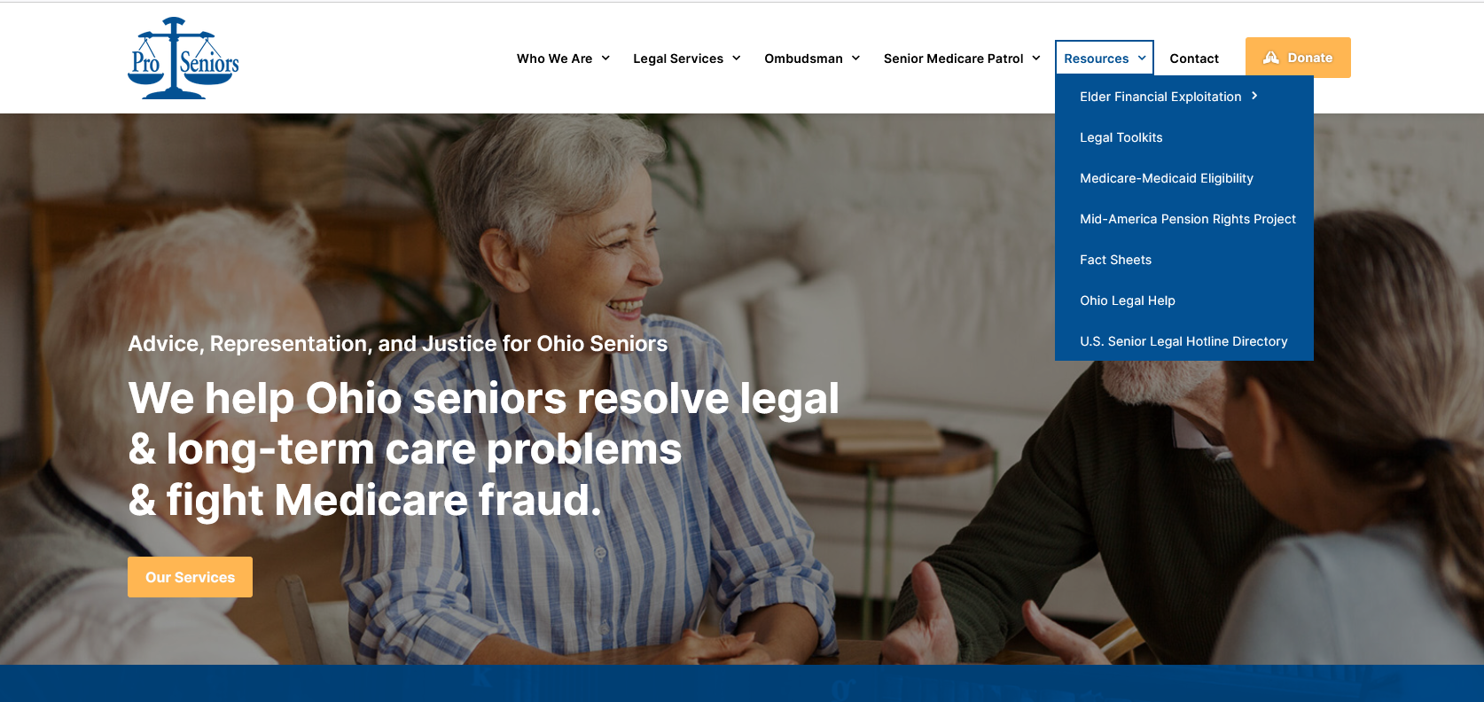
www.ProSeniors.org Resources Medicare-Medicaid Eligibility
Notes:
- For financial eligibility factors, there are a lot of numbers involved, Pro Seniors’ website keeps track of those numbers.

Slide 3
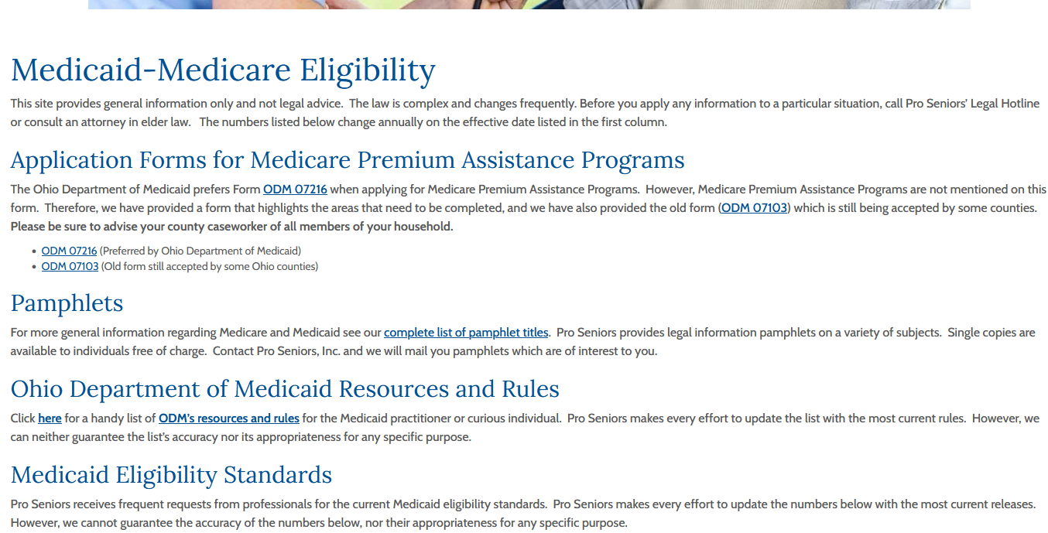
www.ProSeniors.org ODM’s Resources & Rules

Slide 4
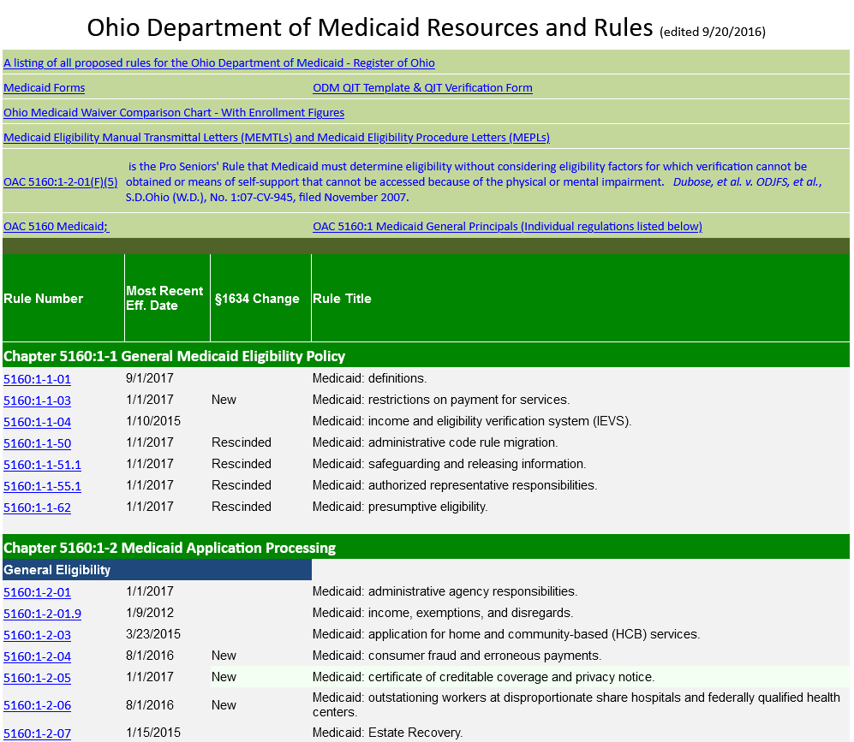

Slide 5
Medicaid Estate Recovery
What is Medicaid Estate Recovery (MER)?
Federally mandated program.
Began in Ohio on January 1, 1995.
When a Medicaid recipient dies, the MER Program attempts to recover from their estate what Medicaid paid for services provided. These costs include “capitation rates” meaning the MCO premiums. See RC § 5162.21, et seq.

Slide 6
Medicaid Estate Recovery
Who is subject to Medicaid Estate Recovery?
Medicaid recipients aged 55 years or older.
MER recovers Medicaid benefits correctly paid after the individual attained age 55.
Recover Medicaid benefits correctly paid to a person of any age while they were permanently institutionalized.

Slide 7
Medicaid Estate Recovery
What Medicaid services are recovered?
Any medical assistance correctly paid by Medicaid.
However, Medicaid recipients age 55 and older and not permanently institutionalized, the amount Medicaid paid for Medicare Savings Programs, such as QMB (Qualified Medicare Beneficiary), SLMB (Special Low Income Medicare Beneficiary) or QI-1 (Qualified Individuals-1), after January 1, 2010 is not subject to estate recovery.

Slide 8
Medicaid eligibility rules
What about improper transfers, lookback, exemption rules under Medicaid? How do they apply to MER?

Slide 9
Medicaid eligibility rules, including exemptions, DO NOT APPLY to MER. The only question is what did the Medicaid recipient own at the time of death.

Slide 10
Medicaid Estate Recovery
What is a Medicaid Estate Recovery estate?
(A) As used in this section and section 5162.211 of the Revised Code:
(1) “Estate” includes both of the following:
(a) All real and personal property and other assets to be administered under Title XXI of the Revised Code and property that would be administered under that title if not for section 2113.03 or 2113.031 of the Revised Code;
(b) Any other real and personal property and other assets in which an individual had any legal title or interest at the time of death (to the extent of the interest), including assets conveyed to a survivor, heir, or assign of the individual through joint tenancy, tenancy in common, survivorship, life estate, living trust, or other arrangement. R.C. 5162.21

Slide 11
What does ODM do with the Medicaid Estate?
R.C. 5162.21(B): To the extent permitted by federal law, the department of medicaid shall institute a medicaid estate recovery program under which the department shall . . . do all of the following:
(1) For the costs of medicaid services the medicaid program correctly paid or will pay on behalf of a permanently institutionalized individual of any age seek adjustment or recovery from the individual's estate or on the sale of property of the individual or spouse that is subject to a lien imposed under section 5162.211 of the Revised Code;
(2) For the costs of medicaid services the medicaid program correctly paid or will pay on behalf of an individual fifty-five years of age or older who is not a permanently institutionalized individual seek adjustment or recovery from the individual's estate;
(3) Seek adjustment or recovery from the estate of other individuals as permitted by federal law.

Slide 12
In re Estate of Anderson, 3rd Dist. No. 17-20-03, 2020-Ohio-6924, 165 N.E.3d 406, ¶ 34
“Under the expanded definition of “estate” in R.C. 5162.21(A)(1)(b), which includes non-probate assets, Betty's legal interest in the child support arrearages owed to her as guardian-obligee for Emily and Bradley represented a quantifiable asset for the purposes of the Medicaid Estate Recovery Program.”
In Anderson, AG was appointed administrator for the estate. Debate was whether child support arrearages were part of the probate estate. The court found the distinction irrelevant.

Slide 13
“In an effort to further supplant the common law principle of divestiture of certain interests upon death, R.C. 5162.21(A)(5) provides: “ ‘Time of death’ shall not be construed to mean a time after which a legal title or interest in real or personal property or other asset may pass by survivorship or other operation of law due to the death of the decedent or terminate by reason of the decedent's death.”
In re Estate of Anderson, @ ¶ 33 quoting

Slide 14
John is in a nursing home on Medicaid. He has a bank account on which he has a POD designation to his daughter Susie.

Slide 15
Poll Question #1

Slide 16
MER-How ODM administers the program
The department of medicaid shall certify amounts due under the medicaid estate recovery program . . . to the attorney general pursuant to section 131.02 of the Revised Code. The attorney general may enter into a contract with any person or government entity to collect the amounts due on behalf of the attorney general.
The attorney general, in entering into a contract under this section, shall comply with all of the requirements that must be met for the state to receive federal financial participation for the costs incurred in entering into the contract and carrying out actions under the contract. The contract may provide for the person or government entity with which the attorney general contracts to be compensated from the property recovered under the medicaid estate recovery program or may provide for another manner of compensation agreed to by the parties to the contract. R.C. 5162.212

Slide 17
Attorney General Contact
Attorney General in Charge of the MER program:
Robert Byrne
Assistant Attorney General – Collections Enforcement
Office of Ohio Attorney General Dave Yost
30 E Broad Street, 14th Floor
Columbus, Ohio 43215
Office number: 614-752-8085
Robert.Byrne@OhioAGO.gov

Slide 18
Generally, the AG, upon receipt of the certified amount due, sends a letter with a questionnaire to the next of kin on State of Ohio AG letterhead.
Who has the obligation to respond?
“(B) The person responsible for the estate of a decedent subject to the medicaid estate recovery program or the estate of a decedent who was the spouse of a decedent subject to the medicaid estate recovery program shall submit a properly completed medicaid estate recovery notice form to the administrator of the medicaid estate recovery program not later than thirty days after the occurrence of any of the following:
(1) The granting of letters of administration or letters testamentary;
(2) The filing of an application for release from administration or summary release from administration.” R.C. 2117.061

Slide 19
Medicaid Eligibility-Proper transfers: Home
Under OAC § 5160:1-6-06(D) The IS may transfer the home, that is still considered the principal place of residence, to:
The CS
The IS’s child under the age of twenty-one;
The IS’s child age twenty-one or over who is blind or permanently and totally disabled.

Slide 20
Proper Transfers
The sibling equity exclusion: The IS’s sibling who has an equity interest (must be a documented, legal interest) in the home and was residing in the home for at least one year immediately before the individual became institutionalized.

Slide 21
Proper Transfers
The adult child caretaker who
Continuously resided in the home for at least 2 years immediately before the date the IS becomes institutionalized, and
who provided care to the IS which permitted the IS to reside at home, rather than in an institution or facility or under an HCBS waiver

Slide 22
None of these authorize transfer after death of the Medicaid recipient. Medicaid eligibility rules regarding proper transfers do not apply. Instead you must look to the MER rules.

Slide 23
Medicaid Estate Recovery- Exceptions
R.C. 5162.21 (C)(1) No adjustment or recovery may be made . . . from a permanently institutionalized individual's estate . . .while either of the following are alive:
(a) The spouse of the permanently institutionalized individual or individual;
(b) The son or daughter . . . under age twenty-one or, under the “Social Security Act,” section 1614, 42 U.S.C. 1382c, is considered blind or disabled.

Slide 24
Medicaid Estate Recovery-exception to home
No recovery may be made against the individual’s home while either of the following lawfully resides in the home:
The permanently institutionalized individual’s sibling who:
Resided in the home for at least one year immediately before the date of the individual’s admission to the institution, and
Has resided in the home on a continuous basis since that time.
R.C. 5162.21(C)(2)

Slide 25
Medicaid Estate Recovery-exception to home
R.C. 5162.21(C)(2)(b)
The permanently institutionalized individual’s son or daughter who:
Provided care to the permanently institutionalized individual that delayed the individual’s institutionalization, and
Resided in the home for at least two years immediately before the date of the individual’s admission to the institution, and
Has resided in the home on a continuous basis since that time, and
Documents the above providing the following:

Slide 26
Medicaid Estate Recovery-caretaker exception
(a) A written statement of the date that he or she moved into the home;
(b) A level of care assessment showing that the individual would have become institutionalized earlier without care provided by the adult son or daughter;
(c) A written statement from the individual's attending physician, stating the kind and duration of care that was required to delay the individual's institutionalization; and
(d) All relevant documentation of the care that delayed institutionalization and the role the adult son or daughter played in that care. This documentation shall include (but is not limited to) one or more of the following:

Slide 27
Medicaid Estate Recovery
(i) A written statement of the number of hours per day during which the adult son or daughter provided personal care, specifying the extent and type of care provided;
(ii) A written statement of any part-time or full-time jobs performed by the adult son or daughter, and any schools or other similar institutions attended by the adult son or daughter, while providing care; or
(iii) Written documentation from a service agency which provided care to the individual, the dates on which care was provided, and the extent and type of care provided.
OAC 5160:1-2-07(D)(3)(b)

Slide 28
John Smith was in a nursing home for 3 years and died July 1, 2021. John and Joan owned their home joint with rights of survivorship, worth 200,000. John had no other property. Joan Smith, his wife just received a letter from the attorney general that she owes $300,000. What does she do?

Slide 29
Poll Question# 2

Slide 30
Sample fact pattern
John Smith was in a nursing home for 3 years and died July 1, 2021. John and Joan owned their home joint with rights of survivorship, worth 200,000. John had no other property. Joan Smith, his wife just received a letter from the attorney general that she owes $300,000. What does she do?
Does she need to respond? No, only the executor or administrator of the estate needs to answer

Slide 31
What if John did not own the home, only Joan did, but they had a joint bank account payable to Joan on his death with a balance of $2000?
Although Joan has no obligation to respond, she should document the value she received from John upon his death to limit the MER claim in Joan’s estate

Slide 32
Husband and wife owned a refund in a continuing care community. Wife went on Medicaid and later died. Later, husband died and his estate was entitled to a refund.
“Lessel's ownership interest in her half of the BRC refund endured post-mortem and represented a quantifiable non-probate asset which ODM was entitled to recover for Medicaid medical assistance benefits previously paid on Lessel's behalf, by means of a properly filed claim for estate recovery. See R.C. 2117.061(D). In other words, Lessel's interest was not extinguished by her death, and half of the BRC refund was a non-probate asset in which Lessel had a legal interest when she died; that interest was conveyed to Harry and subject to recovery from his estate in the amount of $24,390.” Ohio Dept. of Medicaid v. French, 2nd Dist. No. 2019-CA-4, 2020-Ohio-2744, 154 N.E.3d 426, ¶ 66

Slide 33
Medicaid Estate Recovery
RC § 5162.22 states re PNA accounts:
0 to 60 days after death pay PNA to
Funeral home for unpaid expenses; or
Probate estate representative
60 to 90 days after death pay PNA to
ODM through the OAG
Note: no statutory provisions for surviving spouse

Slide 34
Medicaid Estate Recovery
Summary
If you own any real or personal property when you die, no MER while the following are alive:
Spouse, minor child or disabled or blind child
If you own a house and are permanently institutionalized when you die, no MER against the home while living in the home:
son or daughter who provided 2 years of care or
sibling who has resided in the home for at least one year
Notes:
- Even though no recovery while alive, special counsel may file affidavit of fact related to title on real property

Slide 35
Sample fact pattern
Joan Smith calls that she found a lien on her home from John Smith’s Medicaid. Does she pay it?
NO,
Also probably NOT a lien but instead an affidavit relating to title.
What if Joan is the daughter of John?

Slide 36
Medicaid Liens
Authority for Medicaid Liens is found only in RC 5162.211
(A) Except as provided in division (B) of this section and section 5162.23 of the Revised Code, no lien may be imposed against the property of an individual before the individual's death on account of medicaid services correctly paid or to be paid on the individual's behalf.

Slide 37
(B) Except as provided in division (C) of this section, the department of medicaid may impose a lien against the real property of a medicaid recipient who is a permanently institutionalized individual and against the real property of the recipient's spouse, including any real property that is jointly held by the recipient and spouse. The lien may be imposed on account of medicaid paid or to be paid on the recipient's behalf.

Slide 38
Lien Prohibitions
(C) No lien may be imposed under division (B) of this section against the home of a medicaid recipient if any of the following lawfully resides in the home:
(1) The recipient's spouse;
(2) The recipient's son or daughter who is under twenty-one years of age or, under the “Social Security Act,” section 1614, 42 U.S.C. 1382c, considered to be blind or disabled;
(3) The recipient's sibling who has an equity interest in the home and resided in the home for at least one year immediately before the date of the recipient's admission to the institution.

Slide 39
How Created
(D) The medicaid director or a person designated by the director shall sign a certificate to effectuate a lien required to be imposed under this section. The county department of job and family services shall file for recording . . .in every county in which real property of the recipient or spouse is situated. From the time of filing the certificate in the office of the county recorder, the lien attaches to all real property of the recipient or spouse described in the certificate for all amounts for which adjustment or recovery may be made under section 5162.21 of the Revised Code and, except as provided in division (E) of this section, shall remain a lien until satisfied.
Upon filing the certificate in the office of the recorder, all persons are charged with notice of the lien and the rights of the department of medicaid thereunder.

Slide 40
When does the Lien Terminate?
(E) A lien imposed with respect to a medicaid recipient under this section shall dissolve on the recipient's discharge from the institution and return home.

Slide 41
Effect of Filing after Death
Because a lien imposed by statute is without the consent of the owner, statutory liens cannot be created by implication, but may arise and attach only where they are clearly created by statute. City of Akron v. Citizens Savings & Loan Co., 17 Ohio Law Abs. 159, 160–61 (9th Dist.1934). This principle is based on the fact that “a lien would not exist in the absence of statutory provisions creating it...”. Home Owners' Loan Corp. v. Tyson, 133 Ohio St. 184, 186, 12 N.E.2d 478 (1938).

Slide 42
Statutory Lien Defined
“The character, operation, and extent of a statutory lien must be ascertained from the statute creating and defining it. Such statute cannot be amended or extended by judicial construction to meet a situation not provided for nor contemplated thereby. The remedy is legislative.” Mahoning Park Co. v. Warren Home Dev. Co., 109 Ohio St. 358, 142 N.E. 883, 2 Ohio Law Abs. 150 (1924).

Slide 43
When does real property transfer after death?
“The rule is and has long been that in intestate estates, where heirs take by way of inheritance, they take title to the real estate immediately upon the death of the intestate . . ..” Winters Nat. Bank & Tr. Co. v. Riffe, 2 Ohio St.2d 72, 76, 206 N.E.2d 212, 216 (1965).
However, ODM’s statutory lien is not effective until “[t]he medicaid director or a person designated by the director shall sign a certificate to effectuate a lien . . ..” R.C. 5162.211(D).

Slide 44
What about Certificates of Judgment?
“[N]o lien is obtained by a certificate of judgment filed after the judgment debtor's death because the real property descends to the heirs at the time of death. Dressler v. Bowling (1986), 24 Ohio St.3d 14, 16, 24 OBR 12, 13, 492 N.E.2d 446, 448.
. . . [W]e conclude that the certificates of judgment filed after Jimmie Keaton had died did not create liens on his real property. A decedent's estate is fixed at the time of his death, and a judgment alone is not a lien on the estate. Ohio Citizens Bank v. Meyer (1985), 23 Ohio App.3d 74, 76-77, 23 OBR 138, 139-142, 491 N.E.2d 319, 321-322.
Brandon v. Keaton, 90 Ohio App.3d 542, 544-545, 630 N.E.2d 17 (2nd Dist.1993).

Slide 45
Ohio Dept. of Job & Family Serv. v. Tultz
The 9th District “construed” the predecessors to R.C. 5162.21 and 5162.211 as authorizing post death liens because of the “severe burden this would place on ODJFS and federal limitations on ODJFS’s ability to file liens during the recipient’s lifetime.” 152 Ohio App.3d 405, 2003-Ohio-1597, 787 N.E.2d 1262, ¶ 19, cause dismissed, 101 Ohio St.3d 1414, 2004-Ohio-101, 801 N.E.2d 851 (2004).

Slide 46
Admr., State Medicaid Estate Recovery Program v. Miracle
In this case, the Court used equitable principles to impose a “constructive trust” in favor of the State upon the real estate proceeds for property sold by the owners. 4th Dist. No. 14CA1, 2015-Ohio-1516, 31 N.E.3d 658 ¶ 33.
Ignoring the question whether the government is even entitled to “equity”(which is to protect individuals from the unbending application of the law), a basic maxim of equity is that equity cannot create rights which do not exist under law.

Slide 47
Response to Miracle
Specifically addressing the ability to impose a lien through equity, in 1833 the Ohio Supreme Court stated: “Liens upon land are given by statute, and cannot be extended in equity. Judgment creditor acquires no lien, in equity, upon the choses in action of his debtor, until a bill is filed to charge them.” Douglass v. Huston, 1833 WL 34 (Dec. 1833).

Slide 48
Phillips v. McCarthy
The Court recognized “the state must wait until the recipient dies to file a lien against property in pursuit of Medicaid recovery.” Id. at ¶ 19. Rather than consider the plain language of R.C. 5162.21 and R.C. 5162.211, the 12th District “construed” the statutes to “expand” a life estate to exist after death so that the State could impose its lien on property owned by a third party. 12th Dist. No. CA2015-08-017, 2016-Ohio-2994, 55 N.E.3d 20.

Slide 49
Wiesenmayer v. Vaspory
Margaret S. Edwards moved into a nursing facility on October 15, 2014, and resided there until her death on January 3, 2016. The sole asset of her estate was a parcel of real property.
Edwards received Medicaid benefits during the last five months of her residency . On May 19, 2016, ODM recorded a lien against Edwards's real property pursuant to R.C. 5162.21. The lien document stated that ODM sought to recover $ 26,773.84 in benefits paid on behalf of Edwards, plus statutory interest.
In an order entered on June 29, 2016, the probate court appointed Wiesenmayer to act as special administrator of Edwards's estate; on the same date, the nursing facility presented a claim against the estate in the amount of $ 40,750.96.

Slide 50
Weisenmayer Decision
The nursing facility argued that ODM lacks the authority to record a lien against the real property because, at the time the lien was filed, she no longer owned the property by operation of common law.
The definition of “estate” established by R.C. 5162.21(A)(1), however, supersedes the common law definition and embraces property that would otherwise have transferred automatically at the moment of Edwards's death to any survivors, heirs and assigns. 2019-Ohio-1805, 135 N.E.3d 1237, ¶ 15

Slide 51
Weisenmayer Decision
What about due process to the heirs?
R.C. 5162.211(D), however, establishes that Edwards's heirs were, as a matter of law, “charged with notice of the lien and the rights of the department of medicaid thereunder” upon the filing of the lien “in the office of the recorder.” And although Edwards's property would, presumably, have passed to her heirs immediately upon her death under common law, the legislature's enactment of R.C. 5162.21(A), as we have noted, supersedes the common law, meaning that ODM's lien did not result in an unconstitutional taking of any property interest held by the heirs. 2019-Ohio-1805, 135 N.E.3d 1237, ¶ 20

Slide 52
The Dissent
ODM's lien was not valid.
In Ohio, liens on property generally must be perfected prior to the property owner's death. After the property owner's death, unsecured debts are generally satisfied through claims against the person's estate. The federal and Ohio Medicaid statutes allow recovery of properly-paid Medicaid payments from the person's estate (which itself is broadly defined). The statutes do not expressly authorize post-death liens, and they permit pre-death liens only in limited circumstances. ODM could have placed a lien on Edwards's property prior to death, but did not. Under Ohio law, ODM could not place a valid post-death lien on Edward's property. Consequently, under the laws governing the order in which debts are paid from a decedent's estate, BNRC should have been paid prior to ODM. 2019-Ohio-1805, 135 N.E.3d 1237, ¶ 27

Slide 53
The Dissent
Stated simply, R.C. 5162.211(A) prohibits pre-death liens, but R.C. 5162.211(B) provides an exception to the general prohibition for liens, allowing pre-death liens on the property of permanently institutionalized individuals and of that person's spouse. R.C. 5162.211(C) identifies circumstances when the exception to the prohibition does not apply, i.e., when liens are again prohibited; none of the circumstances identified in R.C. 5162.211(C) applied to Edwards.
2019-Ohio-1805, 135 N.E.3d 1237, ¶¶ 43-44

Slide 54
The Dissent
ODM focuses on the phrase in R.C. 5162.211(A) that liens are prohibited “before the individual's death” as support for the conclusion that post-death deaths are not prohibited. ODM, in essence, argues that R.C. 5162.211(A)'s verbiage is superfluous if post-death liens are prohibited, i.e., that there is no reason to specifically prohibit most pre-death liens if post-death liens were also prohibited.

Slide 55
The Dissent
I disagree that R.C. 5162.211(A) can reasonably be interpreted as a general authorization for post-death liens. Post death liens of any kind generally are not allowed in Ohio. While pre-death liens are permitted under Ohio law, the Medicaid statute expressly disallows liens on account of properly-paid Medicaid service “before the individual's death,” unless an exception to the prohibition applies. I do not read the language “before the individual's death,” in this context, as authorization for post-death liens in Ohio. 2019-Ohio-1805, 135 N.E.3d 1237, ¶ 45

Slide 56
The Dissent
The terms of R.C. 5162.211 address the imposition of pre-death liens; there is no additional language in R.C. 5162.211 that explains when post-death liens would be permitted, how they would be recorded, after what period of time they would need to be renewed, and the like. 2019-Ohio-1805, 135 N.E.3d 1237, ¶ 47

Slide 57
Affidavits of Fact Relating to Title
The AG has a practice of filing “affidavits of fact relating to title” on real property owned by the deceased Medicaid recipient inherited by the surviving spouse.

Slide 58
R.C. 5301.252(A)
An affidavit stating facts relating to the matters set forth under division (B) of this section that may affect the title to real estate in this state, made by any person having knowledge of the facts or competent to testify concerning them in open court, may be recorded in the office of the county recorder in the county in which the real estate is situated. When so recorded, such affidavit, or a certified copy, shall be evidence of the facts stated, insofar as such facts affect title to real estate.

Slide 59
R.C. 5301.252(B)
The affidavits provided for under this section may relate to the following matters:
(1) Age, sex, birth, death, capacity, relationship, family history, heirship, names, identity of parties, marriage, residence, or service in the armed forces;
(2) Possession;
(3) The happening of any condition or event that may create or terminate an estate or interest;
(4) The existence and location of monuments and physical boundaries, such as fences, streams, roads, and rights of way;

Slide 60
Legal effect of the affidavit
An affidavit filed under RC 5301.252 is not an instrument which casts doubt on the record owner's title or stands in the way of his full and free exercise of his ownership; the filing, in and of itself, creates no interest in the subject real property or encumbrance on the title, but rather is a statutory device for recording facts which may affect title to real estate in Ohio; thus, the filing of such affidavits does not support a cause of action on the part of the owner of properties described in the affidavits to quiet title or remove a cloud on title. Catawba West, Inc. v. Domo (Ottawa 1991) 75 Ohio App.3d 80, 598 N.E.2d 883.

Slide 61
A Possible Exception for Slander of Title
At the beginning of our analysis of the slander-of-title claim, we noted, citing Catawba, that the filing of an affidavit under R.C. 5301.252 does not support an action to quiet title or to remove a cloud on title. Id. at 6. We then said, however, that “when such an affidavit creates a potential cloud on title, an action for slander of title may be brought by the aggrieved owner of the property described in the affidavit” Green v. Lemarr, 139 Ohio App.3d 414, 432, 744 N.E.2d 212, 225 (2nd Dist.2000) citing Carman v. Entner (Feb. 2, 1994), Montgomery App. No. 13978, unreported, 1994 WL 28633.

Slide 62
Sample Language
“By virtue of the real estate described in paragraph three(3) above being transferred to surviving spouse/surviving joint remainderman, the State of Ohio, in the Medicaid Recovery Statute, maintains a one-half(1/2) interest in said real estate.”

Slide 63
This is false, the MER statute provides they have a claim in the estate and may seek recovery from the estate. R.C. 5162.21(B): 1) seek adjustment or recovery from the individual's estate or on the sale of property of the individual or spouse that is subject to a lien.

Slide 64
There can be no MER during the lifetime of the spouse. They do not maintain a ½ interest in the real estate. R.C. 5162.21 (C)(1) “No adjustment or recovery may be made . . . from a permanently institutionalized individual's estate . . .while either of the following are alive:
(a) The spouse
Remedy: Special Counsel are private debt collection attorneys subject to the FDCPA.

Slide 65
Sample fact pattern
John Jones is on Medicaid and received a notice that they are putting a lien on his house. He is single and has never been married.

Slide 66
John probably received a notice about Medicaid estate recovery and that after he dies his estate is subject to MER and if he owns real property it may be subject to a lien.
Who is the notice from? If ODM it’s a notice about MER in general. Collection or liens come from the AG.

Slide 67
Sample fact pattern
Joan called worried about losing her home if John goes on Medicaid.

Slide 68
No MER during Joan’s lifetime
MER is limited to value of property inherited from John
If on Medicaid, transfer property to Joan during John’s lifetime.
Designate beneficiaries on property so no probate estate, but there is simply no guarantee. AG will take the position, if they know about it, that MER attaches. Issue of litigation.

Slide 69
Medicaid Estate Recovery
MER Would Cause Undue Hardship

Slide 70
Medicaid Estate Recovery
O.A.C. 5160:1-2-07, contains an undue hardship waiver request process.
What constitutes an undue hardship is assessed on a case-by-case basis and the circumstances must be compelling.

Slide 71
Medicaid Estate Recovery
The granting of an undue hardship waiver may involve either a permanent waiver of recovery efforts, or a temporary deferral or postponement of recovery while the hardship exists, including negotiation of a modified recovery agreement or the imposition of a lien.

Slide 72
Medicaid Estate Recovery-Undue Hardship Waiver
2) An undue hardship waiver may be requested by an heir or an individual with an interest in the property who would suffer an undue hardship if a waiver is not granted.
3) ODM may, at the sole discretion of the ODM director or the director’s designee, waive estate recovery when recovery would work an undue hardship on an individual’s survivors.

Slide 73
Medicaid Estate Recovery
Undue hardship may be found in the following cases:
The survivor is age sixty-five or older and financially dependent upon receipt of the estate proceeds.
The estate proceeds are preserved for the benefit of a survivor who is totally and permanently disabled and is financially dependent upon receipt of the estate proceeds.

Slide 74
Medicaid Estate Recovery
c) The estate subject to recovery is the sole income-producing asset of the survivor, such as a family farm or other family business, which:
Produces a limited amount of income, or
Is the sole asset of the survivor.
d) Without receipt of the estate proceeds, the survivor would become eligible for public assistance.

Slide 75
Medicaid Estate Recovery
Recovery would deprive the survivor of necessary food, shelter or clothing.
f) The survivor provides clear and convincing evidence of substantial personal financial contributions to the deceased individual, creating an equity interest in the property.

Slide 76
John Jones was in a nursing home on Medicaid before he died. He owned his home joint with rights of survivorship with his granddaughter, Julie Jones who was disabled receiving SSI.
John Jones died. Julie discovered that the AG had recorded a lien against the home.

Slide 77
Poll Question # 3

Slide 78
Julie as a disabled survivor and financially dependent upon the estate would meet the criteria for undue hardship and should apply.
However, there is no guarantee as the waiver determination is case by case in ODM’s discretion and could be rather than waiver of the claim, the placement of a lien with no collection until Julie either moves or dies.

Slide 79
Not eligible for Waiver
OAC 5160:1-2-07(H)
(3) Regardless of actual hardship, an undue hardship waiver will not be granted in the following situations:
(a) When the individual created the hardship by using estate planning methods under which the individual divested, transferred, or otherwise encumbered assets in whole or in part to avoid estate recovery.
(b) When an undue hardship waiver will result in the payment of claims to other creditors with lower priority standing under Ohio's probate law.

Slide 80
Waiver request process
OAC 5160:1-2-07(I)
(1) Within thirty calendar days after notice of the estate recovery claim was mailed by the AGO, an undue hardship waiver may be requested by an heir or potential heir who would suffer an undue hardship if a waiver is not granted, a person with an interest in assets of the estate, or a representative of such persons. An undue hardship waiver may not be requested by a creditor of the estate, unless such creditor is also a potential heir of the estate.
(2) Within sixty calendar days of receipt of the request for an undue hardship waiver, ODM shall notify the applicant whether the waiver request has been approved (in full, in part, or for a limited time) or denied. Failure to meet this sixty day deadline does not result in an automatic decision on the request.

Slide 81
Waiver Request process
(3) When the waiver request was not approved in full, or when the approval was time-limited, the applicant may, within thirty calendar days, request that the ODM director, or designee, review the undue hardship waiver decision.
(a) The ODM director, or designee, will review only those portions of the undue hardship waiver request that were denied or time-limited. The director will not deny or limit any portion of the undue hardship waiver request that has already been granted.
(b) The ODM director, or designee, shall review the undue hardship waiver request and notify the applicant within sixty calendar days whether (at the director's sole discretion) the director, or designee, has approved (in full, in part, or for a limited time) or denied the request for an undue hardship waiver. Failure to meet this sixty day deadline does not result in an automatic decision on the request.

Slide 82
QUESTIONS?

Slide 83

Pro Seniors’ Services
Ohio’s Senior Legal Helpline:
Staffed by experienced attorneys
Pre-set 30 minute appointments
By telephone
Free legal advice and counsel
Call 1.800.488.6070 or 513.345.4160.
Mid America Pension Rights Project:
Pension attorneys to help with pension issues.
Call 1-866-400-9164

Slide 84

Pro Seniors’ Services
Ohio Senior Medicare Patrol (SMP)
Our volunteers stop Medicare fraud & scams by educating others to recognize the tell-tale signs. If your Medicare number has been compromised, or you suspect you have been scammed, we may be able to help!
Give us a call at 1-800-293-4767.
www.proseniors.org/Ohio-SMP/

Slide 85
Pro Seniors Referral Service
Statewide
Pre-screened clients (referral made only after helpline attorney has done the initial consultation)
Opportunities for attorneys to help Seniors.
www.proseniors.org/legal-services/hrap/

Slide 86
Thank You!
This webinar series is presented by
Pro Seniors & the Ohio Department of Aging in collaboration with the
Ohio Training Advisory Committee of the Alliance of Ohio Legal Aids.

