Slide 1





Social Security Overpayments
Michael Walters, Esq.
Legal Helpline Managing Attorney
Pro Seniors, Inc.
September 6, 2024

Slide 2
Pro Seniors’ Mission
Our mission is to enhance the independence and quality of life for older adults by empowering them, by protecting their interests and by facilitating their access to resources

Slide 3

Pro Seniors’ Services
Ohio’s Senior Legal Helpline:
Staffed by experienced attorneys
Pre-set 30 minute appointments
By telephone
Free legal advice and counsel
Call 1.800.488.6070 or 513.345.4160.
Pension Questions?:
Pension attorneys to help with pension issues.
Call 1-866-783-5021

Slide 4

Pro Seniors’ Services
Ohio Senior Medicare Patrol (SMP)
Our volunteers stop Medicare fraud & scams by educating others to recognize the tell-tale signs. If your Medicare number has been compromised, or you suspect you have been scammed, we may be able to help!
Give us a call at 1-800-293-4767.
www.proseniors.org/Ohio-SMP/

Slide 5
Pro Seniors’ Veterans Services
Veterans age 60 and older are eligible for Pro Seniors services
Pro Seniors emphasizes services to veterans
We successfully advocated with the Ohio Department of Veterans Services to change a policy which discriminated against disabled veterans
We participate in a local Veteran Legal Clinic

Slide 6


Long-Term Care Ombudsman Program Butler, Clermont, Clinton, Hamilton and Warren counties in Southwest Ohio
Pro Seniors’ Services
Educate and empower residents and families about residents’ rights
Empower residents to speak up for excellence in their care
Advocate for residents, for quality of care, quality of life issues
Provide unbiased assistance to select a long-term care community
Locate Your Local LTC Ombudsman by Calling 1-800-282-1206
Notes:
Every State, per federal law, has an Ombudsman Program. In Ohio the Ombudsman program is part of the Ohio Department of Aging. The Ombudsman program for the 5 counties of Southwest Ohio is housed in the Pro Seniors agency. What does an Ombudsman do? Educate, empower, advocate. Hamilton, Butler, Warren, Clermont and Clinton Counties.

Slide 7
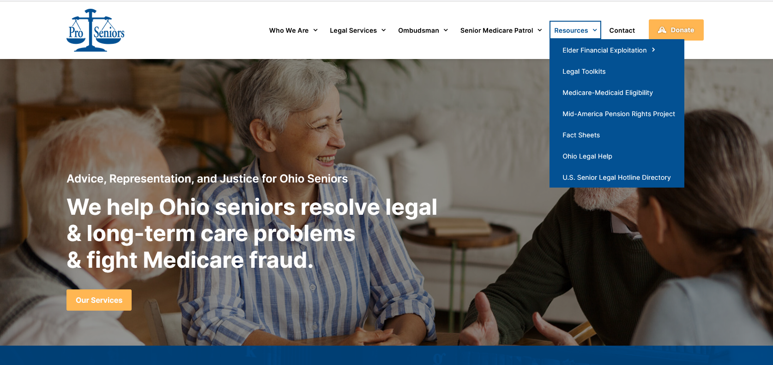
www.ProSeniors.org Resources Medicare-Medicaid Eligibility
Notes:
- For financial eligibility factors, there are a lot of numbers involved, Pro Seniors’ website keeps track of those numbers.

Slide 8
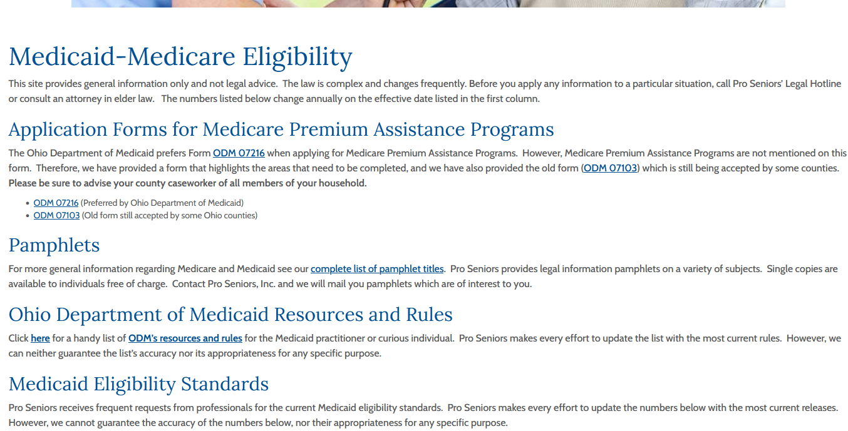
www.proseniors.org
Fact Sheets

Slide 9
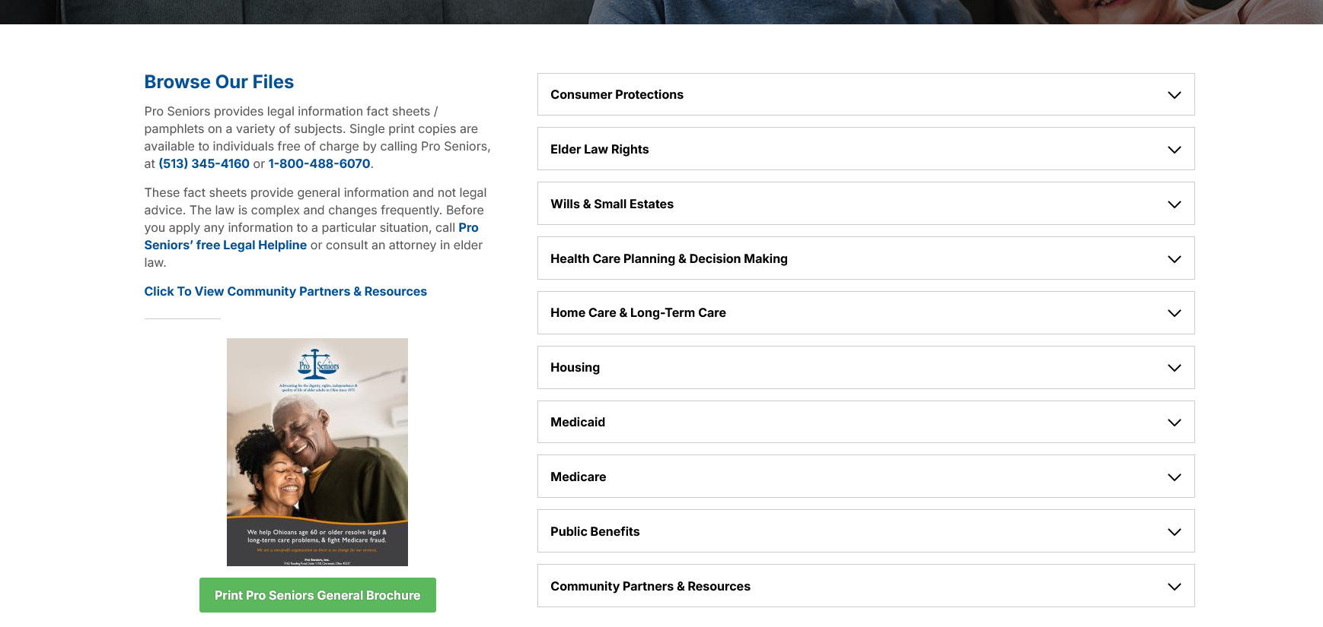

Slide 10
Pro Seniors’ Monthly Veterans Legal Clinic
+
The Veterans Justice Outreach Project at Cincinnati VA Medical Center
+
Greater Cincinnati Legal
Aid
Social Security Basics

Slide 11
Supplemental Security Income (SSI)
Means tested. Based on income and resources.
$2000 limit on “countable” resources ($3000 couple)
Must be age 65 or older, or adjudicated as disabled
$943 for individual ($1415-couple)

Slide 12
SSI VS. SSDI
SSDI=“Social Security Disability Insurance”
Not means tested
Paid on 3rd of month (or later)
If SSDI (or retirement benefit) is low, client may receive both
What day of month is check paid? How much is monthly income?

Slide 13
Poll Question #1
Client age 47, says “I get SSI”
Client gets 2 checks, $300 on the 1st, and $663 on the 3rd
What can we conclude?

Slide 14
Earning Credits
40 Quarters for retirement (10 years)
Maximum 4 credits in 1 year
$1,730 earnings = 1 credit in 2024 ($6,920)

Slide 15
Retirement Benefits
Worker
Reduced benefits as early as age 62
Full benefits at age 65-67
Increased benefits after full retirement age (FRA)
Wife or Husband
As early as age 62
At any age if caring for child under age 16 or disabled
Divorced spouses may qualify if married at least 10 years
Child
Unmarried and up to age 18 or 19 if still in high school
Any age if disabled before age 22

Slide 16
Benefits for Spouses
Spouse may receive up to 50% of a worker’s full Social Security benefit
A spouse benefit is reduced by amount equal to full retirement benefit the spouse has earned on his/her own work record
Reduced if started early (before FRA)

Slide 17
Survivor Benefits
Widow(er)
Reduced benefits as early as age 60 or, if disabled, age 50
At any age if caring for child of worker under age 16 or disabled before age 22
Divorced widow(er) may qualify if married at least 10 years
Remarriage @ age 60 or later does not end benefit
Benefit at full retirement age is usually the same as what worker was receiving at his death or would have received at full retirement age
Notes:
You may wish to explain how a widow or widower can receive a survivors benefit at age 60 and then switch to a benefit on their own work record at age 62. Or, how a widow or widower could receive a reduced survivors benefit at age 60 and then file for an unreduced benefit on their own work record at their full retirement age.
Regardless of the change in full retirement age, a widow(er) can still receive 71-1/2% at age 60.

Slide 18
Spouse Benefit Computation
Fred and Alice both paid FICA. Fred receives $2,513/month Social Security benefit at Full Retirement Age
Alice receives $1,400 Social Security benefit at Full Retirement Age
Spouse 50% rate = $1,256
Alice cannot get spouse benefits because her own Social Security benefit is greater
Alice’s own benefit offsets spouse benefit!
Notes:
$2,513 is the maximum SSA benefit in 2012.

Slide 19
Calculating Benefits
Lifetime Social Security earnings adjusted for wage inflation
Add together highest 35 years
Divide total by 420 months (35 years x 12) to calculate monthly average
Benefit reflects a percentage of lifetime average monthly earnings figure

Slide 20
Calculating Benefits
Higher average lifetime Social Security earnings produce a higher benefit but
Lower-paid workers receive larger benefits in relation to their earnings than higher-paid workers

Slide 21
Replacement Rates (Approximate)
57%
Low Income Worker
$20,800 annual avg. ($10.00/hr)
$989/month benefit at full age
Middle Income Worker
$41,600 annual avg. ($20.00/hr)
$1,543/month benefit at full age
Higher Income Worker
$84,032 annual avg. ($40.00/hr)
$2,241/month benefit at full age
44.5%
% of earnings
32%

Slide 22
Medicare
Automatic if you are getting Social Security benefits at 65, or receiving SSDI for 24 months
Contact SSA at age 65 if you are not getting benefits
May apply on own Social Security record or the record of a spouse -living, deceased, disabled, or divorced
May file even if deferring cash payments
Notes:
Many people question the need to file for Part B of Medicare. They should be reminded that their health insurance when they retire will pay only after Medicare pays. Many supplemental plans actually require people to file for Part B. The Medicare premium that beneficiaries pay represents 1/3 of the actual cost; the federal government (through the Medicare tax that workers pay) covers the balance of the cost.
While Social Security has plenty of time to address its challenges, Medicare has more immediate solvency concerns. The SMI (Part B) trust fund is expected to be adequately financed for the future.

Slide 23
Filing for Benefits
How to File
Via the Internet at www.socialsecurity.gov
In the office or over the telephone
For an appointment, call 1-800-772-1213
When to Contact Social Security
Up to 3 months before you retire or attain age 62
If over age 62, review your work plans before Feb. 1 to determine when benefits could start
Notes:
Many people question the need to file for Part B of Medicare. They should be reminded that their health insurance when they retire will pay only after Medicare pays. Many supplemental plans actually require people to file for Part B. The Medicare premium that beneficiaries pay represents 1/3 of the actual cost; the federal government (through the Medicare tax that workers pay) covers the balance of the cost.
While Social Security has plenty of time to address its challenges, Medicare has more immediate solvency concerns. The SMI (Part B) trust fund is expected to be adequately financed for the future.

Slide 24
Poll Question #2
When is Medicare Effective?

Slide 25
Questions
Questions?

Slide 26
Overview of Overpayments

Slide 27

Overpayments
An overpayment occurs when a beneficiary receives more benefits than the amount they are entitled to, in a given month
If the individual is currently receiving SSA benefits, SSA will withhold funds from current benefits to repay
*slides used with permission of Justice in Aging

Slide 28
Why Overpayments Happen
1. SSI benefits: Income, resources, living arrangement.
2. Government pension offset/Windfall Elimination Provision.
3. Excess earnings.
4. Work Activity while receiving SSDI benefits.
Notes:
Government Pension Offset, Windfall Elimination Provision, excess earnings in early retirement

Slide 29
Overpayment Options
Appeal the overpayment (request “Reconsideration”)
Request a waiver
Negotiate a lower repayment amount
Do nothing
Bankruptcy (beyond the scope of this presentation)
Notes:
Outside of SSA administrative process: bankruptcy​​

Slide 30
“Passive-Aggressive” Collection
SSA puts the burden on the claimant in how the propose to collect an overpayment. They will notify your client of the overpayment, provide appeal rights, demand immediate payment of the entire amount, and they will withhold the entire check unless the claimant contacts them within the period provided (usually 30 days, even though reconsideration may be filed within 60 days).
Notes:
Outside of SSA administrative process: bankruptcy​​

Slide 31
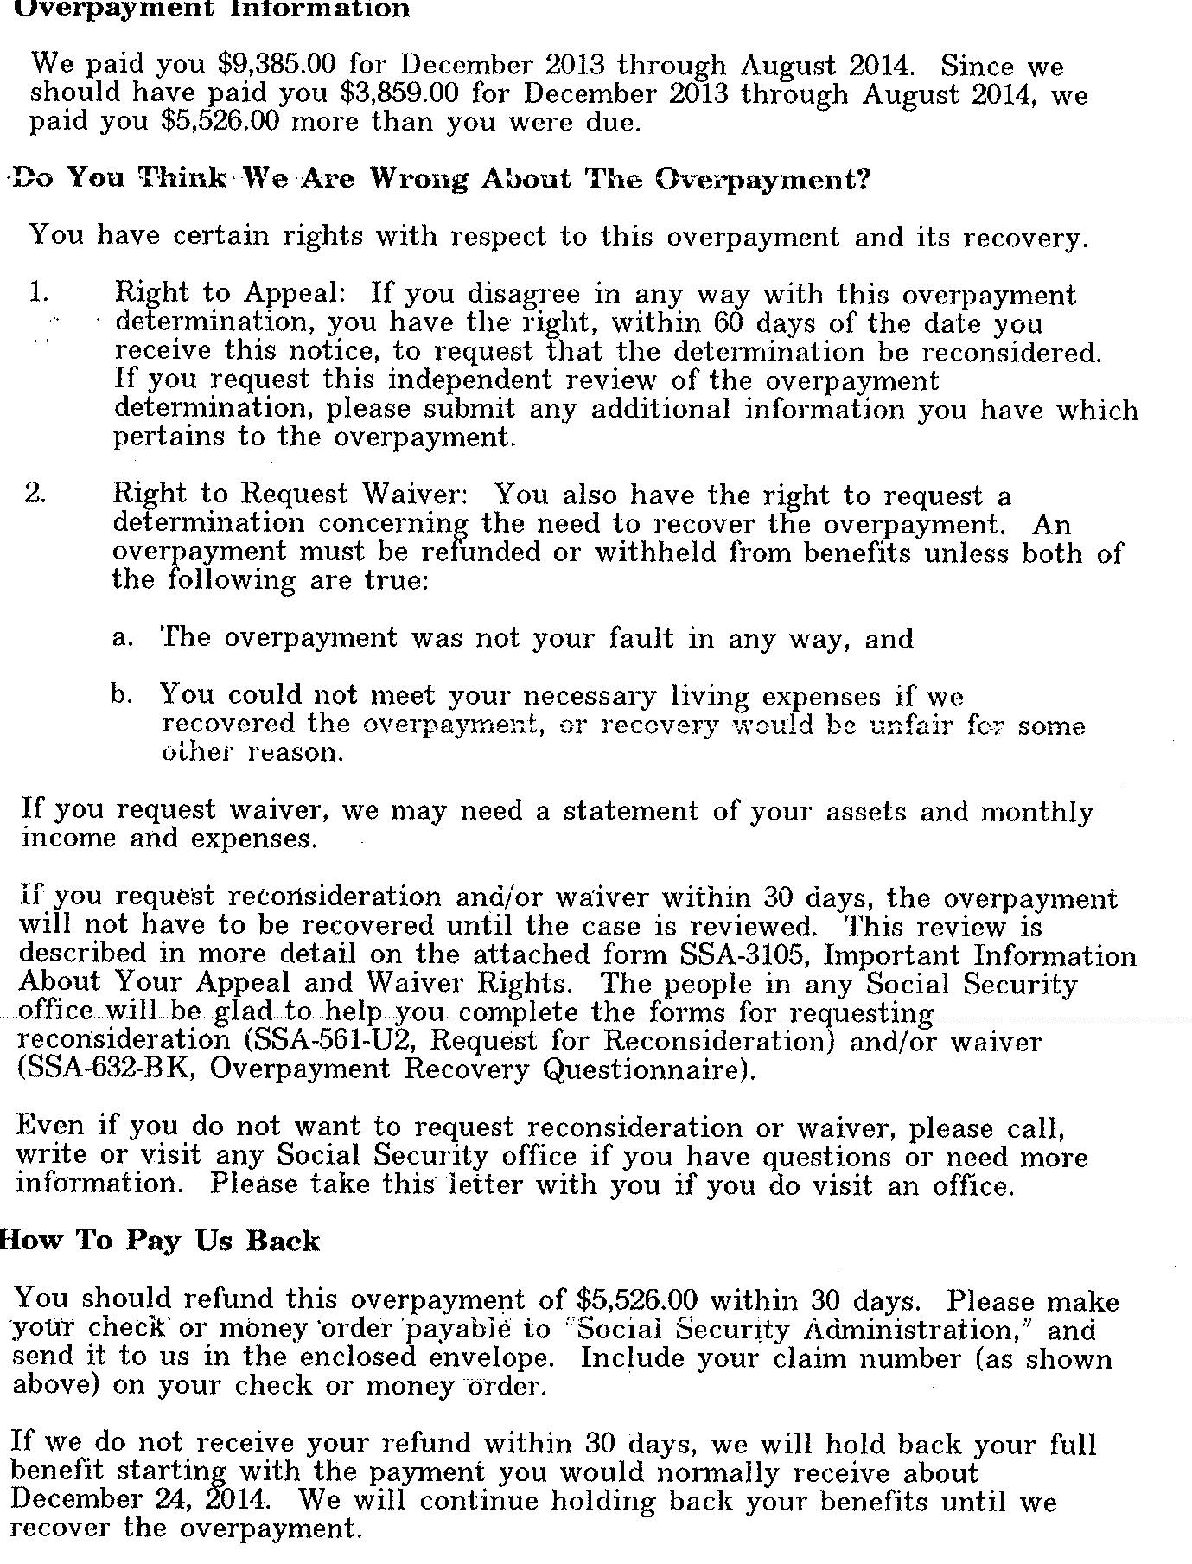

Slide 32
Reconsideration
Reconsideration challenges the fact of the overpayment and/or the amount of the overpayment. Must be filed within 60 days of a notice (note 5 day mailing time tolerance). Multiple notices may give multiple reconsideration opportunities. SSA-561: http://www.socialsecurity.gov/forms/ssa561.pdf (downloading the form with Adobe should make it a fill-in form).
Notes:
Outside of SSA administrative process: bankruptcy​​

Slide 33
Waiver
Without fault AND 2. Inability to repay (Defeat the purpose of the Act) or 3. Against equity and good conscience. http://www.law.cornell.edu/cfr/text/20/404.506
SSA-632 form: https://www.ssa.gov/forms/ssa-632-bk.pdf
Notes:
Outside of SSA administrative process: bankruptcy​​

Slide 34
Fault
Incorrect payment resulted from (a) An incorrect statement made by the individual which he knew or should have known to be incorrect; or (b) Failure to furnish information which he knew or should have known to be material; or (c) With respect to the overpaid individual only, acceptance of a payment which he either knew or could have been expected to know was incorrect
Notes:
Outside of SSA administrative process: bankruptcy​​

Slide 35
Get the Notice!
Critical information needed:
Amount of the overpayment?
When is withholding scheduled to start?
Is there an explanation?
Notes:
Outside of SSA administrative process: bankruptcy​​

Slide 36
Inability To Repay
A client receiving cash public assistance benefits is deemed unable to repay.
Waiver can be an easy way to dispose of an overpayment under the right circumstances but waiver also requires that the client provide detailed financial information to SSA. Remember that even when the “fault” is clearly with SSA, a client who has excess income or virtually any assets will lose
Notes:
Outside of SSA administrative process: bankruptcy​​

Slide 37
Reaching Local SSA Office
Refer to the Notice
“If You Have Any Questions…
You can also write of visit any Social Security office. The office that serves your area is located at…”
Notes:
Outside of SSA administrative process: bankruptcy​​

Slide 38
SSA Field Office Locator
https://www.ssa.gov/locator/
Still need to find an office near you?
Locate An Office By Zip
Notes:
Outside of SSA administrative process: bankruptcy​​

Slide 39
Questions
Questions?

Slide 40
Recent Changes to Overpayment Policies

Slide 41
Decrease Default Withholding (1 of 2)
New Rule
TITLE II (RSDI) | TITLE XVI (SSI)
10% (or $10, whichever is greater) – previously 100% | Up to 10% of monthly benefit – $94.30 maximum for 2024

Slide 42
Decrease Default Withholding (2 of 2)
EM-24011: Change in Title II Overpayment Default Rate of Benefit Withholding​
Went into effect on March 25, 2024
Beginning in June 2024, those with new RSDI overpayments will see new language in notices, experience 10% default​
July 2024: letter sent to all current RSDI beneficiaries paying more than 10%
In interim, RSDI beneficiaries can call 800-772-1213 to request adjustment to 10%

Slide 43

Mr. O
Mr. O calls you because he has no income
He was receiving SSDI, worked for over 3 years, and his SSDI was terminated
He had to stop work, asked SSA to restart his checks, but they are withholding his entire check to collect a $20,000 overpayment.
Mr. O’s gross Social Security check was $2000 month, before the benefit was withheld to collect the overpayment

Slide 44

Poll Question #3
What should Mr. O do first?

Slide 45
Repayment Time Frame
Expanded from 36 months to 60 months
Easier to lower repayment amount without having to provide financial documentation
POMS GN 02210.030 - Request for Change in Overpayment Recovery Rate
POMS SI 02220.026 - Request for a Change in Recovery Rate - SSI

Slide 46
Administrative Waiver
Level increased from $1,000 to $2,000
Individual must request waiver
No further development needed if no indication individual was at fault
POMS GN 02210.220 - Request for Waiver - $2,000 Tolerance
POMS SI 02260.030 - Impede Effective or Efficient Administration of Title XVI of the Act (Administrative Waiver)​
Notes:
Effective May 13, 2024

Slide 47
Shifting Burden in Showing “Without Fault”
First step in every request that overpayment be waived – showing individual was “without fault” in causing overpayment
Previously, burden was on individual to prove they were “blameless”
Shift to assessment of fault to be more “fair”
Waiting for implementation – changes to POMS, training for SSA employees
Notes:
SSA describes as more neutral and fair approach in assessing circumstances around overpayments
Recognizing how complicated programs are, and how difficult it is to remember all ins and outs of reporting
Earlier in 2024, SSA had said that they would be shifting to assuming that individual was not at fault, unless SSA has evidence to the contrary; SSA has recently shifted talking points to a less beneficiary friendly stance – changes will “ensure the assessment of whether a person is at fault in causing an overpayment is fair (including ensuring that consideration is given to mistakes SSA may have made in the case)”

Slide 48
Easier to Apply for Waiver
Streamlining Form 632*, Request for Waiver of Overpayment Recovery
SSA is developing two- to three-page form with minimal financial information required
New form not released yet
* current form does not include new amount for admin waiver

Slide 49
Other Improvements to Come
Revising overpayment notices
Changes to auxiliary liability rules for Title II overpayments
Changes to step two of waiver process
Expanding “defeats the purpose” financial hardship analysis
Expanding “against equity and good conscience” analysis
Notes:
Adding receipt of more needs-based benefits as presumed to defeat the purpose
Increasing resource limits for waiver purposes under defeats the purpose
Increasing what needing “substantially all” of income to meet expenses means under defeats the purpose

Slide 50
Resources
RESOURCES:
Social Security: SSA Overpayment Publication: https://www.ssa.gov/pubs/EN-05-10098.pdf
National Center on Law and Elder Rights:
https://ncler.acl.gov/socialsecurity
LawHelp.org/DC: Social Security Overpayment Pro Se Toolkit
Pro Seniors’ Overpayment Pamphlet: Social Security Overpayments:
https://www.proseniors.org/wp-content/uploads/2023/02/SSO-2024.pdf
Notes:
Adding receipt of more needs-based benefits as presumed to defeat the purpose
Increasing resource limits for waiver purposes under defeats the purpose
Increasing what needing “substantially all” of income to meet expenses means under defeats the purpose

Slide 51
Questions
Questions?

Slide 52
Thank You!
This webinar series is presented by
Pro Seniors & the Ohio Department of Aging in collaboration with the
Ohio Training Advisory Committee of the Alliance of Ohio Legal Aids.

