Slide 1





Reverse Mortgages
Miriam H. Sheline
Managing Attorney
Erin M. Campbell
Staff Attorney
Pro Seniors, Inc.
October 18, 2024

Slide 2


Slide 3

https://www.consumerfinanc.gov/about-us/newsroom/cfpb-takes-action-against-reverse-mortgage-companies-deceptive-advertising/
Notes:
American Advisors Group, headquartered in Orange, Calif., is licensed in 49 states and the District of Columbia. It is the largest reverse mortgage lender in the United States. The company ran television advertisements almost daily and disseminated its information kit to approximately 1 million consumers. The information kit included a DVD and several brochures with information about reverse mortgage products.
Through its investigation, the CFPB found that since January 2012 American Advisors Group’s advertisements misrepresented that consumers could not lose their home and that they would have the right to stay in their home for the rest of their lives. The company also falsely told potential customers that they would have no monthly payments and that with a reverse mortgage they would be able to pay off all debts. In fact, consumers with a reverse mortgage still have payments and can default and lose their home if they fail to comply with the loan terms. These terms require, among other things, paying property taxes, making homeowner’s insurance payments, and paying for property maintenance. Moreover, a reverse mortgage is a debt and therefore cannot be used to eliminate all of a consumer’s debt.
Under the terms of today’s consent order, the company must make clear and prominent disclosures in its reverse mortgage advertisements and implement a system to ensure it is following all laws. It will also pay a civil penalty of $400,000.

Slide 4
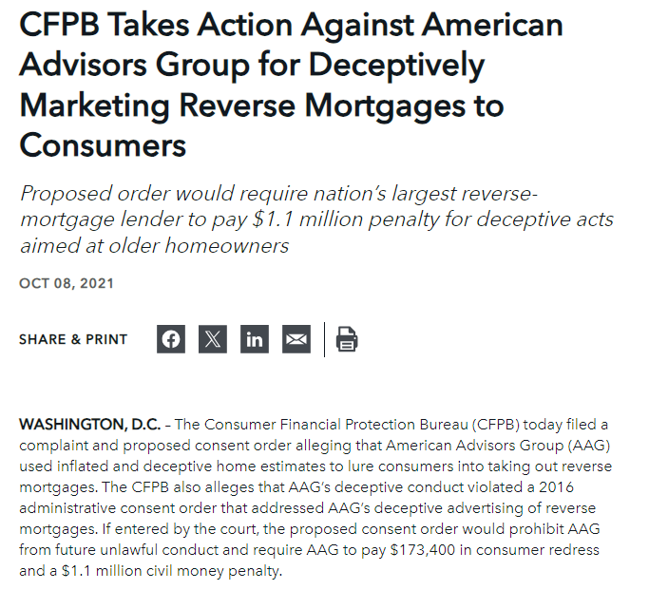
https://www.consumerfinance.gov/about-us/newsroom/cfpb-takes-action-against-american-advisors-group-for-deceptively-marketing-reverse-mortgages-to-consumers/
Notes:
The CFPB alleges that AAG violated the Consumer Financial Protection Act of 2010’s (CFPA’s) prohibition on deceptive acts and practices. Specifically, the CFPB alleges that AAG:
Deceptively inflated home values: In marketing their reverse mortgage products, AAG provided consumers with inflated estimates of home values to entice them to enter into negotiations to open a reverse mortgage. AAG’s actions were deceptive because they would lead a reasonable consumer to believe that the consumer could reap more proceeds from the reverse mortgage than were actually available.
Made deceptive representations about the accuracy of home estimates: AAG’s marketing materials to consumers stated that it “makes every attempt to ensure the home value information provided is reliable.” In fact, AAG made no real attempt to do this. AAG’s misrepresentations induced consumers to rely on AAG’s inflated estimates and to enter into negotiations with the company.
Violated 2016 administrative consent order: In December 2016, the CFPB filed an administrative consent order against AAG for a variety of deceptive statements made in marketing materials that violated the CFPA. The order prohibited AAG from violating the CFPA for five years, or until December 2021. The deceptive acts and practices committed by AAG as described in this complaint violate the 2016 consent order.

Slide 5

https://www.usatoday.com/in-depth/news/investigations/2019/06/11/seniors-face-foreclosure-retirement-after-failed-reverse-mortgage/1329043001/
Notes:
Consumer advocates said the analysis supports what they have complained about for years – that unscrupulous lenders targeted lower-income, black neighborhoods and encouraged elderly homeowners to borrow money while glossing over the risks and requirements.
USA TODAY found that reverse mortgages end in foreclosure six times more often in predominantly black neighborhoods than in neighborhoods that are 80% white.
Even comparing only poorer areas, black neighborhoods fare worse. In ZIP codes where most residents make less than $40,000, the analysis found reverse mortgage foreclosure rates were six times higher in black neighborhoods than in white ones.
The foreclosure disparity resembles a more familiar scenario from the late 2000s, when subprime lenders targeted specific neighborhoods with risky loans doomed to fail, according to the nation’s lead reverse mortgage researcher.
Stephanie Moulton, associate professor of public policy at Ohio State University, said cash-strapped minority borrowers were easy targets for “bad apple” reverse mortgage lenders capitalizing on a market shunned by traditional lenders.
“These areas had demand, and they couldn’t access credit any other way,” she said.
In hundreds of reverse mortgage default cases reviewed by USA TODAY, the homeowners’ original financial needs were basic, the kinds of challenges – house repairs and medical bills – that those with easier access to credit and more disposable income can weather with a second traditional mortgage or home equity loan 2.
Brokers desperate to replace income lost from the real estate crash with new commissions didn’t wait around for homeowners to come in seeking reverse mortgages, either. They went to where they knew people needed money and sometimes walked door-to-door, targeting houses with decaying roofs or leaky windows. Door hangers advertised a “tax-free” benefit for seniors.
Cherelle Parker 3, a councilwoman on Philadelphia’s north side, called reverse mortgages a scourge on her community that has put unnecessary financial and emotional strain on seniors. Not only has the area weathered more foreclosures, but the damage cuts deeper.

Slide 6
Roadmap
Overview of Reverse Mortgages Requirements (7-9)
Types of Reverse Mortgages (10)
Home Equity Conversion Mortgage (HECM) Overview (11-12)
Requirements to Qualify for HECM (13-16)
HECM Property Standards (17-18)
Financial Requirements & Assessment (19-23)
Required HECM Disclosures (24)
Designated Alternate Individual (25)
Reverse Mortgage Options (27-29)
Principal Limit (30-32)
Interest Rates (33)
Shared Appreciation (34-37)
Disbursements (38-40)
Ongoing Costs (41)
Property Charges (42)
Sets Asides & LESAs (44-56)
Insurance & Loss Mitigation (57-60)
Due and Payable Provisions (61-64)
Mortgage Terms & Provisions (65-68)
Lender Fails to Pay (69)
Example (70-75)
Medicaid Considerations (76-79)
Cautionary Considerations (81-83)
Other options (84-86)
*No legal advice intended. This presentation omits information that may affect a specific situation and is legal information only.

Slide 7
What is a Reverse Mortgage?
A special type of home loan which allows homeowners to borrow money against the equity in their home.
Unlike a traditional mortgage, a reverse mortgage does not require any payments. The mortgage is repaid when the borrower, co-borrower, or eligible spouse sells the home, moves out of the home, or dies.

Slide 8
What is a Reverse Mortgage?
Reverse mortgage: Nonrecourse consumer credit obligation
1. Nonrecourse means that the loan limits the homeowner’s liability to the proceeds of the sale of the house.
If the mortgage allows recourse against the consumer and the APR, points, or fees are too high then the rules for high cost mortgages apply, including restrictions on balloon payments.
2. The principal, interest, and shared appreciation or equity is not due or payable (unless there is a default) until:
The consumer dies
The home is transferred
The consumer ceases to occupy the dwelling as their principal dwelling.
Regulation Z, 12 C.F.R. § 1026.33

Slide 9

What is a Reverse Mortgage?
Contains a required disclosure which includes:
Statement that consumer does not have to complete the mortgage just because they signed the application or received disclosures
Good faith projection of the total cost of the credit, that reflects all costs to the consumer including shared appreciation
Itemization of the loan terms, charges, age of youngest borrower, and the appraised property value
A table with explanation showing annual loan costs rates for the transaction depending on how long the borrower lives and how much their home appreciates
Regulation Z, 12 C.F.R. § 1026.33
Notes:
Shared appreciation – allows lender to receive a portion of the home’s increase in value. In exchange, the borrower may receive a lower interest rate or other assistance.
https://www.consumerfinance.gov/rules-policy/regulations/1026/k/#d-1k
Tables essentially shows the costs for the loan depending on how long you keep the RM depending on how much the house appreciates in value.
The cost of any reverse mortgage loan depends on how long you keep the loan and how much your house appreciates in value. Generally, the longer you keep a reverse mortgage, the lower the total annual loan cost rate will be.
This table shows the estimated cost of your reverse mortgage loan, expressed as an annual rate. It illustrates the cost for three [four] loan terms: 2 years, [half of life expectancy for someone your age,] that life expectancy, and 1.4 times that life expectancy. The table also shows the cost of the loan, assuming the value of your home appreciates at three different rates: 0%, 4% and 8%.
The total annual loan cost rates in this table are based on the total charges associated with this loan. These charges typically include principal, interest, closing costs, mortgage insurance premiums, annuity costs, and servicing costs (but not costs when you sell the home).
The rates in this table are estimates. Your actual cost may differ if, for example, the amount of your loan advances varies or the interest rate on your mortgage changes.

Slide 10
Types of Reverse Mortgages
A reverse mortgage can either be:
HECM: Home Equity Conversion Mortgages are insured by the U.S. Department of Housing and Urban Development’s (HUD) Federal Housing Authority (FHA). These have numerous additional requirement.
Proprietary: these privately sponsored reverse mortgages typically allow higher borrowing amounts and have lower costs than HECMs. However, the federally insured HECMs typically offer lower interest rates and are more prevalent.
See Reverse Mortgage, Practical Law Glossary Item w-001-3646

Slide 11

Insurance of Home Equity Conversion Mortgages (HECM) for Elderly Homeowners, 12 U.S.C. § 1715z-20
Congress established the Reverse Mortgage program to enable elderly homeowners to convert equity in their homes into a supplemental income stream.
The Statute and implementing regulations set out requirements in detail. 12 U.S.C. § 1715z-20, 24 C.F.R. part 206.

Slide 12
HECM statutory purpose
Meet needs of “elderly homeowners” who are at least age 62 by:
Reducing the effect of economic hardship caused by increase health housing and subsistence needs at a time of reduced income,
Permitting conversion of accumulated home equity into liquid assets, and
Insuring home equity conversion mortgages that meet statutory and regulatory terms and conditions and underwriting requirements.
12 U.S.C. § 1715z-20

Slide 13
Requirements to Qualify for a HECM
The youngest borrower must be 62 at the time of closing
Property must be principal residence of each borrower and non-borrowing spouse eligible for deferral at death of borrower.
Non-borrowing spouse and non-borrowing owners must consent in writing and acknowledge that the property services as collateral for the HECM.
Mortgage secured by: single family home (1 to 4 units), manufactured homes built after June 1976, condos, properties in planned unit developments, townhouses, properties held in a living trust.
Ineligible properties: cooperative units, boarding houses, bed and breakfasts, manufactured homes built before June 15, 1976 or lacking HUD certification labels or a permanent foundation, and flipped properties. 12 U.S.C. § 1715z-20(d), 24 C.F.R. §§ 206.33, 206.35, 206.39, 206.45, https://www.hud.gov/sites/documents/7610-0_5_SECC.PDF
Notes:
“Flipped” properties are ineligible for purchase with a HECM. Properties are ineligible if they are being • sold by anyone other than the owner of record • re-sold 90 or fewer days from the previous sale, or • re-sold between 91 and 180 days from the previous sale and  the new sales price exceeds 100% of the previous sales price, and  there is no additional documentation to validate the property’s value. Note: HUD may issue exceptions to these restrictions to accommodate home sales in economically distressed areas. Potential borrowers must confirm with their lenders whether specific properties are exempt from HUD’s eligibility restrictions.
4. Eligibility of Properties Held in Trust Change Date PROTCL 5.C.4.a Properties Held in Trust Eligibility March 18, 2011 If a property is being held in a living trust for the benefit of the borrower or the future benefit of other individuals (such as the borrower’s heirs), the property may be eligible for a reverse mortgage if it meets all other eligibility criteria. The HECMapplication process for these types of properties is the same as for properties that are not held in trust. FHA does not require a trust to be irrevocable for the property to be eligible for a HECM. However, a lender may require the trust to be irrevocable as a condition for approving a reverse mortgage.

Slide 14
Requirements to Qualify for a HECM
Property has to be owned in fee simple or by a long term lease
Property must be freely marketable
Borrowers must have credit standing satisfactory to HUD and go through a Financial Assessment.
Borrower receives counseling from an independent third party not associated with the Borrower or anyone who sells annuities, investments, long-term care insurance or other financial or insurance products
Borrower received full disclosure of all costs to them including any non-required related services such as estate planning or financial advice
Lender must be approved by HUD
12 U.S.C. § 1715z-20(d), 24 C.F.R. §§ 206.37, 206.41, 206.45, https://www.hud.gov/sites/documents/7610-0_5_SECC.PDF
.
Notes:
Long Term Lease -- renewable lease of at least 99 years or not less tan 50 years beyond the date of the 100th birthday of the youngest borrower https://www.hud.gov/sites/documents/7610-0_5_SECC.PDF

Slide 15
Requirements to Qualify for a HECM
The borrower must have sufficient equity to pay any federal debts, all costs and fees, and any mortgage or liens on the property.
The borrower’s property will need to meet required property standards or the borrower can make the required repairs.
Make payments to the borrower either based:
on a line of credit,
on a monthly basis over either a specified term or the tenure of the mortgage, or
Over a monthly basis and based on a line of credit
Required disclosures to the borrower
12 U.S.C. § 1715z-20, 24 C.F.R. §§ 206.25(b)(7), 206.47(a).

Slide 16
Requirements to Qualify for a HECM
Prepayment, in whole or in party, can be made at any time without penalty
The borrower is not liable for any difference in the net amount of remaining indebtedness of the mortgage and the amount recovered by the lender from the net sale proceeds of the dwelling or the Government’s insurance disbursements
This is because the borrower purchases Government insurance that guarantees borrower will receive loan funds when the lender does not pay. The insurance pays the lender when the loan balance exceeds balance of home.
12 U.S.C. § 1715z-20
Notes:
If balance of the loan is more than the appraised value, the home can be sold at 95% of appraised value and the remaining balance of the loan is covered by mortgage insurance.
If property sells for more than the balance, owed you keep the difference.

Slide 17
HECM Property Standards
Properties must be habitable and safe to be eligible for a HECM loan.
Properties must meet HUD’s property requirements to be eligible or must be repaired to make sure the property will serve as adequate security for the insured mortgage.
The mortgage may be closed before the repair work is completed if the HUD estimated cost of remaining repairs does not exceed 15% of the maximum claim amount.
24 C.F.R. §§ 206.45, 206.47, https://www.hud.gov/sites/documents/7610-0_5_SECC.PDF

Slide 18
HECM Property Standards: Repairs Made After Closing
For repairs completed after closing, the property has to be inspected by a HUD approved inspector before funds can be released.
Held back funds are released after final inspection and approval of the release by the lender.
The lender shall not reimburse the borrower for any labor the borrower performed. The lender may reimburse the borrower for the actual cost of repair materials from the Repair Set Aside
24 C.F.R. § 206.47

Slide 19
Financial Requirements
The lender will verify the borrower’s income, assets, monthly living expenses, recurring monthly payments and credit history
The lender will confirm the borrower is paying the real estate taxes and property insurance
The borrower needs to document sufficient income or assets to continue payment of real estate taxes and property insurance.

Slide 20
Financial Assessment
Prior to loan approval, the lender must assess the financial capacity of the borrower.
This evaluation is required to determine if the HECM is a sustainable solution for the borrower.
Must be conducted in a uniform manner that does not discriminate. Must comply with the Fair Housing Act, Fair Credit Reporting Act, Equal Credit Opportunity Act, and Regulation B.
24 C.F.R. § 206.37(b)(1)
Notes:
(3) Nondiscrimination.
(i) The Financial Assessment shall be conducted in a uniform manner that shall not discriminate because of race, color, religion, sex, national origin, familial status, disability, marital status, actual or perceived sexual orientation, gender identity, source of income of the borrower, location of the property, or because the applicant has in good faith exercised any right under the Consumer Credit Protection Act (15 U.S.C. 1601 et seq.).
(ii) The Financial Assessment shall be conducted in compliance with all applicable laws and regulations, including but not limited to, the following:
(A) Fair Housing Act (42 U.S.C. 3601 et seq.);
(B) Fair Credit Reporting Act (15 U.S.C. 1681 et seq.);
(C) Equal Credit Opportunity Act (15 U.S.C. 1691 et seq.); and
(D) Regulation B (12 CFR part 1002).

Slide 21
Financial Assessment
1. Credit history
in-depth credit history analysis by lenders under FHA guidelines to determine if the borrower has demonstrated the willingness to meet his or her financial obligations.
2. Cash flow and residual income analysis:
cash flow and residual income analysis by lenders under FHA guidelines to determine the capacity of the borrower to meet their documented financial obligations with their documented income.
24 C.F.R. § 206.37(b)(1)
Notes:
Credit history. In accordance with FHA guidelines in existence at the time of FHA Case Number
assignment, mortgagees shall conduct an in-depth credit history analysis to determine if the
borrower has demonstrated the willingness to meet his or her financial obligations.
Cash flow and residual income analysis. In accordance with FHA guidelines in existence at the
time of FHA Case Number assignment, mortgagees shall conduct a cash flow and residual
income analysis to determine the capacity of the borrower to meet his or her documented
financial obligations with his or her documented income.

Slide 22
Financial Assessment
3. Extenuating circumstances:
Where the borrower's credit history does not meet the criteria based on FHA guidelines, lenders consider and document extenuating circumstances that led to the credit issues.
4. Compensating factors:
The lender shall document and identify in the Financial Assessment any considered compensating factors.
24 C.F.R. § 206.37(b)(1)

Slide 23
HUD’s HECM Counselors in Ohio
There are 2 certified counseling agencies in Ohio
https://entp.hud.gov/idapp/html/hecm_agency_look.cfm
CHN HOUSING PARTNERS | SUITE 134 2999 PAYNE AVE STE 134 CLEVELAND, OH 44114-4436 | (216) 881-8443 | https://www.chnhousingpartners.org
GREENPATH FINANCIAL WELLNESS | 2465 EXECUTIVE PARK BLVD FAIRBORN, OH 45324-6219 | (888) 860-4167 | http://www.greenpath.org
Notes:
24 cfr 406.41 Counseling
(a) List provided. At the time of the initial contact with the prospective borrower, the mortgagee shall give the
borrower a list of the names, addresses, and telephone numbers of HECM counselors and their employing
agencies, which have been approved by the Commissioner, in accordance with subpart E of this part, as
qualified and able to provide the information described in paragraph (b) of this section. The borrower, any
Eligible or Ineligible Non-Borrowing Spouse, and any non-borrowing owner must receive counseling.
(b) Information to be provided.
A HECM counselor must discuss with the borrower:
(i) The information required by section 255(f) of the NHA;
(ii) Whether the borrower has signed a contract or agreement with an estate planning service firm
that requires, or purports to require, the borrower to pay a fee on or after closing that may
exceed amounts permitted by the Commissioner or this part;
(iii) If such a contract has been signed under paragraph (b)(1)(ii) of this section, the extent to which
services under the contract may not be needed or may be available at nominal or no cost from
other sources, including the mortgagee; and
(iv) Any other requirements determined by the Commissioner.
(2) If the HECM borrower has an Eligible Non-Borrowing Spouse, in addition to meeting the requirements
of paragraph (b)(1) of this section, a HECM counselor shall discuss with the borrower and Eligible Non-Borrowing Spouse:
(i) The requirement that the Eligible Non-Borrowing Spouse must obtain ownership of the property
or other legal right to remain in the property for life, upon the death of the last surviving
borrower;
(ii) A failure to obtain ownership or other legal right to remain in the property for life will result in
the HECM becoming due and payable and the Eligible Non-Borrowing Spouse will not receive
the benefit of the Deferral Period;
(iii) The requirement that the property must be the principal residence of the Eligible Non-Borrowing
Spouse prior to and after the death of the borrowing spouse;
(iv) The requirement that the Eligible Non-Borrowing Spouse fulfills all obligations of the mortgage,
including the payment of property charges and upkeep of the property; and
(v) Any other requirements determined by the Commissioner.
(3) If the HECM borrower has an Ineligible Non-Borrowing Spouse, in addition to meeting the
requirements of paragraph (b)(1) of this section, a HECM counselor shall discuss with the borrower
and Ineligible Non-Borrowing Spouse:
(i) The Deferral Period will not be applicable;
(ii) The HECM will become due and payable upon the death of the last surviving borrower; and
(iii) Any other requirements determined by the Commissioner.
(c) Certificate. The HECM counselor will provide the borrower with a certificate stating that the borrower, Non-
Borrowing Spouse, and non-borrowing owner, as applicable, has received counseling. The borrower shall
provide the mortgagee with a physical copy of the certificate.

Slide 24
Additional HECM Disclosures
In addition to the standard reverse mortgage disclosures:
Lender must ensure the borrower received full disclosure of all costs of obtaining the mortgage.
Lender shall ask the borrower about any costs or other obligations that the borrower has incurred to obtain the mortgage.
Lender shall clearly state to the borrower which charges are required to obtain the mortgage and which are not required to obtain the mortgage.
If borrower requests that at least 25% of the principal limit amount be disbursed to them at closing (excluding disbursal of amount used to pay insurance, repairs, and other charges), lender must confirm the disbursement will not be used to pay an estate planning firm.
24 C.F.R. § 206.43

Slide 25
Designated Alternate Individual
Designation of alternate individual:
At origination, the lender shall request that the borrower designate an alternate individual for the purpose of communicating with the lender if they are not able to reach the borrower.
The designation of the alternate individual is at the discretion of the borrower.
If the lender cannot contact or communicate with the borrower for any reason, including death or incapacitation, the lender shall communicate with the alternate individual, if designated.
24 C.F.R. § 206.40(c)

Slide 26
Poll Question # 1

Slide 27
HECM Reverse Mortgage Options
Monthly payment defined by a Term: Equal monthly payments are made to the borrower for a fixed term of months chosen by the lender. Payments are made even if loan balance exceeds principal limit.
Monthly payment defined by Tenure: the amount of the monthly disbursement is calculated as if the payment term is either:
(100 – age of youngest borrower) x 12
or
if youngest borrower is older than 95, (100 – 95) x 12
Payments will continue until the mortgage becomes due and payable unless payments exceed maximum mortgage amount in the security instrument.
Notes:
Term plan – when the term is up payments will be stopped, but you can continue living in your house until you default or the loan becomes due and payable.
Tenure plan – payments are calculated as if the borrower will live to 100. If they live past 100 they will continue receiving money.
If the borrower has a shorter life expectancy, they may do better with a term payment plan, which would allow them to receive higher monthly payments. https://www.investopedia.com/terms/t/tenure-payment-plan.asp

Slide 28
HECM Reverse Mortgage Options
Line of Credit: payments are made to the borrower at times and in amounts determined by the lender. Payment amounts cannot exceed those permitted by HUD.
Modified Term or Modified Tenure: equal monthly payments, but a portion of the principal limit is set aside to be drawn down as a line of credit
Single Disbursement: all available equity is disbursed at time of closing. Unlike other HECMs, these are fixed rate.
24 C.F.R. §§ 206.17, 206.19
Notes:
Line of credit option allows the unused portion of the line of grown to grow at a set interest rate. Also allows the borrower to withdraw more money earlier.

Slide 29
Use of a HECM Reverse Mortgage to Buy a Home
The borrower can use a reverse mortgage to purchase a new home if the borrower has cash sufficient to provide a large down payment to create equity on the purchase.
HECM for Purchase Transaction:
Title to the property is transferred to the HECM borrower and at closing, the HECM first (and second lien if applicable) is the only lien against the property.
Construction must be completed and the property is habitable, as evidenced by the issuance of a Certificate of Occupancy.
24 C.F.R. § 206.45(g)

Slide 30
Principal Limit
Principal Limit: amount of money the borrower can borrow on a reverse mortgage. Its calculation considers:
the age of the youngest borrower or Eligible Non–Borrowing Spouse,
the expected average mortgage interest rate, and
the maximum claim amount, which is lesser of:
Appraised value of property
Sales price, but only for property being purchased for purpose of being principal residence
National mortgage limit for a one-family residence under the National Housing Act, which is $1,149,825 (2024).
24 C.F.R. § 206.3
Notes:
Maximum claim amount means the lesser of the:
- appraised value of the property, as determined by the appraisal
used in underwriting the loan;
- the sales price of the property being purchased for the sole purpose of
being the principal residence; or
- the national mortgage limit for a one-family residence under subsections
255(g) or (m) of the National Housing Act (as adjusted where applicable under section 214 of the
National Housing Act) as of the date of loan closing.
The initial mortgage insurance premium must not be
taken into account in the calculation of the maximum claim amount. Closing costs must not be taken into
account in determining appraised value
https://www.hud.gov/program_offices/housing/sfh/hecm/hecmabou

Slide 31
Principal Limit
Calculated for the first month of a mortgage using factors provided by HUD. It increases monthly at a rate of 1/12th of the mortgage interest rate plus 1/12th of the annual mortgage insurance rate.
For HECMs with adjustable interest rates, the principal limit increase can be made available to the borrower monthly.
For HECMs with a fixed interest rate, no further funds may be made available for the borrower to draw against after closing.
If insurance or condemnation proceeds are paid to the lender to restore or repair damaged property, the principal limit can decrease.
24 C.F.R. §§ 206.3, 206.209.

Slide 32
Principal Limit Set Asides
Borrowers do not get the principal limit. Set asides include:
Servicing Charges
LESAs: Life Expectancy Set Asides, and
Repair Set Asides
24 C.F.R. § 206.19(f)
Notes:
See: http://www.communitysolutions.com/images/upload/resources/sbmv3n12.pdf
Servicing charges – for a period sufficient to cover the period used to calculate tenure payment – must be disclosed at in a range approved by the commissioner.
Set aside accounts – LESAs
Repair set aside for repairs not yet performed

Slide 33
Interest Rates
Fixed Interest Rates for Single Disbursement HECMS – interest rate is agreed to between the lender and borrower
Adjustable Interest Rates for All Other Types of HECMs – the initial rate is agreed to by the lender and borrower:
Annual Adjustable Interest Rate HECMS –annual changes of no more than 2 percentage points per year or 5 percentage points in either direction from initial rate over the life of the loan. Adjustments tied to:
Average weekly yield on US Treasury Securities adjusted to constant maturity of a year,
30-day average Secured Overnight Financing Rate (SOFR), or
Alternative SOFR approved by HUD
Monthly Adjustable Interest Rate HECMS – monthly changes tied to same 3 indexes, cap of no more than a 10 percentage point change from initial rate in either direction for life of loan.
24 C.F.R. § 206.21
Notes:
Adjustable Interest Rate … Whenever an interest rate is adjusted, the new interest
rate applies to the entire loan balance. The difference between the initial interest rate and the index figure
applicable when the firm commitment is issued shall equal the margin used to determine interest rate
adjustments. If the expected average mortgage interest rate is locked in prior to closing, the difference
between the expected average mortgage interest rate and the value of the appropriate index at the time of
rate lock-in shall equal the margin used to determine interest rate adjustments. 206.21(b)
Margin means the amount added to the index value to compute the expected average mortgage interest rate
and the initial mortgage interest (Note) rate and periodic adjustments to the mortgage interest (Note)
rate. 206.3
This means that the index used to calculate the initial mortgage interest rate must be the same index type used to calculate interest rate adjustments. 206.21(b)(1)(ii) and (b)(2)(I)
(c) Pre-loan disclosure.
(1) At the time the mortgagee provides the borrower with a loan application, a mortgagee shall provide a
borrower with a written explanation of all adjustable interest rate features of a mortgage. The
explanation must include the following items:
(i) The circumstances under which the rate may increase;
(ii) Any limitations on the increase; and
(iii) The effect of an increase.
(2) Compliance with pre-loan disclosure provisions of 12 CFR part 1026 (Truth in Lending) shall
constitute full compliance with paragraph (c)(1) of this section.
(d) Post-loan disclosure. At least 25 days before any adjustment to the interest rate may occur, the mortgagee
must advise the borrower of the following:
(1) The current index amount;
(2) The date of publication of the index; and
(3) The new interest rate.

Slide 34
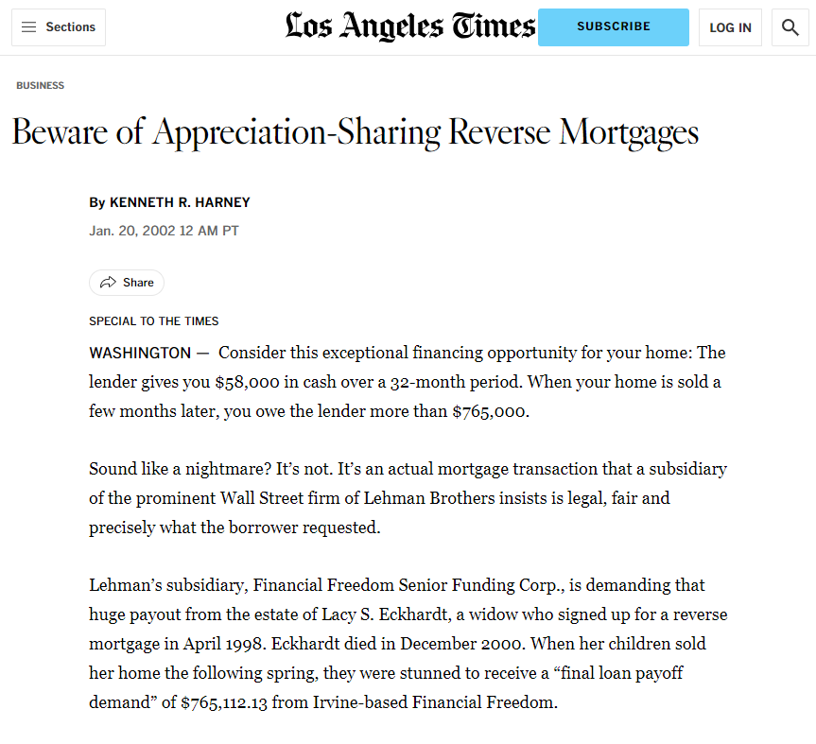
https://www.latimes.com/archives/la-xpm-2002-jan-20-re-harney20-story.html

Slide 35
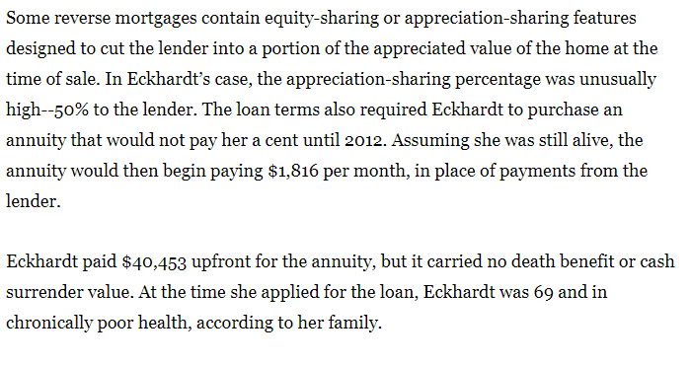
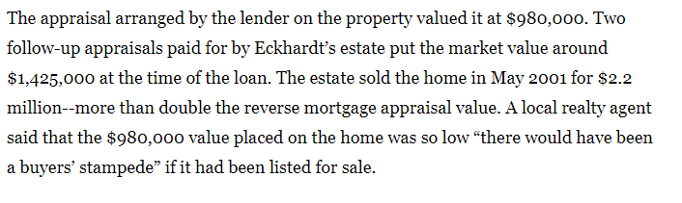
https://www.latimes.com/archives/la-xpm-2002-jan-20-re-harney20-story.html

Slide 36
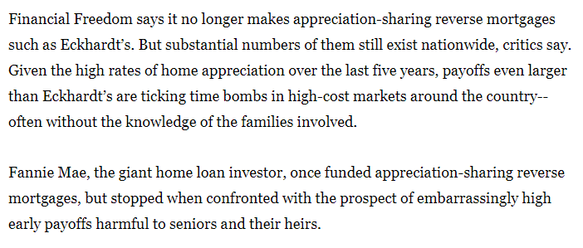
https://www.latimes.com/archives/la-xpm-2002-jan-20-re-harney20-story.html

Slide 37
Shared Appreciation
HECMS can require shared appreciation with the lender as additional interest.
When the mortgage is due and payable, the borrower pays the lender a percentage of the net appreciated value of the property during the life of the mortgage.
Net Appreciated Value Paid to Lender =
Appreciation Margin x (Adjusted Sale Proceeds minus the greater of either the
capped at 25% appraised value at loan origination OR outstanding amount owed)
If loan balance is greater than adjusted sales proceeds, then net appreciated value is zero
If there is no sale, then adjusted sales proceeds is appraised value under HUD procedures
Also subject to an effective interest rate cap of 20% that considers how much interest the lender was paid over the twelve months prior to sale. 24 C.F.R. § 206.23
Notes:
Adjusted sale proceeds – sale proceeds less transfer costs and capital improvement costs incurred by borrower, excluding any liens
Effective Interest Rate Calculation:
Interest which accrued in 12 months prior to sale of the property is added to the lender’s share of net appreciated value.
Then -- (sum of lender’s share of net appreciated value and interest) divided by (sum of outstanding loan balance at the beginning of the 12 month prior to sale (or prepayment) PLUS payments to borrower or on behalf of borrower not including interest in 12 months prior to sale or prepayment) cannot exceed an effective interest rate of 20%.

Slide 38
Initial Disbursement Limit
Initial Disbursement Limit = maximum amount of funds that can be advanced to a borrower at loan closing and during the First 12-Month Disbursement Period following closing. For Fixed Rate HECMS, this is called Borrower’s Advance.
For all HECMs, this amount is the lesser of:
The greater of:
60% of Principal Limit (Amount set by HUD), or
Sum of Mandatory Obligations and 10% of Principal Limit OR
The Principal Limit less funds in a LESA and Servicing Fee Set Aside
24 C.F.R. § 206.25
Notes:
24 cfr 206.25
60% is in the HUD model Agreement -- https://www.hud.gov/sites/dfiles/SFH/documents/HECM%20ARM%20Model%20Loan%20Agreement.pdf

Slide 39
Mandatory Obligation Disbursements
Loan Origination Fee
2% of the first $200,000 of appraised value, plus 1% of additional home value
Floor at least $2,500; Cap of $6,000, increased annually 12 U.S.C. § 1715z-20(r)
Mortgage Insurance Premiums (MIP)
Initiation MIP that does not exceed 3% of the lesser of the appraised value of property, sales price of property being purchased as a principal residence, or the national mortgage limit under the National Housing Act (not including closing costs) 24 C.F.R. § 206.102.
HECM Counseling Fee
Repair Set Asides
Repair administration fees (not to exceed greater 1.5% of amount advanced for repairs or $50)
Delinquent federal debt
Amounts to discharge existing liens on the property

Slide 40
Mandatory Obligation Disbursements
Customary fees and charges for warranties, inspections, surveys, and engineer certifications
Funds to contractors who made repairs as a condition of closing
Certain Property Charges (property tax and flood and hazard insurance)
Reasonable and customary amount, but no more than what the lender actually paid for:
Recording fees and recording taxes, or other charges incident to the recordation of the insured mortgage;
Credit report;
Survey, if required by the lender or the borrower;
Title examination;
Lender's title insurance;
Fees paid to an appraiser for the initial appraisal of the property; and
Flood certifications.
Payoff of other debt required by HUD 24 C.F.R. §§ 206.25, 206.31

Slide 41
Ongoing Costs
Ongoing costs are added to the loan balance each month. These include:
Interest
Servicing fees paid to the lender to cover the costs of sending account statements, distributing loan proceeds, and confirming the borrower’s compliance with loan requirements.
Monthly mortgage insurance premiums up to a rate that does not exceed 1.5% of the outstanding mortgage balance (or 1.55% if the original principal obligation is greater than 95% of the appraised value of the property).
These ongoing costs increase as the loan balance increases, thereby using up the borrower's equity even faster.
24 C.F.R. § 206.105
41
Notes:
The mortgage insurance

Slide 42
Property Charges
The borrower must also be able to pay all Property Charges on an on-going basis. These include:
- Property taxes | - Condominium fees
- Hazard insurance premiums | - Planned unit development fees
- Ground rents | - Homeowner’s Association fees
- Any applicable flood insurance premiums | - Special assessments levied by municipalities or state law
24 C.F.R. §§ 206.3, 206.205
Notes:
property taxes, hazard insurance premiums, any applicable flood insurance premiums, ground rents, condominium fees, planned unit development fees, homeowners' association fees, and any other special assessments that may be levied by municipalities or state law.

Slide 43
Poll Question # 2

Slide 44
Set Aside Accounts
The lender can also establish and set aside funds into a separate account for additional costs such as monthly service fees, required repairs, and property taxes and insurance for the first year of the loan.
24 C.F.R.§ 206.16(f)
If the property requires repairs, the lender may collect a fee for each repair not to exceed 1.5 % of the advance or $50.
24 C.F.R. § 206.31
44

Slide 45
Life Expectancy Set Aside (LESA)
When the financial assessment shows the borrower is unable to pay Property Charges (property taxes and flood and hazard insurance premiums), the lender must require that a portion of the Principal Limit be set aside.
If the borrower can pay the charges, they can elect a full or partial LESA.
24 C.F.R. §§ 206.19(f)(2)(i), 206.205(b)(2)

Slide 46
Lender Duties: Fully Funded LESA
For a Fully–Funded LESA, the lender shall:
(A) Pay property charges before bills become delinquent and establish controls to ensure information needed to pay such bills is obtained on a timely basis;
(B) Make early payments to take advantage discounts to the borrower's advantage;
(C) Not charge the borrower penalties for late payments unless the penalty was the direct result of the borrower's error or omission;
(D) Ensure that LESA funds are not held in an escrow account;
(E) Add payments for property charges to the outstanding loan balance when the lender disburses funds to the taxing authority or insurance carrier; and
(F) Provide written notification to the borrower and FHA within 30 days of the receiving notice that a property charge payment is outstanding when there are no funds or insufficient funds remaining in the LESA, and recommend that the borrower speak with a HUD–Approved Housing Counselor.
24 C.F.R. § 206.205(C)(1)(i)
24 C.F.R. 206.205
Notes:
Fixed Rate Mortgages with LESAs have to be fully funded.

Slide 47
Lender Duties: Partially Funded LESA
For a Partially–Funded LESA, the lender shall:
(A) Ensure that LESA funds are disbursed to the borrower semi-annually;
(B) Establish controls to ensure the taxing authority, insurance carrier, or both, received the borrower's payment;
(C) Ensure the LESA funds are not held in an escrow account;
(D) Add payments disbursed to the borrower for the payment of property charges to the outstanding loan balance when the lender disburses the funds; and
(E) Provide written notification to the borrower and FHA within 30 days of receiving notification that a property charge payment is outstanding when there are no funds or insufficient funds remaining in the LESA, and recommend that the borrower speak with a HUD–Approved Housing Counselor.
24 C.F.R. § 206.205(c)(1)(ii)

Slide 48
LESAs: Calculation of Property Charges
Calculation of property charges.
(i) The projected cost of property charges is calculated with a HUD formula using life expectancy of the youngest borrower.
(ii) Lender cannot require a LESA be funded in excess of projected property charges.
(iii) Fully–Funded LESA: amount withheld will equal the projected cost of property charges.
(iv) Partially–Funded LESA: amount withheld is based on a calculation of the gap in residual income.
24 C.F.R. § 206.205(c)(2)

Slide 49
LESA Annual Analysis
Lender must perform an annual analysis of the LESA to determine if the funds are sufficient to make required distributions for the next year.
If funds are exhausted or there is an insufficient balance determination, the lender must notify the borrower, in writing and within 15 calendar days:
that LESA funds are exhausted or insufficient and
the borrower will be responsible for the payment of property charges.
24 C.F.R. § 206.205(c)(3)

Slide 50
LESAs: Paying Property Charges
The LESA has no more funds and it is a Fully–Funded LESA for an adjustable interest rate HECM.
If the borrower fails to make property charge payments, the lender shall use any available principal limit to pay the outstanding property charges.
The lender must notify the borrower of nonpayment and then the borrower has 30 days to respond and explain.
If there is no available principal limit and the borrower fails to pay the property charges, the mortgage will become due and payable.
24 C.F.R. § 206.205(C)(4)

Slide 51
LESAs: Paying Property Charges
The LESA has no more funds and it is a Fully–Funded LESA for a fixed interest rate HECM:
If the borrower fails to make property charge payments, the mortgage will become due and payable
24 C.F.R. § 206.205(C)(4)(ii)

Slide 52
LESAs: Paying Property Charges
A Partially–Funded LESA has remaining funds, but the borrower fails to pay property charges. The lender shall:
Immediately suspend future semi-annual payments to the borrower from the Partially–Funded LESA, although scheduled and unscheduled payments from the borrower's payment option may continue;
Disburse funds to pay past due property charges; and
Notify borrower in writing that a property charge payment is outstanding and funds were advanced from the Partially–Funded LESA to pay the outstanding property charge. The borrower has 30 days to respond and explain the circumstances.
24 C.F.R. § 206.205(C)(4)(iii)

Slide 53
LESAs: Paying Property Charges
A Partially–Funded LESA has no remaining funds.
If the LESA is exhausted and the borrower fails to make property charge payments when due, the lender can pay property charges with any funds available in the principal limit.
The lender shall provide written notification to the borrower within 30 days of receiving notice of an outstanding property charge. The borrower shall have 30 days to explain the circumstances of the non-payment to the lender.
If there is no available principal limit to pay the property charges and the borrower does not pay them, then the mortgage becomes due and payable.
24 C.F.R. § 206.205(C)(4)(iv)

Slide 54
Optional Withholding for Property Charges
Even if not required to have a LESA, a borrower may elect at closing to require the lender to pay property charges by withholding funds from monthly payments due to the borrower or by charging such funds to a line of credit.
Borrower cannot elect to cancel this
Borrower must start paying property charges if the Principal Limit is reached or if the HECM proceeds are insufficient to pay the property charges.
Lender cannot put funds withheld from borrower payments to pay property charges into an escrow account
Lender is responsible for paying property charges before they become delinquent. They must pay bills early to take advantage of any discount.
Lender must analyze withholdings yearly.
24 C.F.R. § 206.205(d)(2)(i)
Notes:
Not later than the end of the second loan year the mortgagee shall establish a system for the periodic analysis of the amounts withheld from monthly payments. The analysis shall be performed at least once a year thereafter. The amount shall be adjusted, after analysis, to provide sufficient available funds to make anticipated disbursements during the ensuing year. The borrower shall be given at least ten days' notice of adjustment in the amount of withholding and an adequate explanation of the reasons for any change. When the amount withheld is analyzed in accordance with this paragraph, any surplus shall be paid to the borrower and added to the outstanding loan balance. Any shortage shall be corrected through increasing the monthly withholding as provided in paragraph (d)(2)(iv) of this section. If amounts withheld are insufficient to pay a property charge before it is delinquent, and the borrower could request a payment equal to the shortage under § 206.26(b), then the mortgagee shall pay the full property charge and treat payment of the shortage as a payment requested by the borrower under § 206.26(b).
24 C.F.R. 206.205(c)(4)(d)(iii)
The mortgagee's estimate of withholding amount shall be based on the best information available as to probable payments which will be required to be made for property charges in the coming year. If actual disbursements during the preceding year are used as the basis, the resulting estimate may deviate from those disbursements by as much as ten percent. The mortgagee may not require withholding in excess of the current estimated total annual requirement, unless expressly requested by the borrower. Each monthly withholding for property charges shall equal one-twelfth of the annual amounts as reasonably estimated by the mortgagee.
24 C.F.R. § 206.205(c)(4)(d)(iv)

Slide 55
Borrower Elects to Pay Property Charges
If a LESA is not required based on the results of the Financial Assessment, the borrower may elect to be responsible for the independent payment of all property charges
Borrower must pay property charges in a timely manner
Borrower must provide evidence of payment to the lender as required in the mortgage.
24 C.F.R. § 206.205(e)(1)

Slide 56
Borrower Elects to Pay Property Charges
A borrower who elected to pay their own property charges fails to pay them:
The lender may make the payment for the borrower and charge the borrower's account if there are available funds.
If a pattern of missed payments occurs, the lender may begin to pay property charges as if the borrower elected to have the lender pay the property charges under this section.
The lender must notify the borrower and HUD within 30 days of lender receipt of notice of missed payment when there are no available HECM funds. The borrower has 30 days to provide an explanation.
If the borrower is does not repay the lender for funds advanced to pay property charges outside of a LESA, the lender shall submit a due and payable request.
24 C.F.R. § 206.205(e)(2)

Slide 57
What if the loan balance is more than the home value?
The borrower can sell the borrower's home for the appraised fair market value. The mortgage insurance pays the balance.
Upon death of all borrowers and the borrower’s spouse, the borrower's heirs can sell the home and pay 95% of the appraised value. The remaining balance is covered by mortgage insurance.

Slide 58
Loss Mitigation
A borrower, even after a foreclosure proceeding is begun can correct the condition which resulted in the mortgage coming due and payable and to reinstate the mortgage, and the mortgage insurance shall continue in effect. The Lender may require the borrower to pay any costs incurred to reinstate the borrower, including foreclosure costs and reasonable attorney's fees. Such costs shall be paid by adding them to the outstanding loan balance. The Lender may refuse reinstatement if:
(i) Reinstatement of the mortgage within the past two years;
(ii) Reinstatement will preclude foreclosure if the mortgage becomes due and payable at a later date; or
(iii) Reinstatement will adversely affect the priority of the mortgage lien.
24 C.F.R. 206.125(3)

Slide 59
Repayment Plan
Can include HOA fees.
Length of plan may be up to 5 years (60 months)
Length of the plan based on whether the total arrearage divided by the borrower’s monthly surplus income would result in 60 months or less than 60 months of payments
RPP may be offered if the monthly payment consumes more than 25% of surplus income, so long as there is a “reasonable expectation” of performance on the RPP. Handbook 4001at 1496.
https://pfs2.acl.gov/strapib/assets/Reverse_Mortgage_Update_Slides_65a787f5ea.pdf

Slide 60
Hardship Exception
Servicer may request foreclosure extension from HUD if:
• Youngest borrower at least 80; and
• Borrower has critical circumstances such as terminal illness, substantiated long-term physical disability, or a “unique” occupancy need (e.g., terminal illness of family member receiving care at residence)
• Servicer must include supporting documentation which borrower must furnish.
• If approved, servicer to provide supporting docs to HUD on no less than an annual basis. HUD Mortgagee Letter 2015-11
https://www.hud.gov/sites/documents/15-11ML.PDF

Slide 61
HECM Due and Payable Provisions
“Eligible Non-Borrowing Spouse”:
Have been married to the borrower at the time the loan documents were signed and stay married to them until their death.
Have been identified in the loan documents as a non-borrowing spouse.
Have lived, and continue to live, in the home as their principal residence after the borrower dies or the borrower moves into a healthcare facility for more than 12 consecutive months.
Meet any other HUD requirements.
24 C.F.R. § 206.55(c)
Notes:
Principal residence means the dwelling where the borrower and, if applicable, Non-Borrowing Spouse, maintain
their permanent place of abode, and typically spend the majority of the calendar year. A person may have
only one principal residence at any one time. The property shall be considered to be the principal
residence of any borrower who is temporarily in a health care institution provided the borrower's residency
in a health care institution does not exceed twelve consecutive months. The property shall be considered
to be the principal residence of any Non-Borrowing Spouse, who is temporarily in a health care institution,
as long as the property is the principal residence of his or her borrower spouse, who physically resides in
the property. During a Deferral Period, the property shall continue to be considered to be the principal
residence of any Non-Borrowing Spouse, who is temporarily in a health care institution, provided he or she
qualified as an Eligible Non-Borrowing Spouse and physically occupied the property immediately prior to
entering the health care institution and his or her residency in a health care institution does not exceed
twelve consecutive months.

Slide 62
HECM Due and Payable Provisions
The outstanding loan balance is due and payable in full if:
a borrower dies and the property is not the principal residence of at least one surviving borrower or an eligible non-borrowing spouse in deferral.
The property is sold or conveyed and no other borrower retains title to the property. A borrower retains title in the property if the borrower continues to hold title to any part of the property in fee simple, a leasehold interest, or as a life estate.
24 C.F.R. § 206.27(c)
Notes:
Due and Payable status is deferred for a Deferral Period for an Eligible Non–Borrowing Spouse until the death of the last Eligible Non–Borrowing Spouse or the requirements of the Deferral Period in cease to be met and have not been cured.
24 C.F.R. § 206.27(c)(3)

Slide 63
HECM Due and Payable Provisions
The outstanding loan balance is due and payable in full if:
The property ceases to be the principal residence of a borrower for reasons other than death and the property is not the principal residence of at least one other borrower;
For a period of longer than 12 consecutive months, a borrower fails to occupy the property because of physical or mental illness and the property is not the principal residence of at least one other borrower or eligible non-borrowing spouse;
The borrower does not provide for the payment of property charges, or
An obligation of the borrower under the mortgage is not performed.
24 C.F.R. § 206.27(c), 206.03.
Notes:
If the borrower is away for more than 12 consecutive months in a healthcare facility such as a hospital, rehabilitation center, nursing home, or assisted living facility and there is no co-borrower or Eligible Non-Borrowing Spouse living in the home, anyone living with the borrower will have to move out unless they are able to pay back the loan.

Slide 64
Deferral of Due and Payable Provisions
On the death of the borrower, there is a deferral period for a qualifying Eligible Non-Borrowing spouse, when these terms are satisfied:
Within 90 days from the death of the borrower, establish legal ownership or other ongoing legal right to remain for life in the property securing the HECM;
Ensure all other obligations in the loan documents continue to be satisfied; and
Ensure that the HECM does not become eligible to be called due and payable for any other reason.
24 C.F.R. § 206.55(d)
64
Notes:
There is also an additional 30 day period to cure a default for qualifying Non-Borrrowing spouses. 24 CFR 206.57

Slide 65
Mortgage Terms & Provisions
Form for a HECM must be approved by HUD
Mortgage terms must include:
Explanation of how payments will be made to the borrower
Explanation of how interest will be charged,
Explanation of when the mortgage will be due and payable.
Mortgage must defer due and payable status that occurs because of the death of the last surviving borrower for an Eligible Non–Borrowing Spouse.
Borrower must insure the property
24 C.F.R. § 206.27(a), (b)

Slide 66
Mortgage Terms: Disbursements
Term and Tenure HECMS: disbursements mailed or electronically transferred on the first business day of each month beginning with the first month after closing.
Line of Credit HECMS: disbursements mailed or electronically transferred within five business days after the lender receives a written request for disbursement by the borrower.
Disbursements end during a Deferral Period.
24 C.F.R. § 206.27(b)(1)

Slide 67
Mortgage Terms & Provisions
The borrower cannot participate in a real estate tax deferral program or permit any liens to be recorded against the property, except for subordinate liens
A mortgage may be prepaid in full or in part
The borrower must keep the property in good repair
The borrower must provide for the payment of property charges
The payment of monthly insurance premiums (MIP) may be added to the outstanding principal balance
24 C.F.R. § 206.27(b)

Slide 68
Mortgage Terms & Provisions
Borrower shall have no personal liability for payment of the outstanding loan balance.
Lender can only enforce the debt only through sale of the property.
24 C.F.R. § 206.27(b)

Slide 69
What if a Lender fails to make payments?
Borrower should complain to HUD.
HUD will investigate.
If HUD determines that the lender is unable or unwilling to make all payments required under the mortgage, including late charges, HUD shall pay such payments and late charges to the borrower.
HUD will demand repayment from the lender.
If the lender fails to repay, HUD can terminate the insurance contact and take a second mortgage on the property in the amount paid to the borrower
24 C.F.R. § 206.121
24 C.F.R. § 206.121
69
Notes:
If the mortgagee fails to make the payments to the borrower as required under the mortgage, and does not reimburse the Commissioner or assign the mortgage to the Commissioner within 30 days from the demand by the Commissioner for reimbursement or assignment, the contract of insurance shall automatically terminate. The Commissioner may later reinstate the contract of insurance, which shall continue in force as if no termination had occurred, upon reimbursement with interest as provided in § 206.121. Upon reinstatement, the mortgagee shall be liable for all MIP which would have been due if no termination had occurred, including late charge and interest as provided in § 206.113.
24 C.F.R. § 206.133(c)
When the insurance contract is terminated, all rights of the mortgagee shall terminate, including the right to file a claim for insurance benefits. All obligations of the Commissioner shall also cease immediately.
24 C.F.R. § 206.133(f)

Slide 70
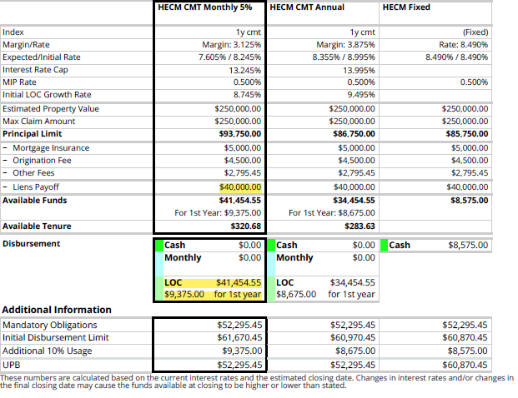
Example
Borrower Age: 75

Slide 71
Notes:
Individual requested a line of credit. RM agent estimated her house was worth $250,000. First column is Monthly Adjustable Interest Rate HECM tied to the average weekly yield of a US Treasury Security adjusted to the constant maturity rate of a year. The proposed margin is 3.125% which means that the interest rate is that much larger that the index that interest is tied to. The higher the margin, the more the insurance company makes over the life of the mortgage. They proposed an initial rate of 8.245%, but expected that the rate would decrease because interest rates were high. The cap for this would be a 10% increase, but this proposal capped the increased at 5%. Individual would also pay .5% for MIP (the mortgage insurance premium paid to HUD. The principal limit grows monthly pursuant to a HUD formula rate and with an Adjustable interest HECM for a line of credit, the line of credit will growth monthly with the principal limit.
Individual could have opted instead for a Annual Adjustable interest rate – where the interest rate only adjusts annually. Higher Margin. Higher initial interest rate. Growth in interest rate or decrease in interest rate is capped at 5%. Notice that the line of credit will have a higher growth rate.
Changes in principal limit are tied to expected interest rate. Generally, the higher the interest rate, the lower the principal limit.
Fixed Interest Rates for Single Disbursement HECMS – interest rate is agreed to between the lender and borrower
Adjustable Interest Rates for All Other Types of HECMs – the initial rate is agreed to by the lender and borrower:
Annual Adjustable Interest Rate HECMS –annual changes of no more than 2 percentage points per year or 5 percentage points in either direction from initial rate over the life of the loan. Adjustments tied to:
Average weekly yield on US Treasury Securities adjusted to constant maturity of a year,
30-day average Secured Overnight Financing Rate (SOFR), or
Alternative SOFR approved by HUD
Monthly Adjustable Interest Rate HECMS – monthly changes tied to same 3 indexes, cap of no more than a 10 percentage point change from initial rate in either direction for life of loan.

Slide 72
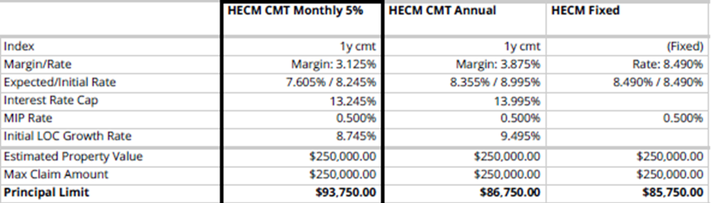
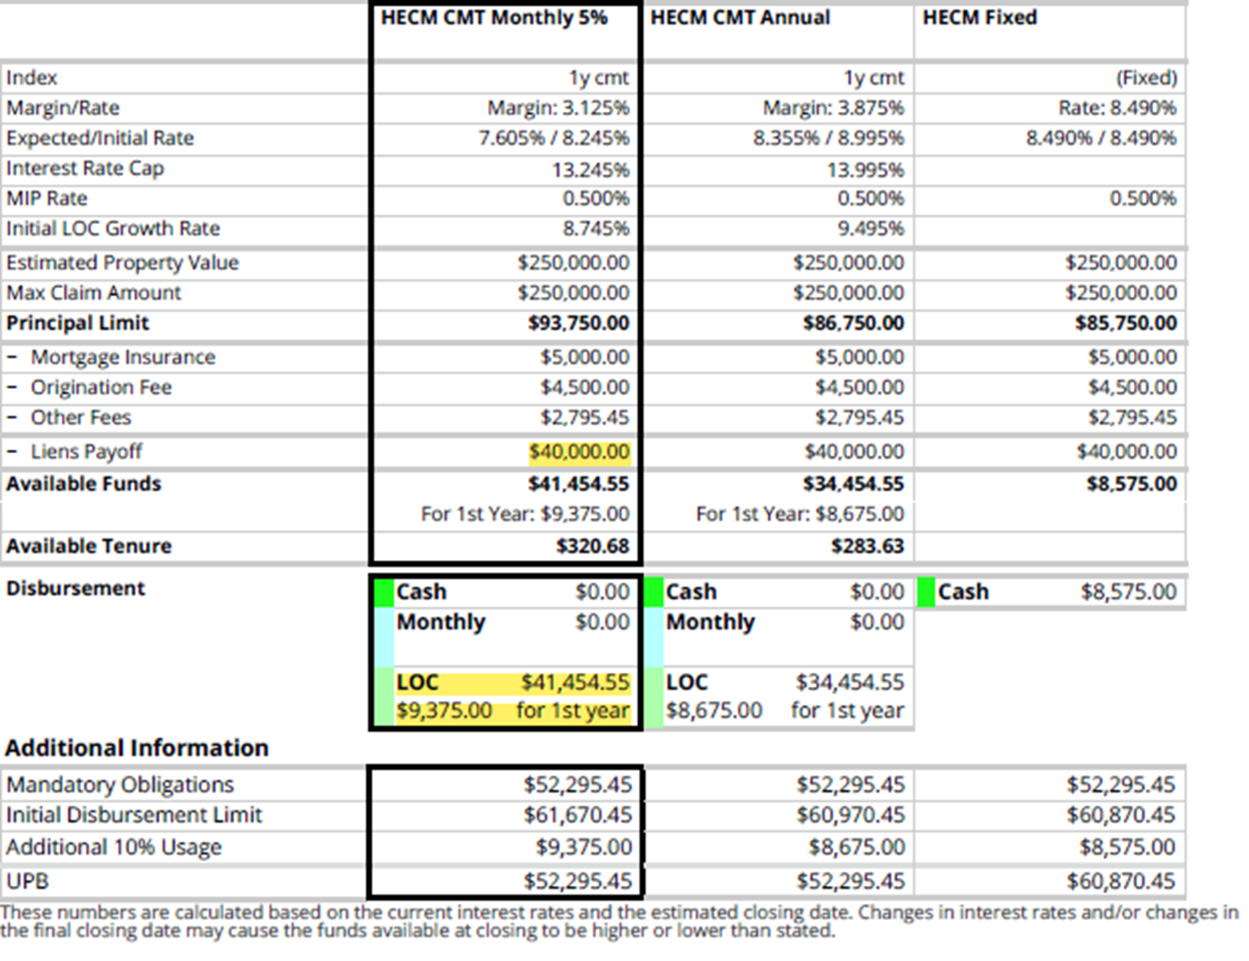
Notes:
Same initial mortgage payment to HUD.
Origination fee to the lender is the same.
Other fees are going to be those mandatory obligations.
Lien payoff is the estimated existing amount of the current mortgage on individual’s house.
Available funds is the amount of the LOC, she can draw. After paying the set asides, she can draw $9.4k for the monthly Adjustable rate HECMS or $8.6k for the annual adjustable HECM
For the fixed rate HECM, individual would get their mortgage paid off and an extra $8.5 and that is it.
Or she could select a monthly payment on a tenure basis and receive $320.68 or $283.63 for life.
Fees (mortgage insurance, original fee other fees) plus lien payoff plus available funds = principal limit

Slide 73
Notes:
Assuming no LESA, Homeowners get the greater of
60% of the principal limit or
the sum of the mandatory obligations plus 10%
Here the initial principal limit was $93,750. 60% of that is $56,250 So the mandatory obligations ($52,295.45) plus 10% ($9,375) are greater at $61,670.45
So $61,670.45 is the initial disbursal limit
UPB= initial loan balance – mandatory obligations plus cash at closing
Mandatory obligations – mortgage payoff, mortgage insurance, origination fees, other fees

Slide 74
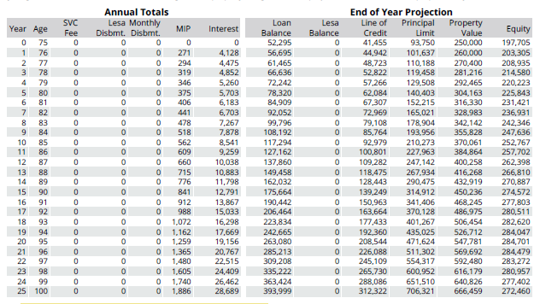









Notes:
Line of credit will continue to grow past what house is conceivably worth in the future. Individual can continue to draw down the credit.
Starting loan balance is $52,295, this is the mandatory obligations – mortgage payoff, the mortgage insurance, the original fee, and the set asides. That plus the line of credit equals the principal limit.
The principal limit grows monthly, allows for more interest, mortgage insurance payments, and interest.
Around year 12, the principal limit will be close to the appraised amount of the house. At that point, due to interest and insurance, loan balance has increased to $137,860. But notice that her yearly line of credit increase is increasing.
The actual value of her house does not matter.

Slide 75
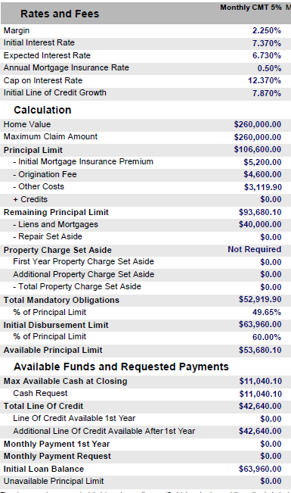
Notes:
Individual did get a second quote. Lower margin and lower interest. Individual would pay less over the life of the loan.
Decided not to proceed when both companies were going to require a LESA.

Slide 76
Medicaid Considerations
To qualify for Medicaid coverage of Long-Term Care, including in home PASSPORT waiver services, an applicant must meet:
The countable resource limit of $2,000 for an individual or $3,000 for a married couple
The home lived in, owned by , and considered the principal place of residence by the individual applying for Medicaid is an excluded resource, regardless of value. OAC 5160:1-3-05.13(C)
The special income limit of $2,829 (2024), or fund and properly manage a Qualified Income Trust.

Slide 77

Medicaid Considerations
Are the proceeds of a Reverse Mortgage countable income or a resource?
Money an individual borrows is not considered income.
However, retained proceeds of a loan in the month following the month of receipt are counted as a resource.
OAC 5160:1-3-05.5(D) & 5160:1-3-03.1(E)(3)

Slide 78
Medicaid Considerations
Medicaid Best Practices:
Those applying for Medicaid should consider a line of credit style reverse mortgage
Those with monthly payments under a term or tenure RM should consider whether they should and can reduce or stop monthly payouts
An unspent fixed payout amount likely counts as a resource after the month of receipt unless another exception applies. Wait to apply for Medicaid long term care until after it is spent down

Slide 79
Medicaid Considerations
Does imposition of a LESA affect Medicaid eligibility?
There is no Medicaid regulation on point, but we believe the answer is no.
A LESA is a set aside of the principal limit. The principal limit is the amount of money the borrower can borrow on a reverse mortgage. 24 C.F.R. § 206.3.
The LESA is a potential loan but with more requirements.
Escrow accounts can be considered trusts, which are often countable resources. See OAC 5160:1-3-05.2(B)(4). LESA funds cannot be held in escrow accounts.
24 C.F.R. § 206.205(c)(1)(i)(D), (c)(1)(ii)(C), (d)(2)(i)
.

Slide 80
Poll Question # 3

Slide 81
Consumer cautions regarding reverse mortgages
1. A reverse mortgage is a home loan, not a government benefit.
Reverse mortgages have fees and compounding interest that must be repaid, just like other home loans. With most reverse mortgages, federal insurance guarantees that borrowers will receive their loan funds if their lender has financial difficulty or if their loan balance exceeds the value of their home. However, borrowers pay for this insurance and it’s not a government benefit.

Slide 82
2. You can lose your home with a reverse mortgage.
When a reverse mortgage ad says you’ll retain ownership of your home, or that you can live there as long as you want to, don’t take these messages at face value. If you fall behind on your property taxes or homeowners insurance, are absent from your home for longer than 12 months, or fail to satisfy other requirements, you can trigger a loan default.

Slide 83
3. Without a good plan, you could outlive your loan money.
After seeing a reverse mortgage ad, you might think that a reverse mortgage guarantees your financial security no matter how long you live. Americans are living longer today than they were just a generation ago. Make sure you have a financial plan in place that accounts for a long life. That way if you need to tap your home equity, you won’t do it too early and risk running out of retirement resources later in life.

Slide 84
Alternatives to HECM
Taking out a reverse mortgage at a young age may mean the borrower runs out of money. The borrower may be unable to afford to pay increasing real estate taxes and insurance which can lead to foreclosure.

Slide 85
Traditional Options
A home equity line of credit may have fewer costs both up front and ongoing as there is no monthly servicing fee. However, there may be monthly payments which are not affordable.
Refinancing your current mortgage could lower your payments. However, there will be closing costs, could be higher interest, and will extend the length of time payments will have to be made before the home is fully paid.

Slide 86
Traditional Options
Lower your monthly expenses: Check for state and local programs that provide assistance with taxes, utilities, and home repairs.
Increase your income: Take in a tenant. Perhaps a trusted friend or relative can move in and contribute to household expenses. Is it feasible to get a job?
Consider selling and moving to a more affordable home

Slide 87
CFPB assistance
If you’re having a problem with your reverse mortgage or having problems getting through to your mortgage servicer, you can submit a complaint to us online or by calling (855) 411-2372 or TTY/TDD (855) 729- 2372. We’ll forward your complaint to the company and work to get you a response within 15 days.
https://www.consumerfinance.gov/about-us/newsroom/consumer-advisory-dont-be-misled-by-reverse-mortgage-advertising/

Slide 88
Additional Sources Referenced
https://www.consumerfinance.gov/consumer-tools/reverse-mortgages/
https://dcoa.dc.gov/sites/default/files/dc/sites/dcoa/page_content/attachments/Reverse%20Mortgage%20Presentation-Idriys%20Abdullah.pdf
https://pueblo.gpo.gov/CFPBPubs/pdfs/CFPB003.pdf

Slide 89

Pro Seniors’ Services
Ohio’s Senior Legal Helpline:
Staffed by experienced attorneys
Pre-set 30-minute appointments
By telephone
Free legal advice and counsel
Call 1-800-488-6070 or 513-345-4160
Mid America Pension Project:
Pension attorneys to help with pension issues.
Pension Intake: 1-866-783-5021
89

Slide 90

Pro Seniors’ Services
Ohio Senior Medicare Patrol (SMP)
Our volunteers stop Medicare fraud & scams by educating others to recognize the tell-tale signs. If the borrower's Medicare number has been compromised, or the borrower suspect the borrower have been scammed, we may be able to help!
Give us a call at 1-800-293-4767.
www.proseniors.org/Ohio-SMP/

Slide 91
Pro Seniors Referral Service
Statewide
Pre-screened clients (referral made only after helpline attorney has done the initial consultation)
Opportunities for attorneys to help Seniors.
www.proseniors.org/legal-services/hrap/

Slide 92
Thank You!
This webinar series is presented by
Pro Seniors & the Ohio Department of Aging in collaboration with the
Ohio Training Advisory Committee of the Alliance of Ohio Legal Aids.

